Slide 1
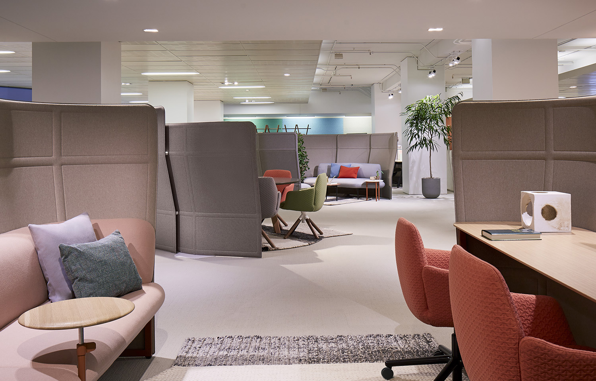
OPENEST™ COLLECTION

Slide 2
DRAW PEOPLE IN
Openest collection is an adaptable solution that responds to the ever-evolving nature of work, enticing people to come into the office while making the most of your floorplate.
Notes:
Openest collection is an adaptable solution that responds to the ever-evolving nature of work, enticing people to come into the office while making the most of your floorplate.

Slide 3
OVERVIEW
VARIETY AND CHOICE
People can work anywhere, anytime. Providing a variety of enticing, comfortable, and
relaxing spaces encourages workers to come in and engage with coworkers.
Notes:
In recent years there has been a steady shift away from independent, heads-down work toward more collaborative, team-based activities.
But people still need spaces where they can to focus.
They can work anywhere, anytime, so providing a variety of spaces that are enticing, comfortable, and relaxing encourage workers to spend time in the office where they can engage with coworkers.

Slide 4
OVERVIEW
STATEMENT OF LINE
Openest offers a variety of elements that work together or alone to create a variety of spaces and give people choice in where they work.
Notes:
Openest offers a variety of elements that work together or alone to create a variety of spaces and give people choice in where they work.
Poufs
Tables
Sofas
Screens
Accessories
Retreats: Booths and Desks
Openest is known for its characteristics that draw people in:
Visible or open but not distracting
Appropriate workspace for multiple workstyles
Flexible furniture to move as needed
Comfortable
Collaborative and focus spaces in one area
Legible spaces that people can easily understand and navigate
Technology and power available
Tactical trends:
Cozy
Relaxed
Warm
Residential feel

Slide 5
OVERVIEW
SEATING
Feather sofas and Chick poufs offer approachable comfort that adapts to people’s needs.
Notes:
Feather sofas and Chick poufs offer approachable comfort that adapts to people’s needs.

Slide 6
OVERVIEW
SPACE DIVISION
Plume screens made from familiar textiles provide soft elements for dividing space.
Notes:
Plume screens made from familiar textiles provide soft elements for dividing space.

Slide 7
OVERVIEW
RETREATS
Booths and desks provide private spaces for thinking, research, focused work, and strategic conversations.
Notes:
Retreats—either booths or desks—provide private spaces for thinking, research, focused work, and strategic conversations.
Clear of personal items – ready for next occupant
Designed for self-regulating
Communicate intended uses
Semi-private
Short-term occupancy – 30 minutes to 2 hours
Limited technology – power and data

Slide 8
OVERVIEW
TABLES AND ACCESSORIES
Sprig tables accompany seating elements where surfaces are needed. Accessories support a variety of workstyles.
Notes:
Sprig tables accompany seating elements where surfaces are needed.
Accessories include:
Soft storage
Coat hook
Square or rectangle pillow
Hideaway power
Bezel Power Module
Bezel USB Module
Height-adjustable table

Slide 9
APPROACHABLE AND COMFORTABLE
Openest gives people variety and choice in collaborative settings or quiet spaces to work alone.
Notes:
Always approachable and inherently comfortable, Openest provides a welcome change of scenery—perfect for creative collaboration or a quiet moment alone.

Slide 10
VARIETY AND CHOICE
COLLABORATIVE SPACES
Lounge elements, desking, mobile or wireless technology, and accessories enable a variety of collaborative activities.
Notes:
Openest offers the variety and choice people need to collaborate within a workspace.
Lounge elements, desking, mobile or wireless technology, and accessories enable a variety of collaborative activities:
Socializing and interacting informally, such as a reception or team-building event.
Tactical execution of work tasks with clearly defined objectives.
Strategic thinking and problem solving through brainstorming or negotiation – while the project may not be clearly defined.
Presentations, including public speeches, staff meetings, or other events in which one person imparts info to others.
[For more about collaborative activities, see “Collaborative Spaces,” Haworth white paper]

Slide 11
VARIETY AND CHOICE
COLLABORATIVE SPACES
Notes:
This is an example of a collaborative space where people could gather for a variety of activities—socializing, strategic thinking, brainstorming, etc.

Slide 12
VARIETY AND CHOICE
TOUCHDOWN SPACES
These same elements support quiet activities and private interactions in touchdown spaces.
Notes:
Openest offers the variety and choice people need in touchdown spaces within a workspace.
These same elements support quiet activities and private interactions in touchdown spaces.
A place to focus by moving away from open spaces to seek a more private, quiet area.
Private conversations are sometimes necessary during the work day.
Work related job activities may require time for concentration and space to spread out.

Slide 13
VARIETY AND CHOICE
TOUCHDOWN SPACES
Notes:
This is an example of a touchdown space where Openest supports people’s needs for focused work, private conversations, and spaces to spread out.

Slide 14
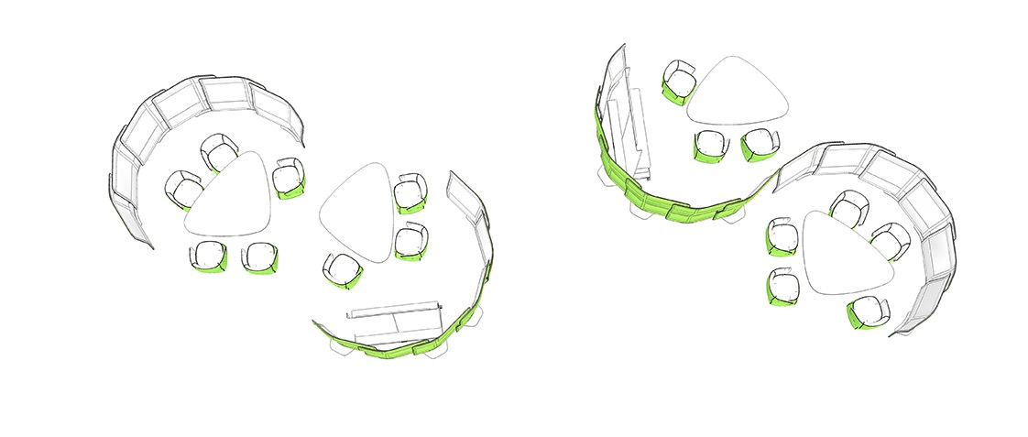
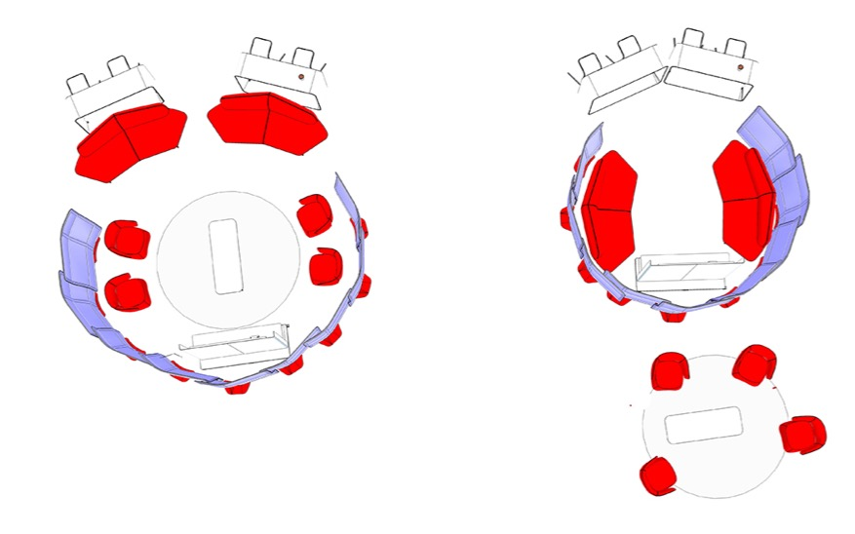
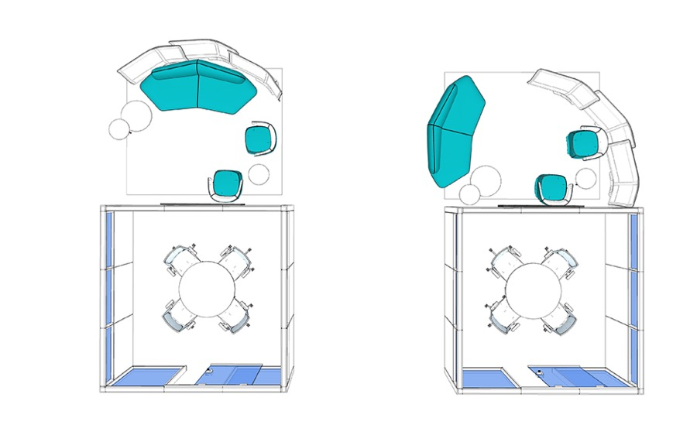
VARIETY AND CHOICE
EASY RECONFIGURATION
Openest offers the flexibility organizations require to adapt to changing needs so you can future proof your facility.
Notes:
[Facility Manager audience]
Openest offers the flexibility organizations require to adapt to changing needs so you can future proof your facility.
With its variety of components that work together or alone, Openest can be moved and adapted by a facilities team as workspace needs evolve.

Slide 15
MIX AND MATCH
Each Openest piece can stand beautifully on its own or integrate with other pieces in the collection to support today’s changing business needs.
Notes:
Each Openest piece can stand beautifully on its own or integrate with other pieces in the collection to support today’s changing business needs.
Mix and match to create collaborative spaces, strategic zones, touchdown spaces for mobile workers, as well as casual settings for social time.

Slide 16
APPLICATIONS
PRESENTATION SPACES
Notes:
Presentations include public speeches, staff meetings, or other events in which one person imparts information to others.
Openest screens divide space to set apart an area where people can gather in comfort on Feather sofas.
Workware technology offers digital display for presenting information.

Slide 17
APPLICATIONS
TACTICAL PERFORMANCE SPACES
Notes:
Tactical performance spaces enable execution of work tasks with clearly defined objectives.
Retreats offer a level of visual and acoustical privacy to help people focus on their work.

Slide 18
APPLICATIONS
STRATEGIC THINKING SPACES
Notes:
Strategic thinking spaces enable problem solving through brainstorming or negotiation.
Booths support face-to-face interaction and Workware technology provides opportunities for displaying information.

Slide 19
APPLICATIONS
SOCIAL SPACES
Notes:
Social spaces are designed for interacting informally and support anything from small group conversations to receptions and team-building events.
Openest elements such as Chick poufs, Feather sofas, and Sprig tables can be easily configured to accommodate social settings.

Slide 20
APPLICATIONS
UNASSIGNED SPACES
Notes:
Unassigned spaces are ideal for mobile workers, consultants, and other guests who need a place to work temporarily.
Openest desks with Plume screens give them a semi-private worksurface and the accessibility they need to collaborate with business partners.

Slide 21
APPLICATIONS
SEMI-PRIVATE CONFERENCE SPACES
Notes:
Plume screens and a Workware easel create space division for groups who need a space for meetings and collaboration.

Slide 22
DESIGNER
PATRICIA URQUIOLA
Inspired by Patricia Urquiola’s passion to create new experiences for people, Openest elements present visual and tactile softness through its simple, graceful pieces.
Notes:
[Designer audience]
Inspired by Patricia Urquiola’s passion to create new experiences for people, Openest elements present visual and tactile softness through its simple, graceful pieces.
Patricia Urquiola, designer and architect, was born in Oviedo, Spain.
She now lives and works in Milan where she runs Studio Urquiola.
Her work is widely known to be playful and poetic, yet pragmatic and functional, a creative combination that is the magic behind her designs.

Slide 23
SUPPORT PEOPLE AT WORK
With Openest you can give people variety and choice in where to work, and demonstrate you care about their needs at work.
Notes:
With Openest you can give people variety and choice in where they work while demonstrating you care about their workplace needs.
Utilize space to accommodate a variety of workstyles
Enable collaboration -> leads to innovation
Improve employee engagement
Attract/retain talent
Reinforce your organizational culture and brand

