Slide 1

Compose Connections and Planes Height-Adjustable Bench
Haworth Wellness Seminar

Slide 2
Compose Connections
Haworth Wellness Seminar

Slide 3
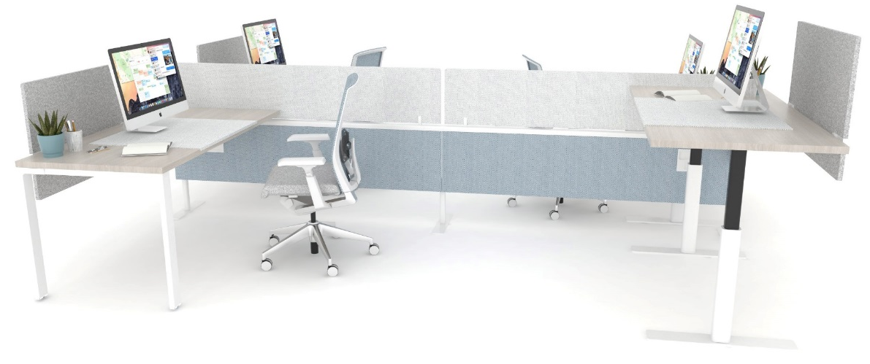
Global Innovation
PLM
WHAT IS COMPOSE CONNECTIONS?
Compose Connections is a lite-scale spine based system designed for the open-plan office environment to delineate space and provide flexible access to power and data.
  Supports project teams or flexible working environments
  Broadens the application range of the Compose product line
    Capable of freestanding applications
    Capable of applications that support other fixed elements (work surfaces, screens, storage, etc.)
  Simple kit of parts

Slide 4
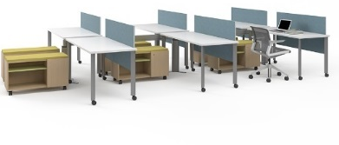
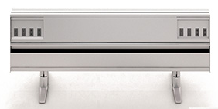
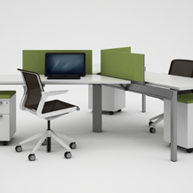
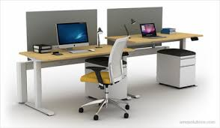
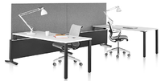
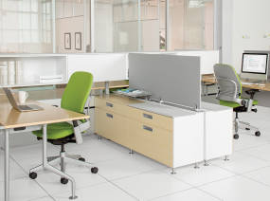
PERFORMANCE CRITERIA
Flexibility | Decouple utility infrastructure from the furniture application via functionally independent elements
Easy utility access | Worksurface height access to power and data on both sides
“Non-cube” aesthetic | Lite scale/simple form language via integrated leg and/or foot options
Application versatility | Accessory screens and worktools integration with off modular attachment
 | Worksurface and storage component integration with off modular attachment
 | System integration with off modular attachment
1
2
3
4
5
6

Slide 5
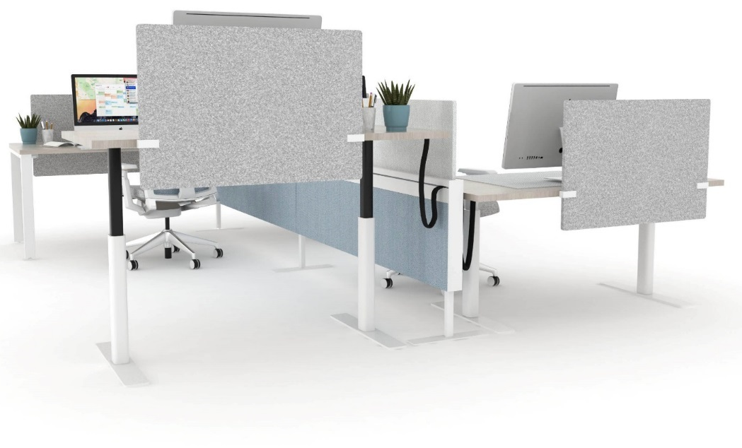
CONNECTIONS COMPONENTS
Functional Top Cap
Off-modular Component Mounting
Standard Top Cap
On-module Component Mounting
Worksurface tethering
Screen mounting
Accessory mounting
Storage mounting
Systems Integration (26”/Stack)
Freestanding Structure
Elevated Aesthetic Detail
Utility Access

Slide 6
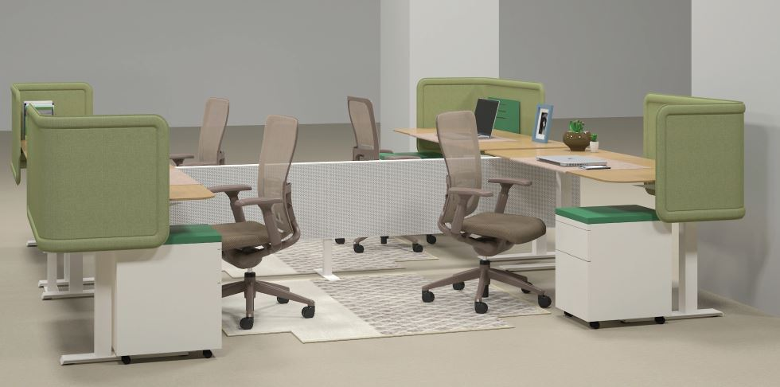
FREESTANDING SPINE
Approx. 80% of the volume (application)

Slide 7
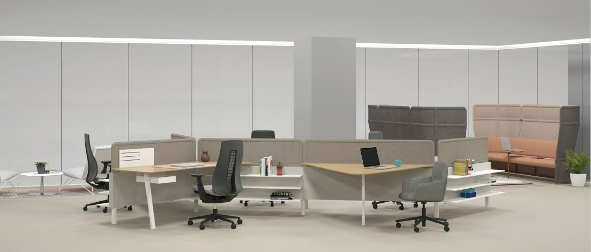
FIXED BASE APPLICATIONS
Approx. 20% of the volume (application)

Slide 8
COMPOSE CONNECTIONS POSITIONING
Minor details make the difference
  Minimal number of feet
  Flat feet
  Price scalability in the top trim
  72” wide option
Vast Application Breadth
  Freestanding or Fixed applications
  Straight spine or Configurable
  Open or Tile to floor options
  On-modular or Off-modular planning
The next evolution of the Integrated Palette
  Made to work with standard Compose
  Leverages Intuity rail profile and screens
  Works with many products from the Active Components line
  Familiar components for specification and installation

Slide 9
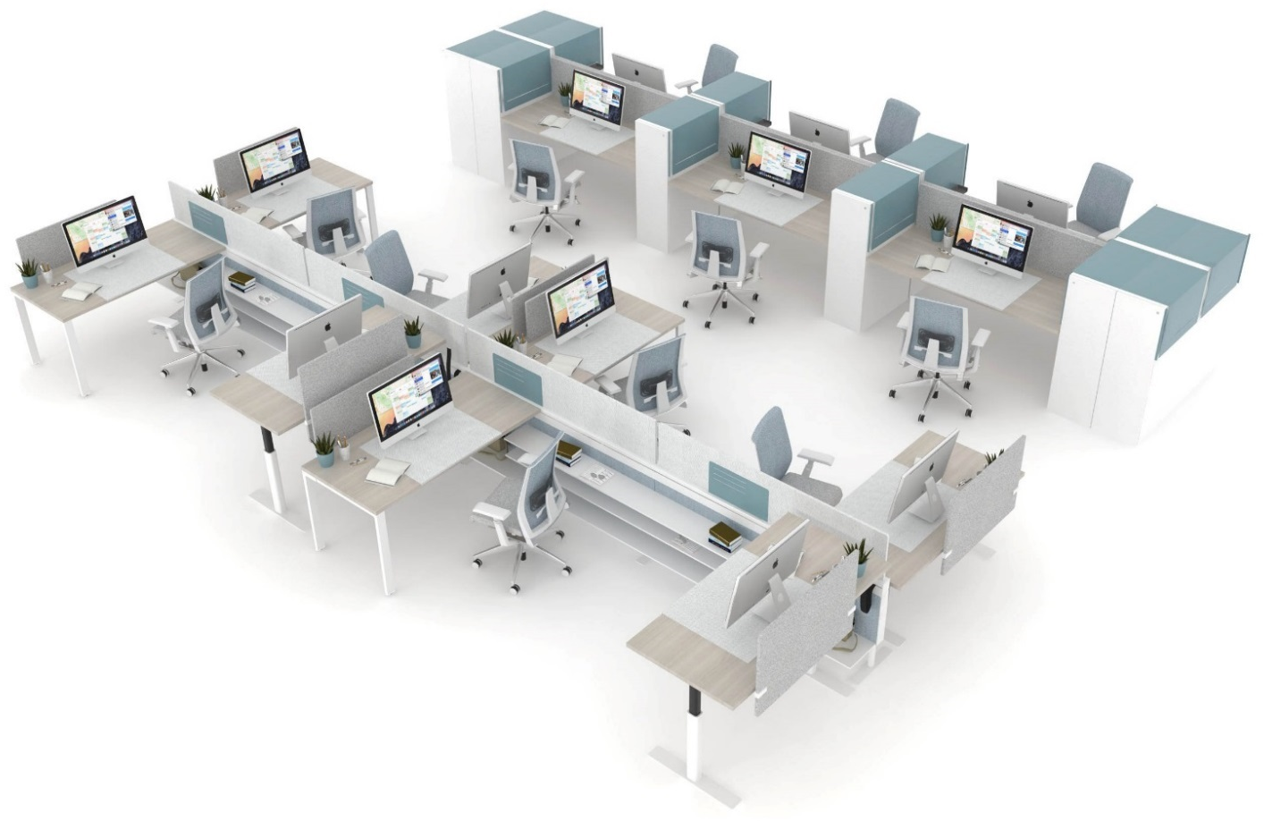

Slide 10
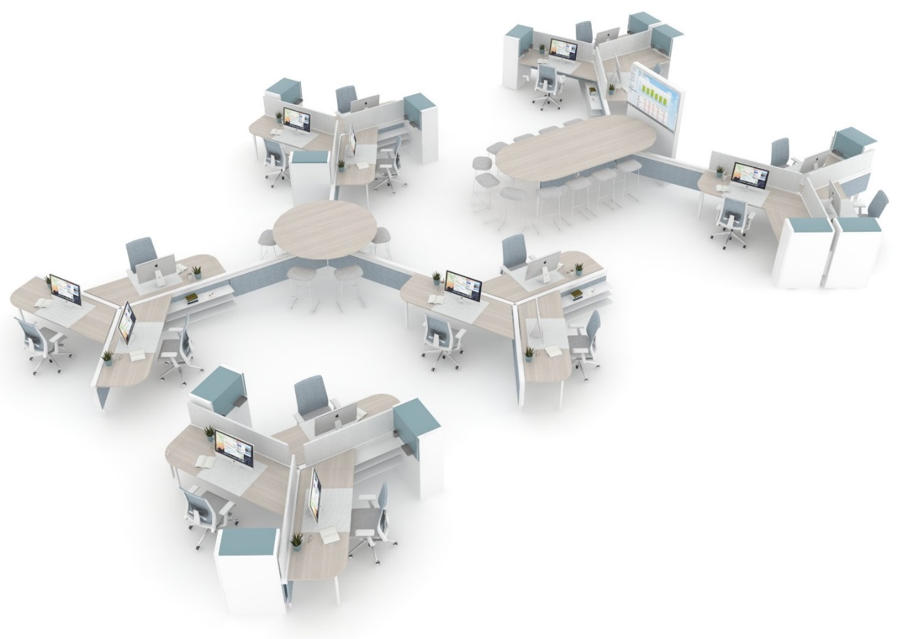

Slide 11
TIMELINE & TOOLS
OOA date of November 1st, 2016
Pre-Sale activity prior to OOA date
CONNECTIONS SPARK TEAM
Currently being assembled and trained
Contact: Kimberly.Lake@Haworth.com

Slide 12
Planes Height-Adjustable Bench
Haworth Wellness Seminar

Slide 13
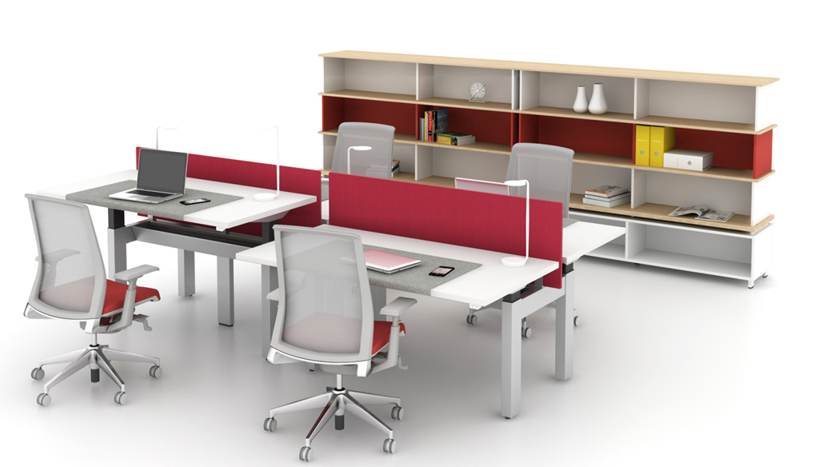
WHAT IS PLANES HEIGHT-ADJUSTABLE BENCH?
Leveraging the award-winning Planes Height-Adjustable Table platform is the latest solution for user-adjustment needs in today’s workplace. Here are some of the features:
Base supports two independently adjustable worktops
Base provides power distribution and visual privacy support
Available in a variety of sizes and mechanism options
Clean design manages cables and provides mechanism support

Slide 14
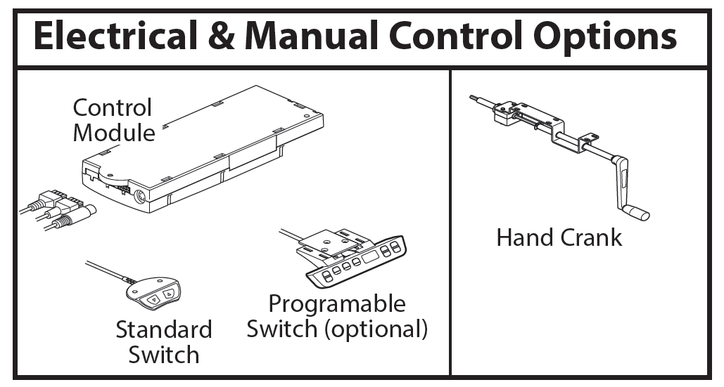
Haworth Planes Height-Adjustable Bench | Options
Mechanism Options and Height Ranges
- Crank: 27” – 45”
- Single-Stage Electric: 27” – 46”
- Dual-Stage Electric: 22” – 48” or 24” 50”
- Electric offers programmable option
Worktop Options
- Depth: 24”, 30”
- Width: 46”, 52”, 58”, 64”, 70”
- Surface: Laminate or Wood

Slide 15
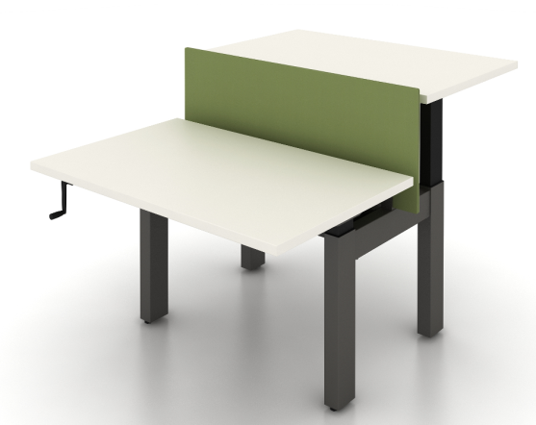
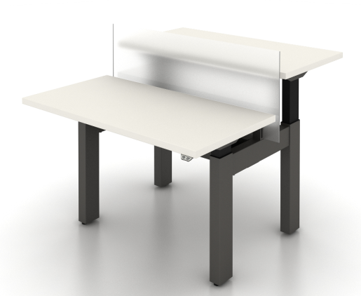
Haworth Planes Height-Adjustable Bench | Options
Power Applications
Located in stretcher:
- 3-Circuit
- 4-Circuit
Building Power Access Options
Base feed
Top feed: Center-of-Run or End-of-Run
Screen Options
- Fabric
- Glass
- Laminate
- Wood
Fabric
Glass

Slide 16
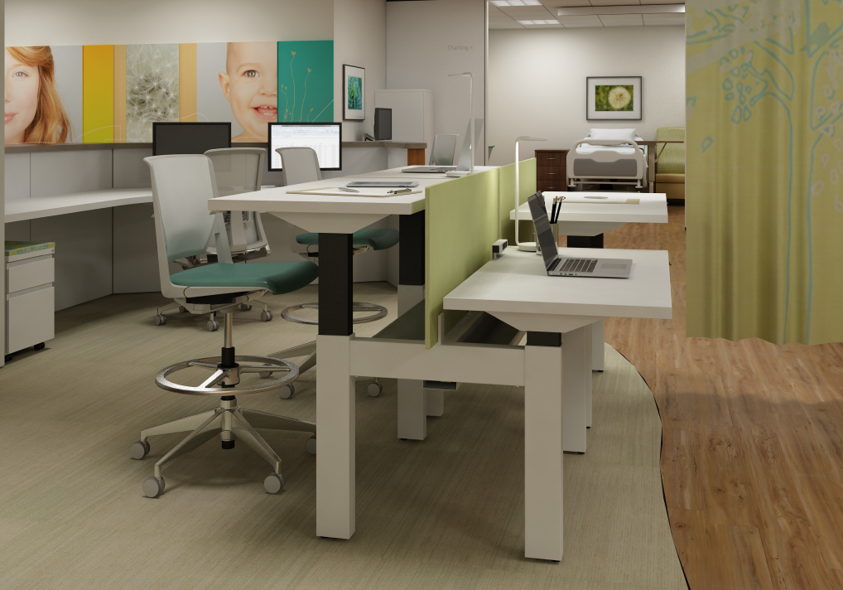
Haworth Planes Height-Adjustable Bench

Slide 17
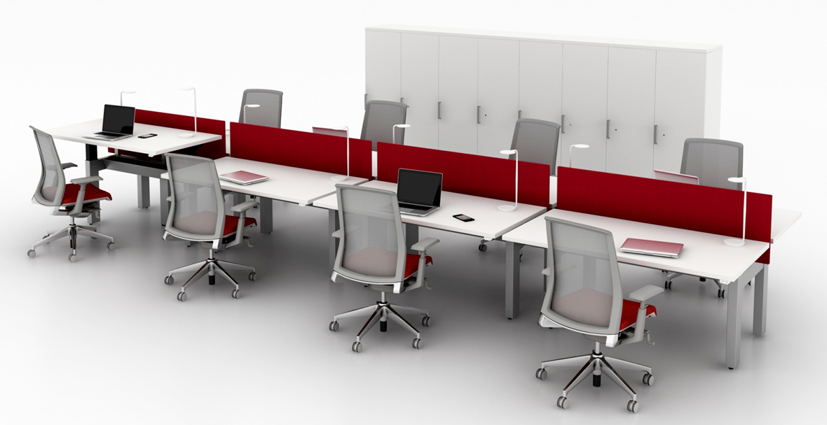
Haworth Planes Height-Adjustable Bench

Slide 18
MARKET POSITIONING (NET PRICE/WORKSTATION)
Priced for 30”d x 72”w 4-pack with 3-circ power
Product Attributes |  |  |  |  |  |  | Accessory Integration | Component Integration | System Integration | Accessory Integration | Component Integration | System Integration
Configurability | Non-Configurable |  |  | Configurable |  |  | Non-Configurable |  |  | Configurable
Structure | Beam Based |  |  |  |  |  | Partition Based
Premium
Off Modular Attachment
$1,500
Mainstream
Planes Height-Adjustable Bench
Compose Connections
$1,000
Economical
Connections with Planes HAT’s
Connections with Hop table
Connections with Swivel table
Basic
Attachment
$500

Slide 19
COMPOSE CONNECTIONS
PLANES HEIGHT-ADJUSTABLE BENCH
Use when:
All surfaces will be height adjustable OR all surfaces are fixed OR there is a mixture of the two
Flexibility in workstation orientation is desired adjacent to the Connections spine
The ability to reconfigure is important
The client has Compose panels (Able to physically integrate with Standard Compose panels)
Desired aesthetic more similar to a panel system
Use when:
All surfaces will be height adjustable
All surfaces will be oriented like a bench
Many things will be attached to the HAT’s OR significant weight will be loaded on the HAT’s
Clean wire management from HAT through structure is crucial to client
Desired aesthetic more similar to a bench

