Slide 1
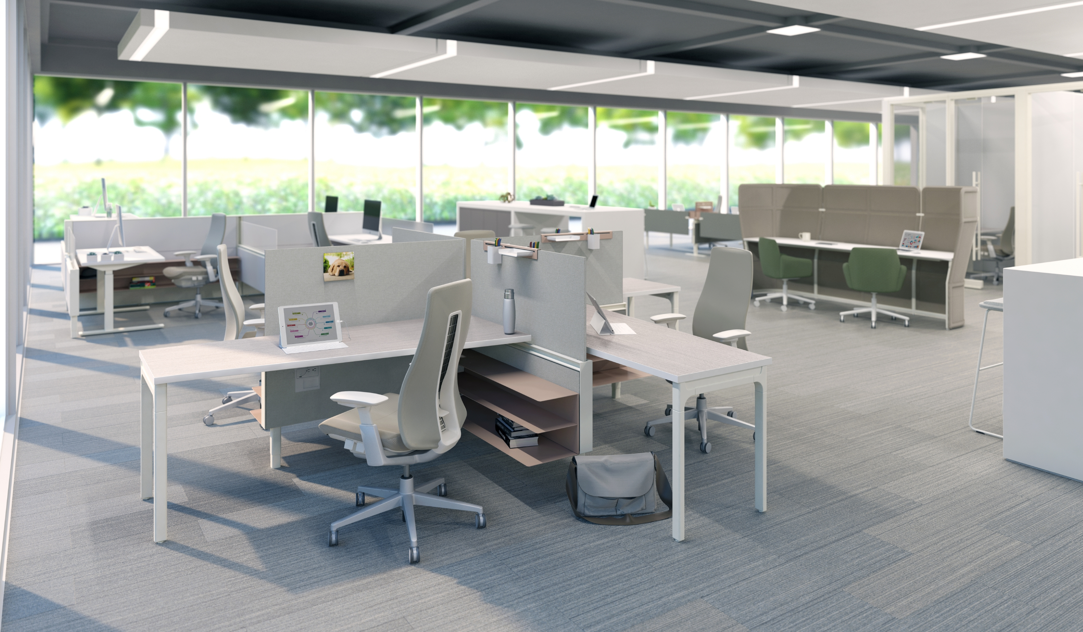
COMPOSE® CONNECTIONS™

Slide 2
For Flexible Workspaces
Designed to add flexibility, spontaneity, and lightness to the open plan, Compose Connections brings an all-new dimension to Compose® panel-based systems.
Notes:
What is Compose Connections?
Designed to add flexibility, spontaneity, and lightness to the open plan, Compose Connections brings an all-new dimension to Compose panel-based systems.
It’s a spine-based system independent of surrounding infrastructure, putting power and data within easy reach, no matter how people prefer to work.

Slide 3
OVERVIEW
Because an organization's culture―and org chart―are not etched in stone, a smart environment should be able to adapt from day to day and as an organization’s needs evolve.
GROWING & CHANGING
Notes:
Marketplace Overview
Businesses require flexible spaces as they grow and change:
Because an organization's culture―and org chart―are not etched in stone, a smart environment should be able to adapt from day to day and as an organization’s needs evolve.
Variety and choice for a range of workstyles:
For many of us, work varies day by day―sometimes hour by hour.
Accommodating distinct workstyles is fundamental to creating spaces that perform.
Dynamic workforces thrive when desks and devices are untethered, allowing them to work, meet, think, and move in the ways they like best.
Spaces need to be able to shift to accommodate individual and collaborative work:
Collaboration yields the potential for innovation, made possible by colleagues interacting spontaneously throughout the day.
Balancing this need with spaces designed for focus offers opportunities for people to perform at their best.

Slide 4
OVERVIEW
ROBUST INFRASTRUCTURE
A spine-based system independent of surrounding infrastructure.
Notes:
Robust Infrastructure
Supports both individual or collaborative surfaces if desired.
Capable of freestanding or configured in 90 or 120 degree applications.
Pair Connections with fixed, mobile, or height-adjustable worksurfaces.
Power- and Data-infused Freestanding Spine, enabling:
Increased utility access
Elevated aesthetic
Statement of Line
Standard Aluminum Top Trim for modular component capability
Work Rail Top Trim for off-modular capability, enabling:
Worksurface tethering
Screen mounting
Storage mounting

Slide 5
Empower People to Perform
Compose Connections supports a range of workstyles, accommodating the shifts between individual and collaborative work with flexible configurations that adapt quickly.
Notes:
Compose Connections supports a range of workstyles, accommodating the shifts between individual and collaborative work with flexible configurations that adapt quickly.

Slide 6
SUIT PEOPLE’S NEEDS
a Range of Workstyles
Create spaces for the various ways people need to work—from individual, focused tasks to collaborative activities.
Notes:
Benefits – Accommodate a Range of Workstyles
Organizations can more cost-effectively have a variety of workstations on their floorplate.
Create a cohesive aesthetic while meeting the needs of different types of workers through diverse applications.
Add spaces for various ways people need to work: focus areas, touchdowns, and also collaborative spaces.
With freestanding, height-adjustable tables, people can sit or stand to enhance wellness—while staying connected to power and data through the spine.
A comprehensive and well-planned toolkit creates multiple configurations to suit a full spectrum of workstyles and preferences:
Straight
90-degree
120-degree
Freestanding with height-adjustable tables
Supporting fixed surfaces
Modular
Off-modular

Slide 7
SUIT PEOPLE’S NEEDS
Encourage spur-of-the-moment ideation and sharing with open applications where everyone has connection to power and data.
SUPPORT COLLABORATION
Notes:
Benefits – Support Collaboration
Especially in an open plan, it’s important for people on teams to collaborate.
Compose Connections lets you Intermingle larger group worksurfaces for unplanned ideation and sharing.
Power and data are minimally intrusive, yet always within easy reach.
Planning capabilities allow you to use negative space more effectively for collaboration.

Slide 8
Freedom to Move
Enables change, choice, and respond to user preferences in dynamic, open-plan environments.
Notes:
Compose Connections enables change and choice, responding to user preferences in dynamic, open-plan environments.

Slide 9
CHANGE YOUR SPACE
UTILIZE SPACE EFFICIENTLY
Create a flexible floorplate that makes the most of your real estate footprint.
Notes:
Benefits – Utilize Space Efficiently
Freed of infrastructure constraints, Compose Connections provides unmatched flexibility and space utilization.
Its slim profile and flexibility let you adjust a floorplate quickly and easily.
Compose Connections makes it more achievable and cost effective to have multiple applications on the same floorplate.

Slide 10
CHANGE YOUR SPACE
RECONFIGURE WITH EASE
The minimalist infrastructure allows organizations to quickly adapt or re-orient workstation configurations when work and teams change.
Notes:
Benefits – Reconfigure with Ease
Delineate space with an airy, off-the-floor look that opens the whole environment.
Quickly add, remove, and re-orient workstations or create different configurations when work and teams change.
When it's time, you can completely reconfigure without waste.
For example, as shown on this slide, you can switch out the collaboration area with two workstations with no structural changes to the Connections spine.

Slide 11
CHANGE YOUR SPACE
CONNECTS WITH COMPOSE SYSTEMS
Transition your existing Compose system to an open-plan environment without starting over.
Notes:
Compose Connections’ design aligns perfectly with existing Compose systems, making it easy for organizations with installed Compose product to transition to an open plan without starting from scratch.
Over time, supplement existing furniture to transition into the environment that suits your organization’s needs, while retaining a cohesive look and feel.

Slide 12
CHANGE YOUR SPACE
Compose Connections is fully integrated with other Haworth product platforms to ensure your entire workspace evolves with future needs.
FUTURE ASSURANCE
Notes:
Benefits – Future Assurance with Integrated Palette
Compose Connections expands Haworth’s Integrated Palette to ensure your workspace evolves with future needs.
It integrates visually and dimensionally with many other Haworth products, and Compose Connections integrates especially well, functionally, with:
Compose panels
Planes, Hop and Jump height-adjustable tables
Active Components
A robust Functional Work Rail supports worksurfaces, as well as Intuity screens and Active Components elements.

Slide 13
Designed for Change
Compose Connections delineates space in a light-scale solution that provides flexibility for today’s ever-changing work environment.
Notes:
Compose Connections delineates space in a light-scale solution that provides flexibility for today’s ever-changing work environment.

