Slide 2
Notes:
What is Immerse?
Designed in partnership with Patricia Urquiola, Immerse is a collection of tables in a variety of shapes, sizes, and levels that create visual comfort to make a space more inviting and support different activities.

Slide 4
Notes:
Why Immerse?
People desire variety and choice to perform their best.
As space design requires more flexibility, organizations recognize the growing need for adaptable spaces that support the diverse and dynamic ways people work.
People seek meaningful spaces that support purposeful work.
Comfortable spaces that feel like home entice people to come into the office, keeping talented workers engaged.
Work environments that holistically affect physical, cognitive, and emotional needs foster well-being in people.
Positive emotions are consistently associated with better performance. A workplace that truly supports the well-being of its occupants must go beyond protecting physical health by providing physical, cognitive, and emotional comfort.

Slide 5
Notes:
Immerse helps you furnish a variety of environments that support people’s collaborative work processes for creative performance and innovation.
As workspaces continue to change in support of collaboration, Immerse creates an adaptable area where communal instincts can spontaneously come to life.
Each Immerse worksurface creates a social hub of positive energy that invites serendipity, variety and choice in the workplace.

Slide 6
Notes:
Immerse creates meaningful, purposeful spaces that help people feel comfortable at work.
Immerse helps create a balance between functional and sensory spaces that offer a welcome sense of warmth and comfort in the workplace.
With Immerse, teams can come together, connect, and collectively engage in an intimate workplace setting.
Immerse allows interpersonal interactions to organically change by the moment, adding a unique personality to conference rooms, project spaces, studios, and dining areas.

Slide 7
Notes:
The people-centric designs of Immerse tables contribute to an enduring state of well-being, keeping everyone inspired and engaged.
Immerse tables help create destinations that foster well-being through physical, cognitive, and emotional ergonomics.
Immerse provides physical support for changing postures at varying fixed height worksurfaces, from standing height collaboration to perching or sitting.
Immerse offers a micro atmosphere of options in one space, creating a sense of cognitive separation.
The user control and choice Immerse offers helps decrease emotional stress levels to support emotional well-being.

Slide 8
Notes:
Statement of Line
Immerse conference table worksurfaces are available in a variety of standard finish options, including laminate, powder-coat paint, solid surface, or veneer.
Immerse Ledge worksurfaces are offered in veneer or laminate.
Leg base options include powder-coated steel, as well as select wood finishes.

Slide 9
Notes:
Stack
Features a double-layer design with a lower sill for storage that is handy, yet out of the way.

Slide 10
Notes:
Shift
Creates two adjacent sitting and standing worksurfaces, each at varied heights, to support choice and a natural inclination to work together.

Slide 11
Notes:
Overlap
Made for movement, sitting, or standing, with a unique dual level worksurface that supports well-being and your choice to sit, stand, and work actively.

Slide 12
Notes:
Single
Single table in round, square, rectangular and racetrack shapes.

Slide 13
Notes:
Ledge
Great for impromptu conversations, or a place to buckle down and get busy.

Slide 14
Notes:
Planter
Provides central open storage and power outlets, letting teams share, store and power up for thoughtful engagement.

Slide 15
Notes:
Why Immerse?
Immerse tables create a landscape of varied surfaces, providing a hub of spaces that support collaboration and diverse workstyles.
The welcoming feel of Immerse draws people in for the spontaneous interaction, collaboration, and communication experiences they crave at work.
Immerse warms up the work environment, inspiring the engagement and creativity that leads to innovation.

Slide 17
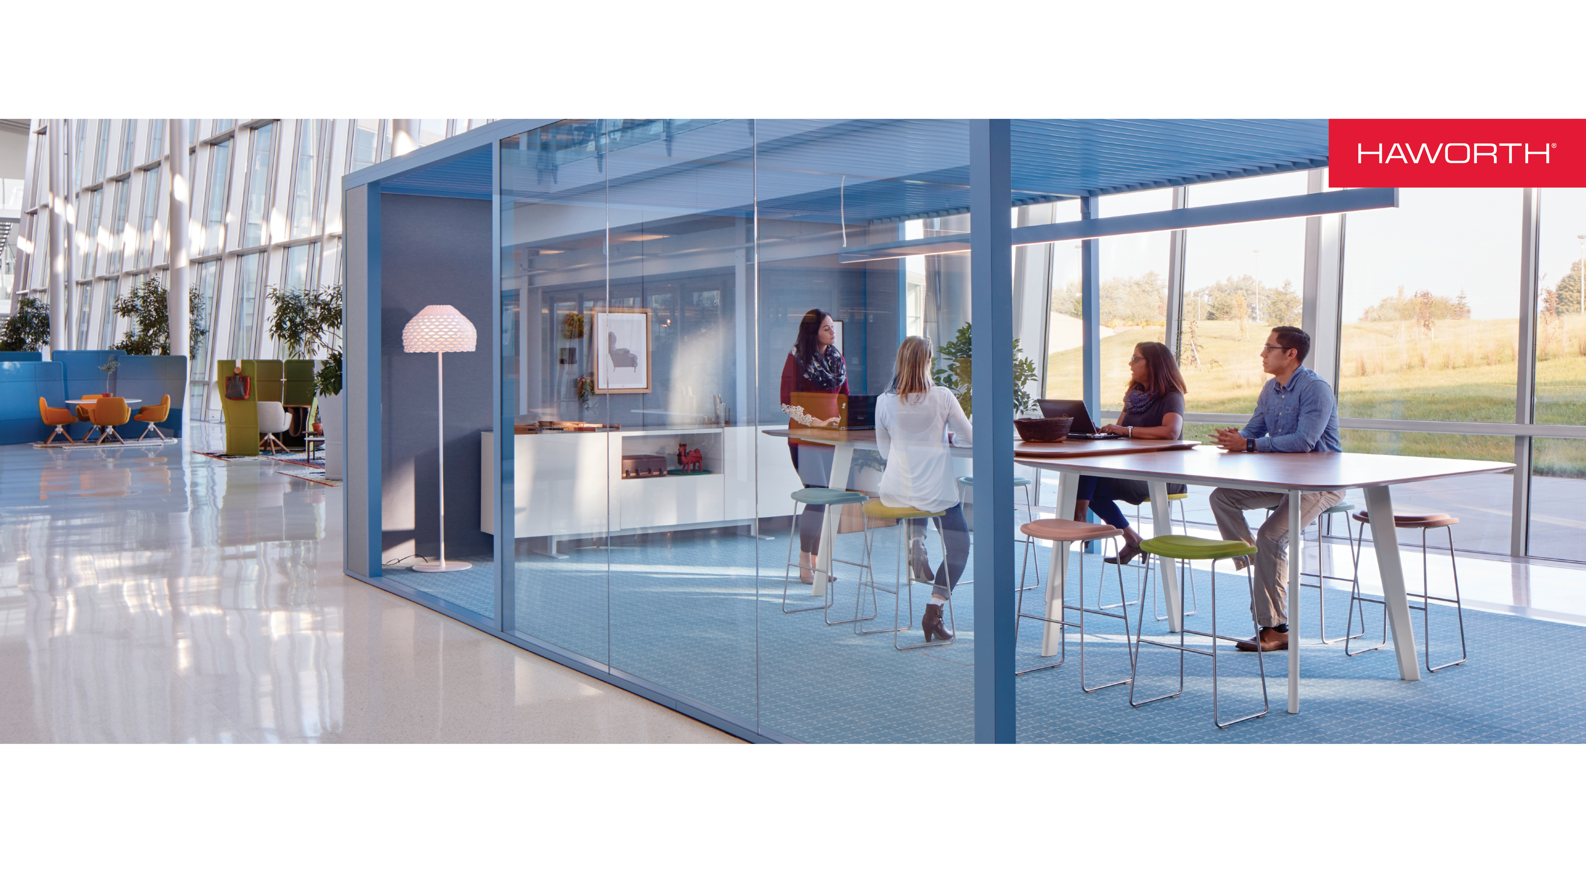
Notes:
Thank you.

