Slide 1
Notes:
Thank you for joining me today as we discuss the importance of people in the workplace and how Fern can help promote wellness, satisfaction, and productivity.

Slide 2
Notes:
Work is life and life is work. What people do at work affects their home life. What they do at home affects their work life. If both are approached mindfully, balance and centeredness can be achieved.

Slide 3
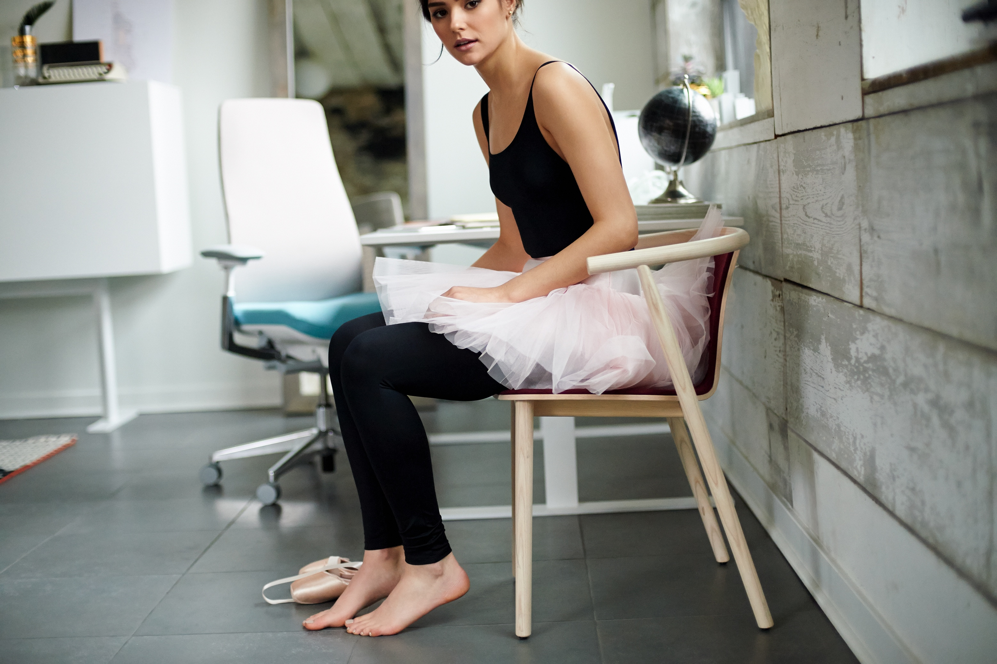
A NEW MOVEMENT
Notes:
Human capital is every organization’s greatest asset-and its greatest expense. To optimize human capital, especially knowledge workers, successful organizations build human-centered cultures that empower and inspire. Providing a productive place where people can connect, find meaning, and feel a sense of accomplishment.

Slide 4
SIT WELL
Part of a culture
of wellness.
___
Notes:
Fern plays a vital role in a healthy workplace environment. Better worker health means reduced attendance issues and improved performance. Engaged workers are more productive and help increase productivity.
Fern provides all-day comfort with total back support.

Slide 5
WORK WELL
A perfect fit.
___
Notes:
Fern enables workers to better focus. More comfort means less distraction. An edgeless design eliminates impact from a hard outer edge, which can disrupt movement and interrupt work.

Slide 6
FEEL WELL
Fosters a feeling
of engagement.
___
Notes:
Fern helps workers feel rewarded and cared for, which can have a positive impact on attraction and retention and trust, assurance of safety, and emotional comfort. Fern has an approachable design, more residential and warm (less mechanical). It also has accessible adjustments with responsive controls which are artfully integrated into the simple aesthetic.

Slide 7
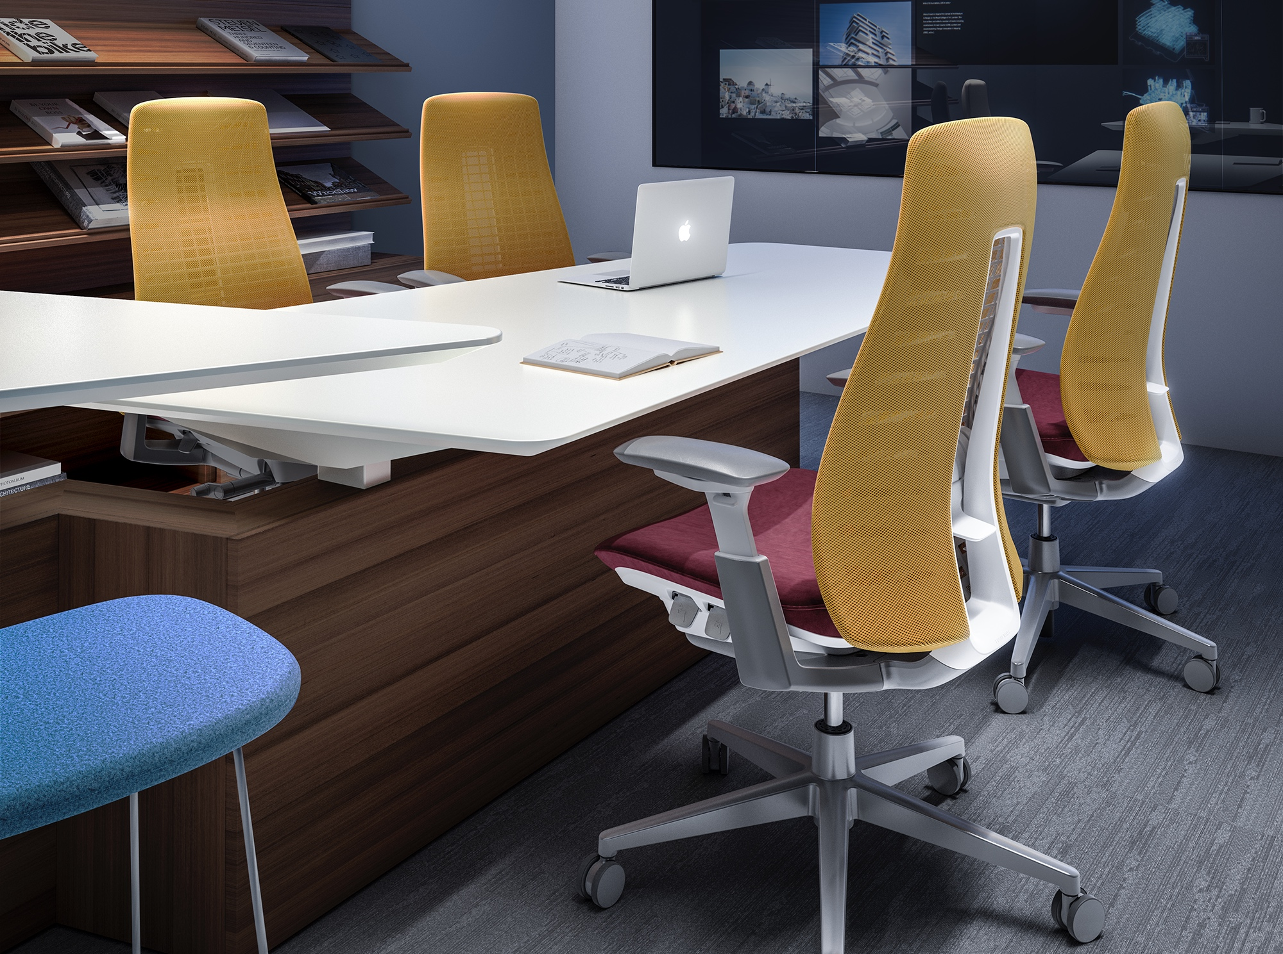
Notes:
The office is an ecosystem and ideally the workplace is built for people. Fern can be an important part of workplace design from collaborative conference applications to…

Slide 8
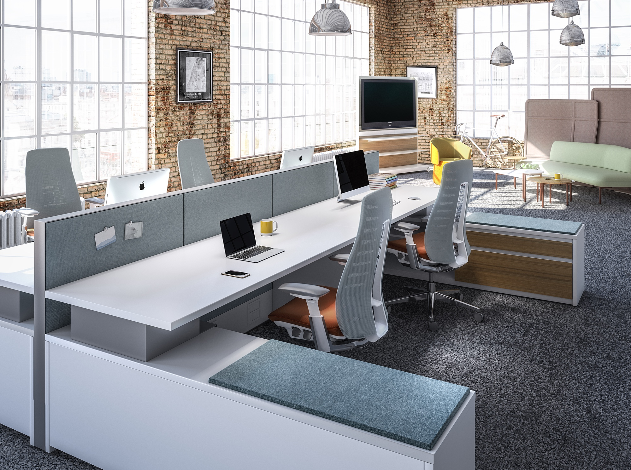
Notes:
Heavy task spaces to…

Slide 9
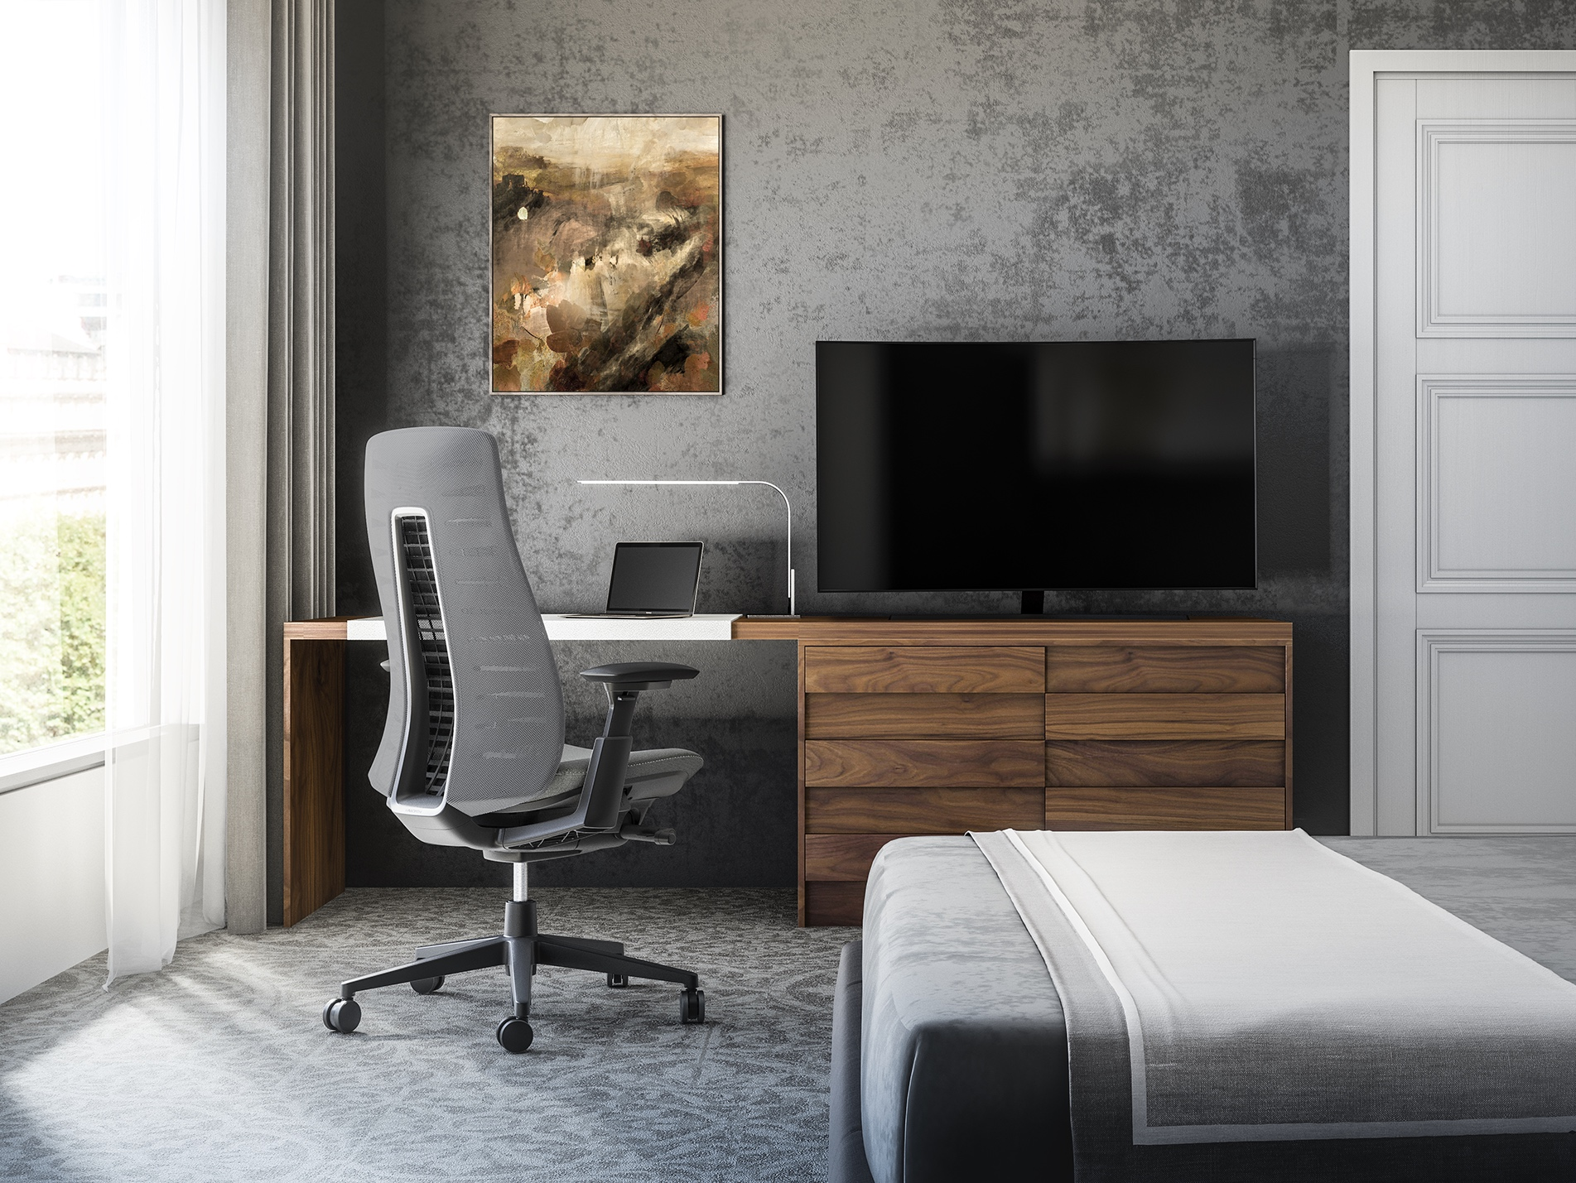
Notes:
Hotel rooms and home offices to…

Slide 10
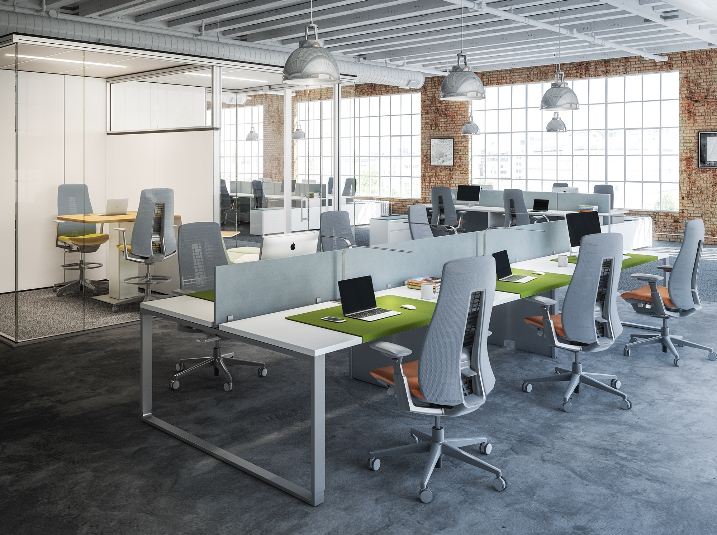
Notes:
Touchdown spaces and desking environments. Fern works in many applications from light tasking to heavy tasking.

Slide 11
UNLIKE WHAT YOU’VE SEEN.
UNLIKE WHAT YOU’VE FELT.
___
Notes:
Fern’s groundbreaking comfort and support will change how you feel about task seating. It is unlike any chair you’ve seen before, thanks to a new concept in back support.

Slide 12
WAVE SUSPENSION™
Notes:
Fern provides new levels of balance, flexibility, and performance. It’s designed to support the person. Fern’s Wave Suspension system is the heart of the chair and the key to its back comfort and flexibility. From the outside, the back looks simple. But inside is an intricate level of science, engineering, and innovation that enables Fern to work with you, not against you.

Slide 13
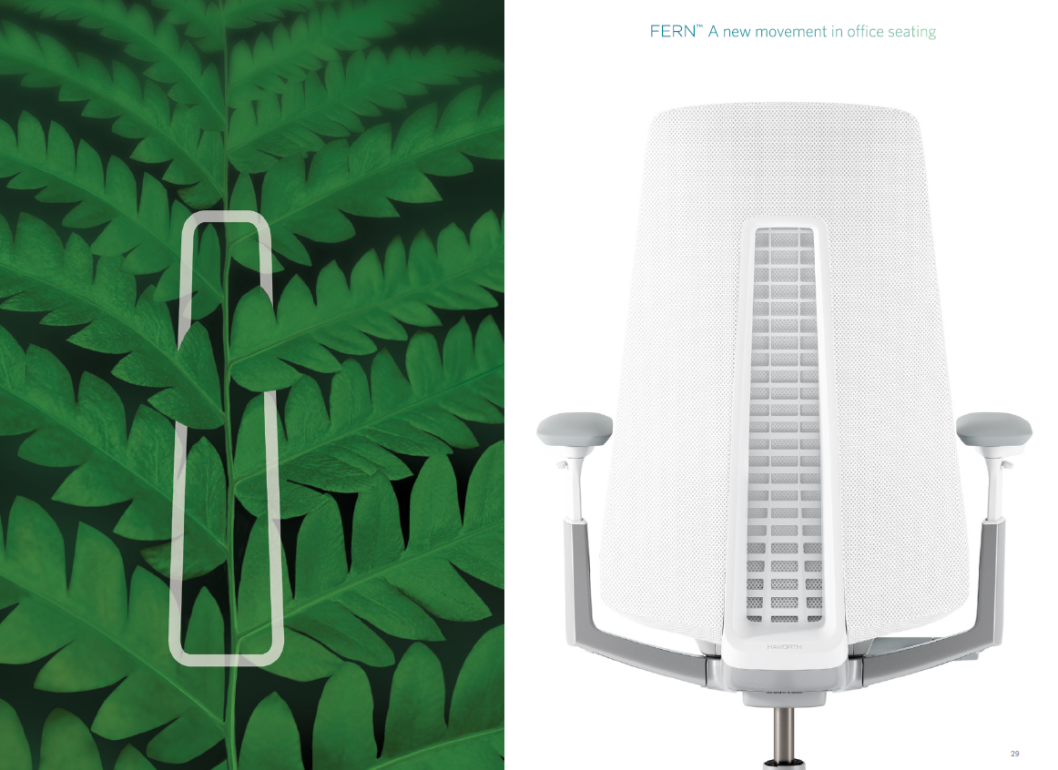
Notes:
Inspired by the structure of a fern, the Stem™ is a centered spine that supports a series of Fronds that extend like leaves. Each Frond™ is calibrated to support a different area of the back from the thoracic (upper back) to the lumbar, to the pelvic areas. The Cradle™ overlays the Fronds and Stem, working in concert with them for effortless support.

Slide 14
INFINITY EDGE ™
Notes:
The Wave Suspension system is the key to the soft Infinity Edge™. Fern’s Infinity Edge is soft and pliable for an edgeless comfort experience. Nothing interferes with movement to create discomfort and distraction.

Slide 15
TOTAL BACK SUPPORT
Notes:
Based on research with physical therapists, this chair also offers thoracic back support (upper back), which goes further than most task chairs giving the user total back support.

Slide 16
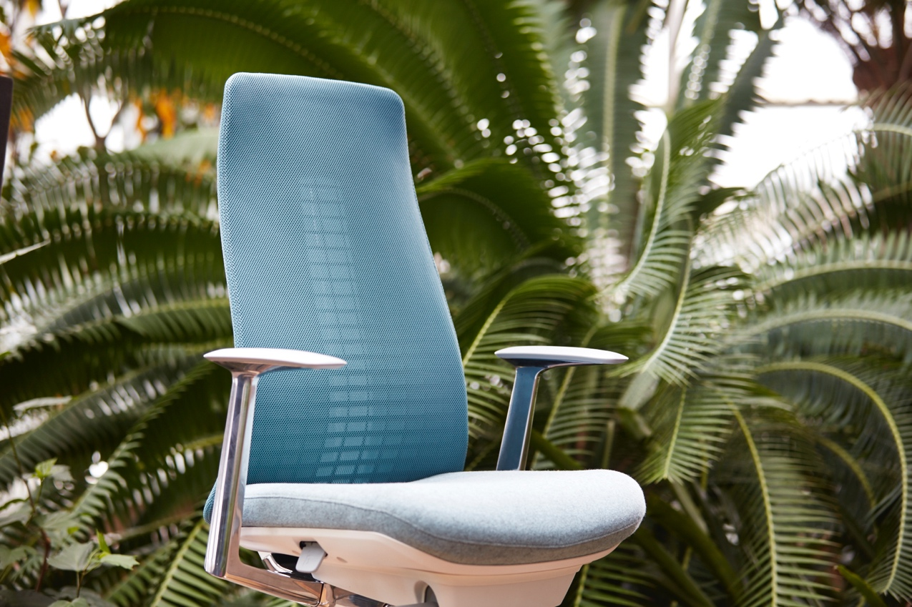
COMFORT & FIT
Notes:
Fern offers a full complement of ergonomic adjustments that are easy to find, reach, and
use. The ability to fine-tune for comfort and fit is especially important for longer-term,
focused work. Fern’s groundbreaking innovations earned 16 patents.
The front of the seat flexes for a total comfort experience. The silent, fluid movement of the arm caps encourages adjustment with less interruption and less audible controls minimize distraction. The deep recline keeps you properly centered and balanced as you lean back.
The optional simple, lumbar pillow is height adjustable to provide additional support.
The back tension control is very responsive. A couple easy handle turns achieves
proper recline resistance. Includes a clutch, to assure you don't take it too far.

Slide 17
RESEARCH BASED
Notes:
When it comes to studying human movement in the office environment, Haworth and the Human Performance Institute at Western Michigan University have partnered for 12 years with the goal of investigating the physical relationship between a person and a seating surface. This effort has resulted in over 5.5 billion high resolution pressure mapping data points used to understand seating phenomena. This means Haworth engineers bring you the very latest science through analytics in their products.
Seat-comfort research started with looking at the 5th percentile female to 95th percentile male. We knew we had to improve our base structure to allow for maximum support, flexibility, and also long-term comfort. We looked at various approaches to achieve a flexible seat pan that offered proper support, coupled with the right set of contours.

Slide 18
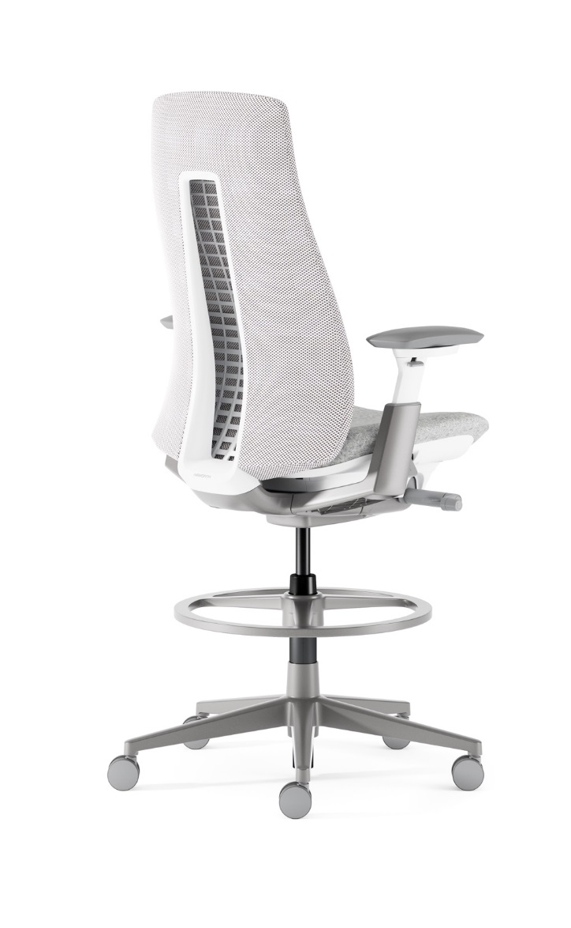
Notes:
Fern is available in a Task Chair and a Task Stool. There are a wide variety of colors and finishes offered.

Slide 19
EXPERIENCE
Notes:
Ideally, now is the time to encourage sitting in Fern and experiencing it. Make sure the chair is adjusted properly for the user. Inform that more information can be found at Haworth.com/fern. Thank you.

