Slide 1
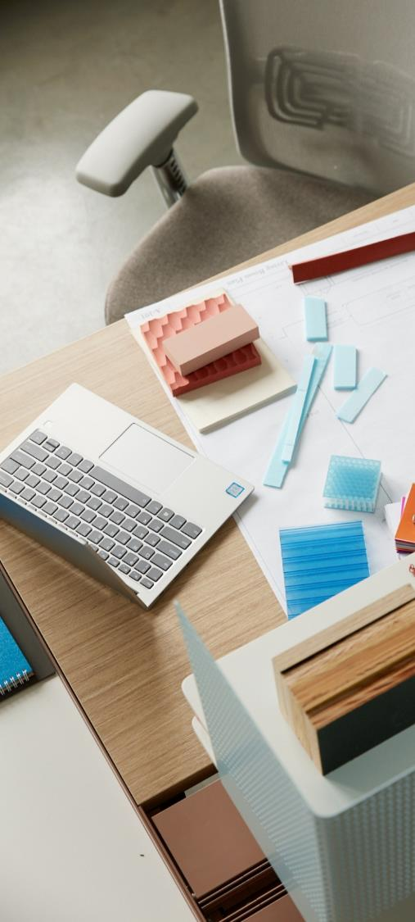
Work anywhere
Sit everywhere

Slide 2
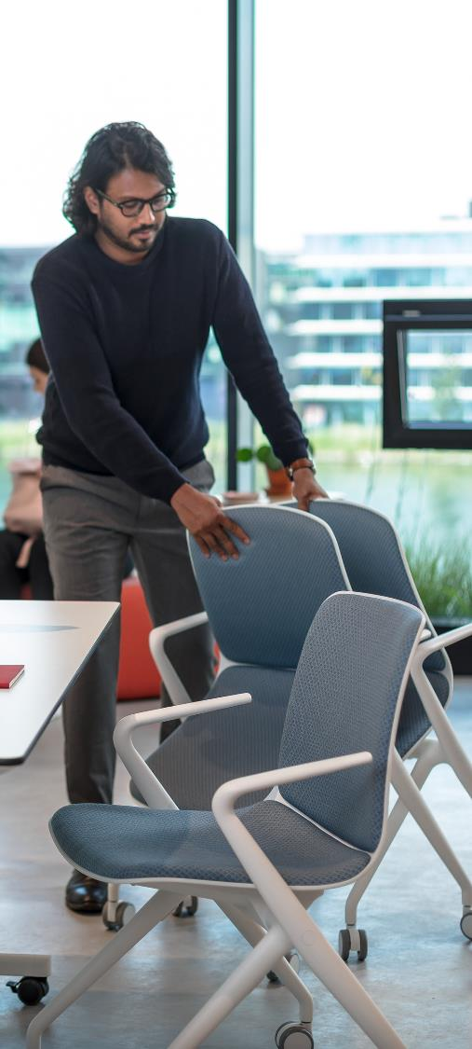
Work anywhere
Sit everywhere

Slide 3
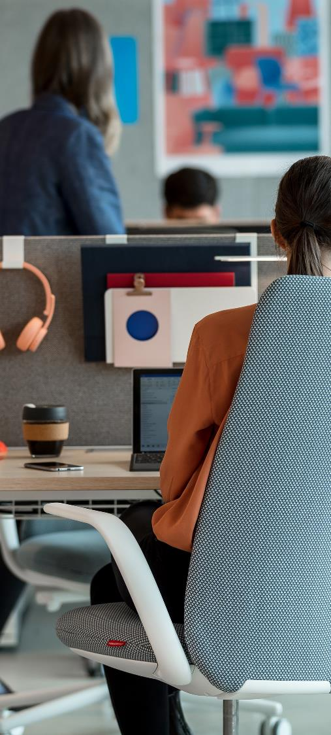
Work anywhere
Sit everywhere

Slide 4
Content
Work anywhere, Sit everywhere
What is Active Seating?
Our Active Seating Portfolio
Fabrics and Finishes
Sustainability and Seating

Slide 5
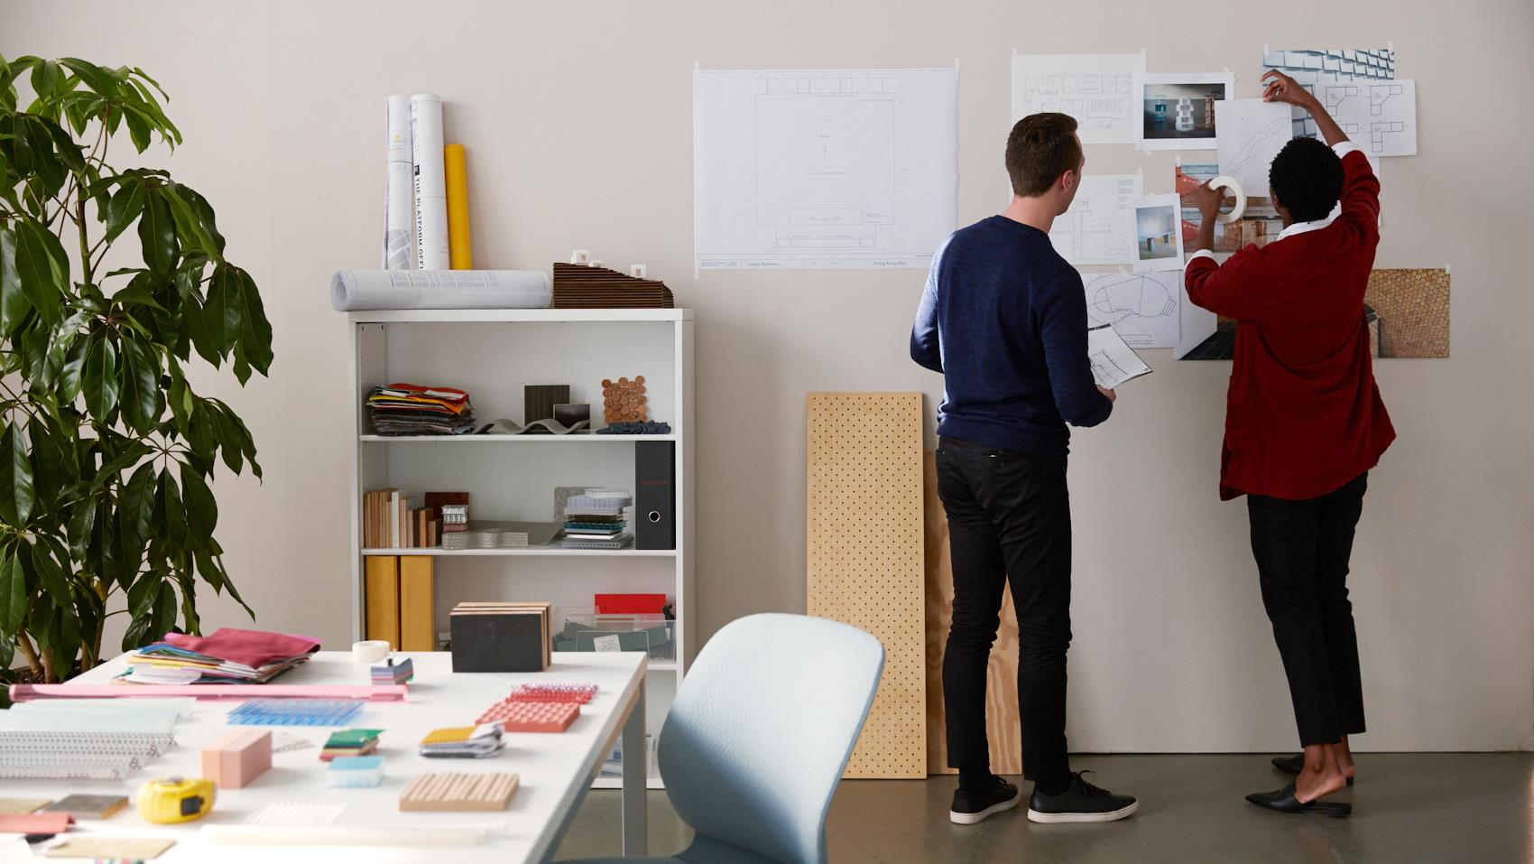
The world of work is changing and
New Work is happening now.

Slide 6
Technology has
freed people to
work anywhere.

Slide 7
Choice-based workplace experience: Variety and encouragement of in-office mobility improves effectiveness and a positive experience.
  P. 7
79%
of people in workspaces
with a variety of settings report a great experience
71%
of people with choice in where to work report a great workplace experience
Gensler Research Institute, 2019

Slide 8
New Work means new ways…
to fit the workspace and technology to the individual.

Slide 9
New Work means new ways…
to create a variety of spaces for a variety of postures that people can choose from.

Slide 10
New Work means …
to find your way of sitting.

Slide 11


Slide 12


Slide 13
With us you can choose the right task chair for your way of New Work, no matter where your focus lies.
1
Movement
2
Design
3
Ergonomics
4
Pricing
Notes:
Movement: How much does the chair need to support movement throughout the day
Design. How important is design apüproach?
Ergonomy: How much functionality is needed?
Pricing: How budgetfriendly needs the solution to be?

Slide 14
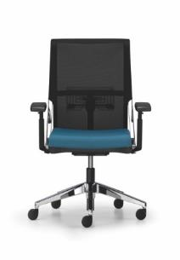
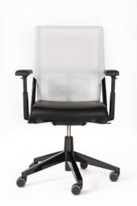
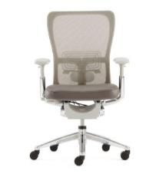
Sitting duration
0
2h
4h
6h
8h
Lounge
Visitor
Meeting/Conference
Active Seating
Task Seating
Notes:
Click on chair for detailed information. Use back-button to get back to this overview

Slide 15
Portfolio
0
2h
4h
6h
8h
Lounge
Visitor
Meeting/Conference
Active Seating
Task Seating
Notes:
Click on chair for detailed information. Use back-button to get back to this overview

Slide 16

What is Active Seating?
+
Duration
Type of Activity

Slide 17
Sitting duration
0
2h
4h
6h
8h
Lounge
Visitor
Meeting/Conference
Active Seating
Task Seating
Notes:
Click on chair for detailed information. Use back-button to get back to this overview

Slide 18
Sitting duration
0
2h
4h
6h
8h
Lounge
Visitor
Meeting & Conference
Active Seating
Task Seating
Notes:
Click on chair photo for detailed information.

Slide 19









How to use this overview
Maari
Maari
Fern
Zody
Poppy
Poppy
Intermezzo
Comforto 59
Select the application
Select a product
Click on it to get to your product.
Very
Very
Very
Chick Pouf
Soji
Nia
Bowi
Lively
Lively
0
< 2h
<4h
<6h
<8h
Lounge
Visitor
Meeting & Conference
Active Seating
Task Seating
Notes:
Click on chair photo for detailed information.

Slide 20
Lounge
P.20
Poppy
Chick Pouf
0
2h
4h
6h
8h
Lounge
Visitor
Meeting & Conference
back to overview
Active Seating
Task Seating
Notes:
Click on chair photo for detailed information.

Slide 21
Visitor
P.21
Maari
Poppy
Intermezzo
Very
Chick Pouf
Lively
0
2h
4h
6h
8h
Lounge
Visitor
Meeting & Conference
back to overview
Active Seating
Task Seating
Notes:
Click on chair photo for detailed information.

Slide 22
Meeting & Conference
Maari
Poppy
Intermezzo
Very
Nia
Bowi
Lively
0
2h
4h
6h
8h
Lounge
Visitor
Meeting & Conference
back to overview
Active Seating
Task Seating
Notes:
Click on chair photo for detailed information.

Slide 23
Active Seating
The first of many more to come
Nia
0
2h
4h
6h
8h
Lounge
Visitor
Meeting & Conference
back to overview
Active Seating
Task Seating
Notes:
Click on chair photo for detailed information.

Slide 24
Task Seating
Fern
Zody
Comforto 59
Very
Soji
Lively
0
2h
4h
6h
8h
Lounge
Visitor
Meeting & Conference
back to overview
Active Seating
Task Seating
Notes:
Click on chair photo for detailed information.

Slide 25
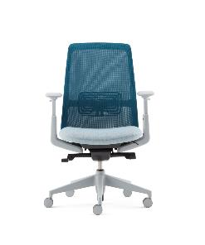
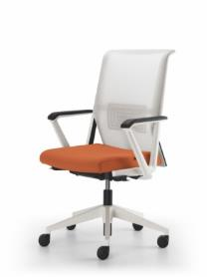
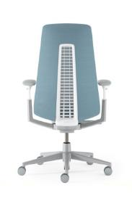
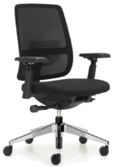
Best in class seating overview
Lively
Soji
Nia
Very
Comforto 59
Dynaflex
Zody
Fern
Movement
Design
Ergonomy
Pricing
€
€ €
€ €
€ €
€ €
€ € €
€ € €
€ € €
Notes:
Click on chair for detailed information. Use back-button to get back to this overview

Slide 26
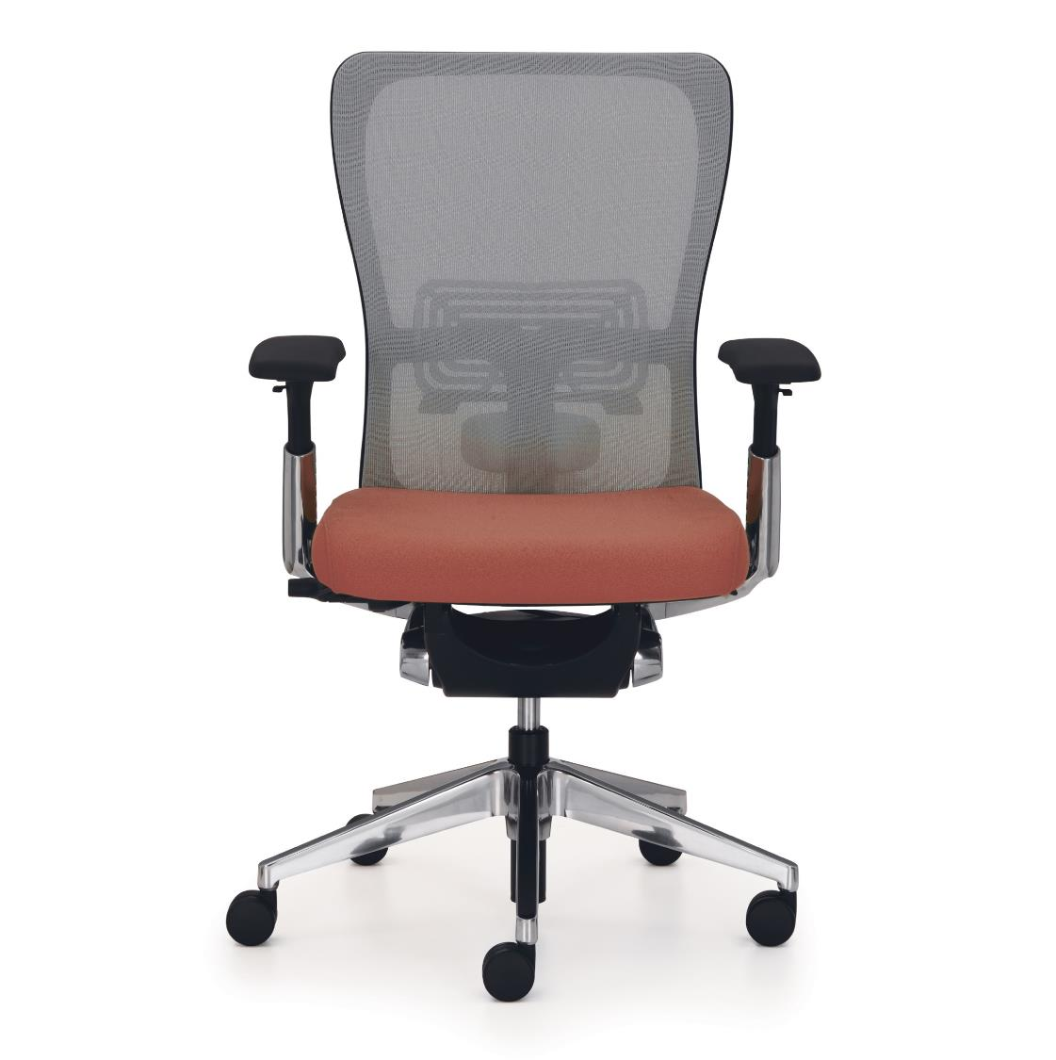
Zody
PAL™ Back System for lumbar and pelvic support that maintains the spine’s natural shape
Asymmetric lumbar support
Adjustable 4D armrests
Ergonomic seat pan
3-point synchronised adjustment
back to overview
Notes:
Add Key Selling Points (from DLP Sheets) here instead of technical Details

Slide 27
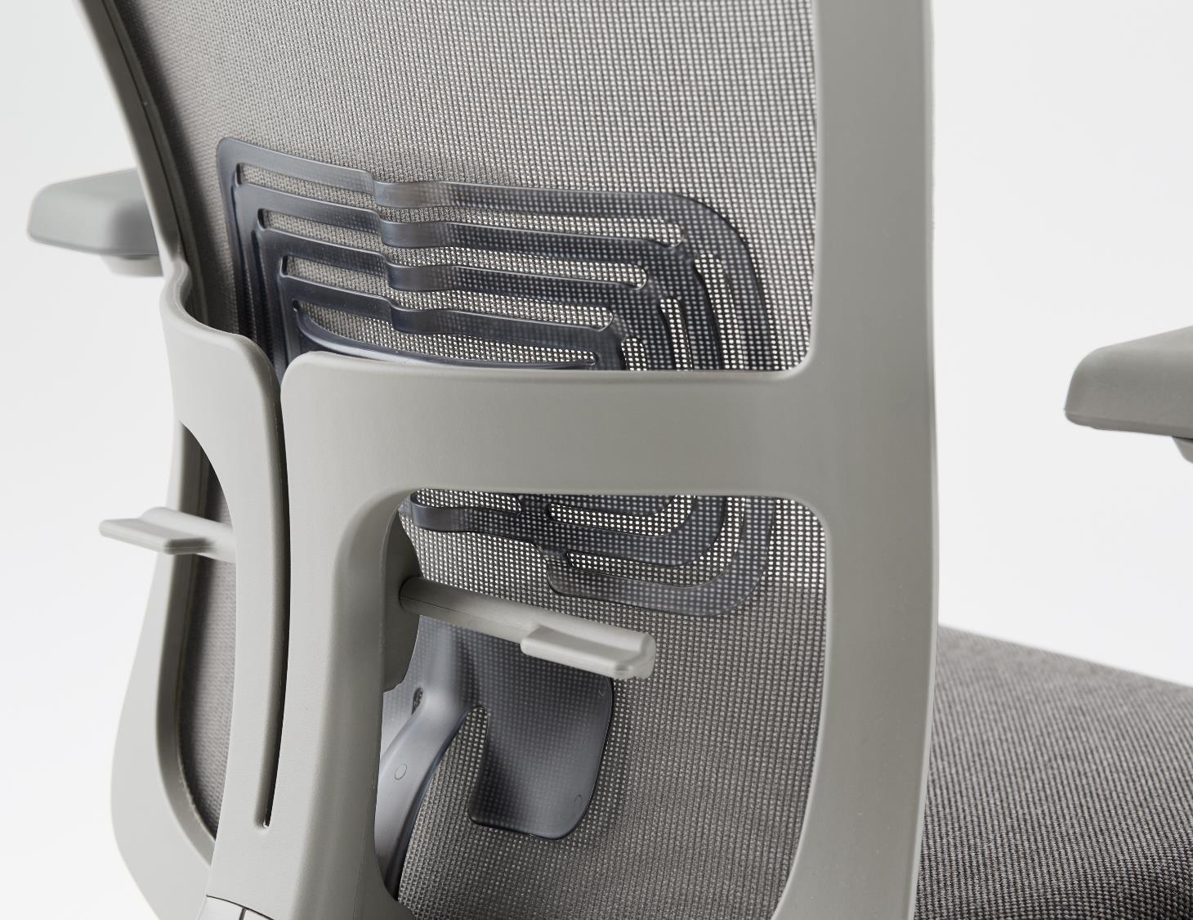
Zody
PAL™ Back System for lumbar and pelvic support that maintains the spine’s natural shape
Asymmetric lumbar support
Adjustable 4D armrests
Ergonomic seat pan
3-point synchronised adjustment
back to overview
Notes:
Add Key Selling Points (from DLP Sheets) here instead of technical Details

Slide 28
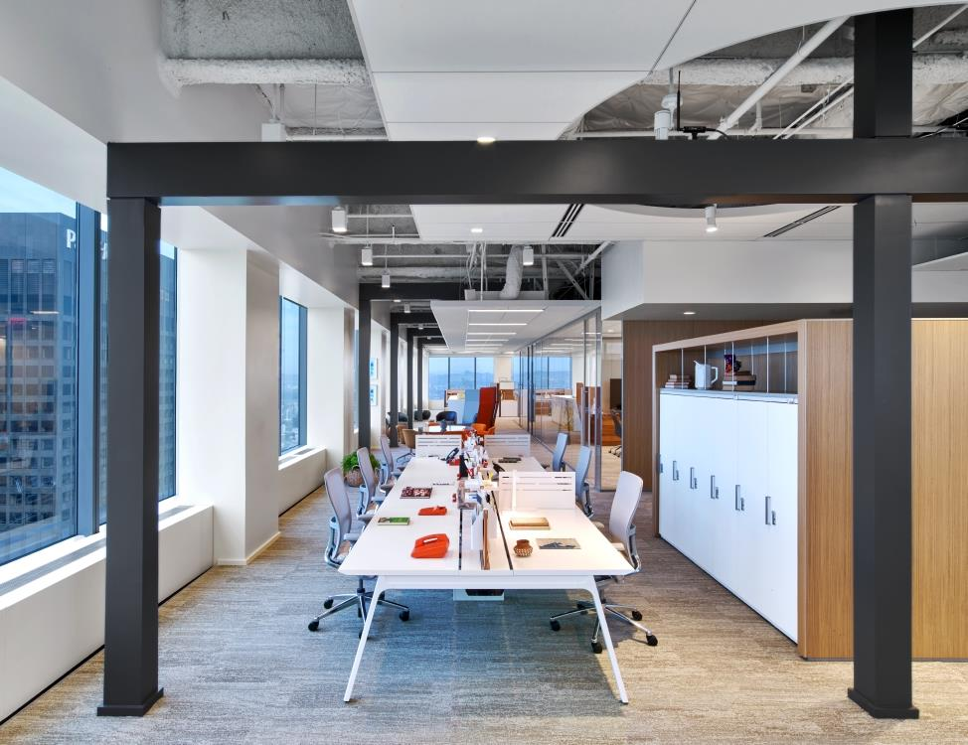
Zody
Form follows science:
A high-performance task chair blends science-based wellness and comfort with sustainability and award-winning international design
back to overview

Slide 29
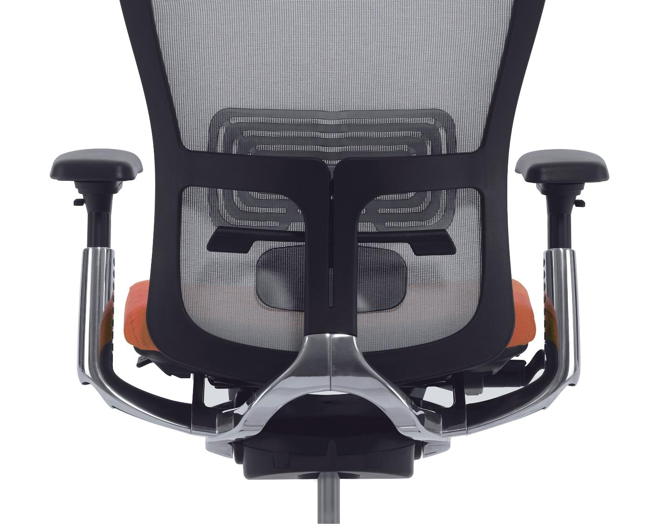
Zody
Form follows science:
A high-performance task chair blends science-based wellness and comfort with sustainability and award-winning international design
back to overview

Slide 30
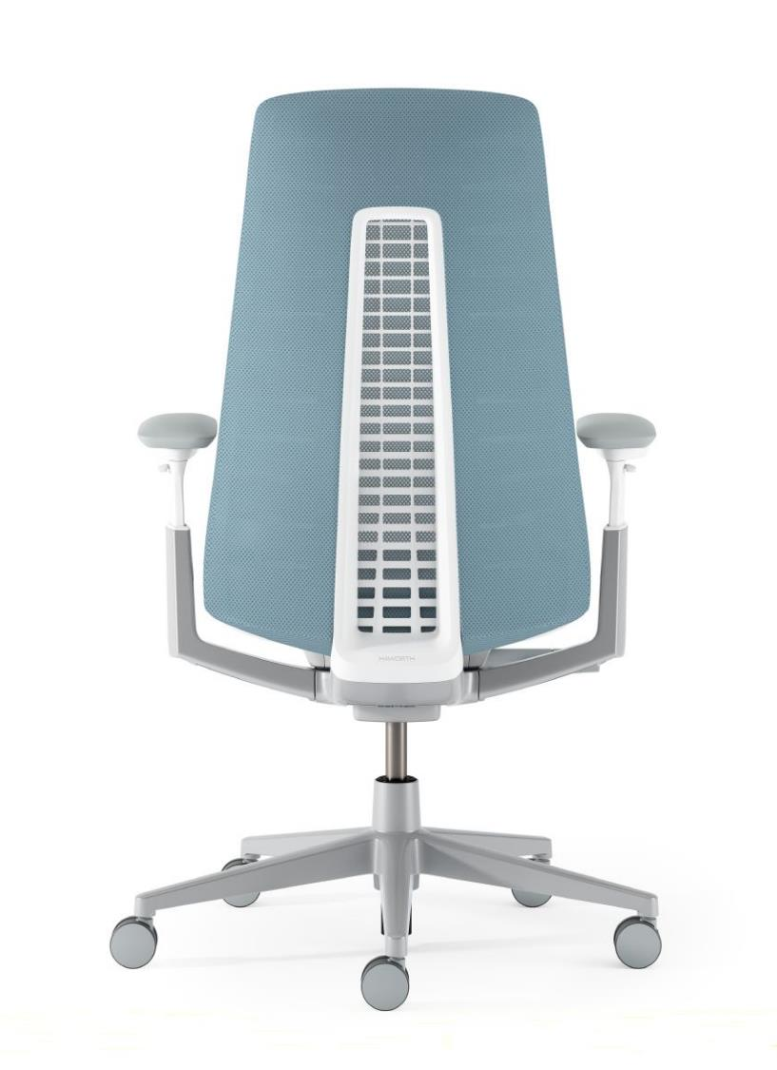
Fern
DESIGNED by Haworth Design Studio and ITO Design
FERN 3-point mechanism with back-stop in 5 positions
FORWARD TILT (optional)
LUMBAR SUPPORT – height adjustable (optional)
4D ARMREST
FLEXIBLE BACKREST instead of torsional rigidity
back to overview
Notes:
Add Key Selling Points (from DLP Sheets) here instead of technical Details

Slide 31
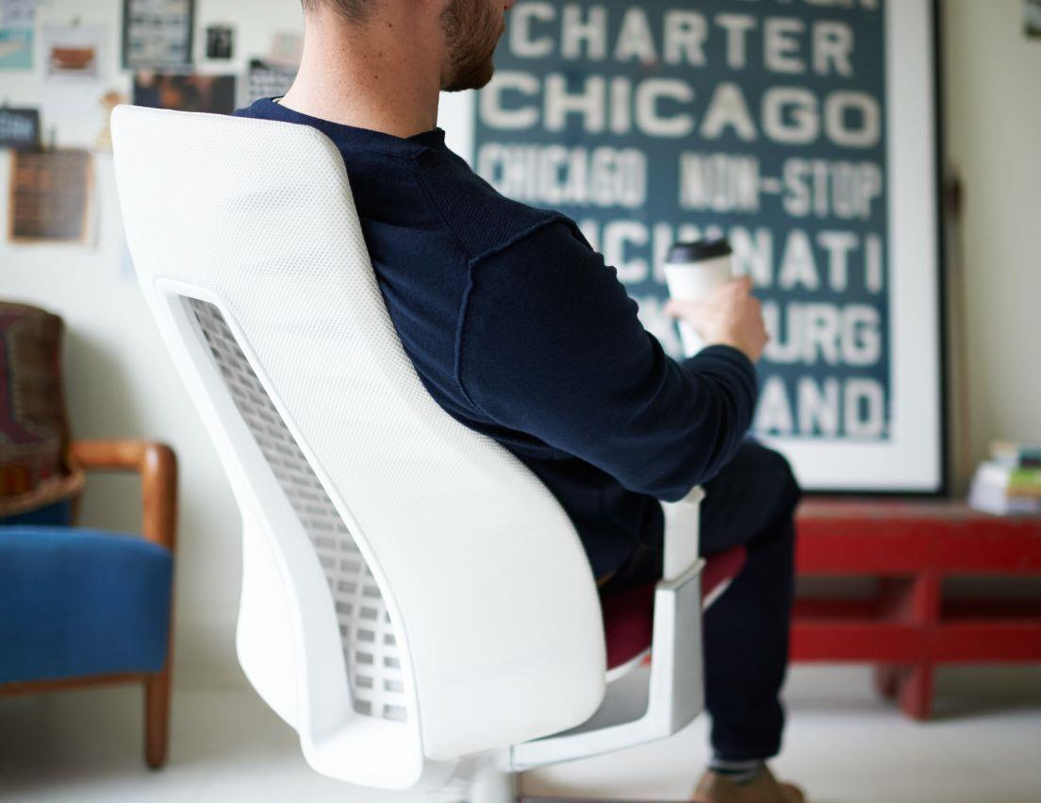
Fern
DESIGNED by Haworth Design Studio and ITO Design
FERN 3-point mechanism with back-stop in 5 positions
FORWARD TILT (optional)
LUMBAR SUPPORT – height adjustable (optional)
4D ARMREST
FLEXIBLE BACKREST instead of torsional rigidity
back to overview
Notes:
Add Key Selling Points (from DLP Sheets) here instead of technical Details

Slide 32
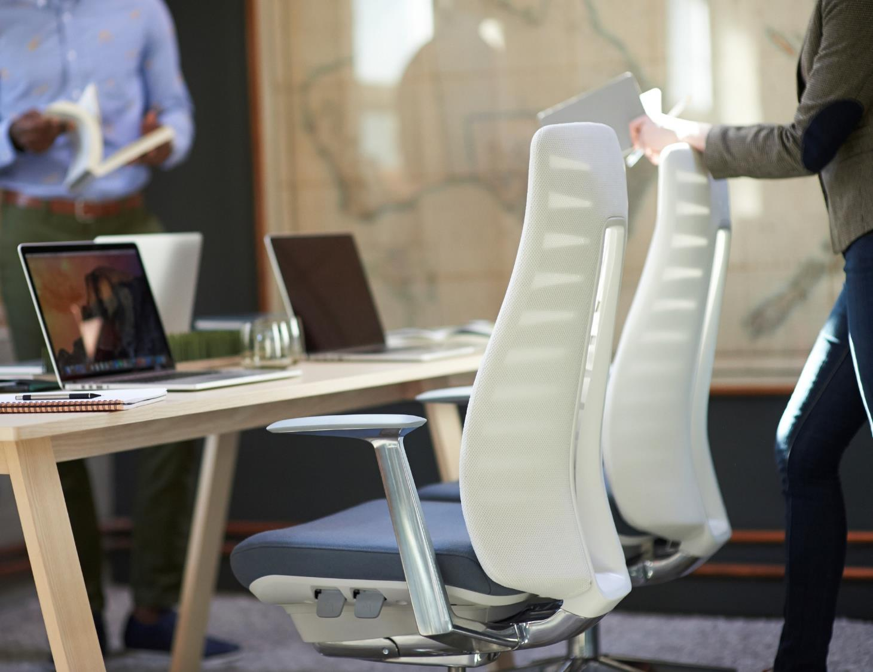
Fern
Fern provides a comfortable, engaging sitting experience that creates good feelings,
keeping you balanced and centered in your chair. Its approachable design is
less machine, more human, with mechanics discreetly integrated into the warm,
residential aesthetic.
back to overview

Slide 33
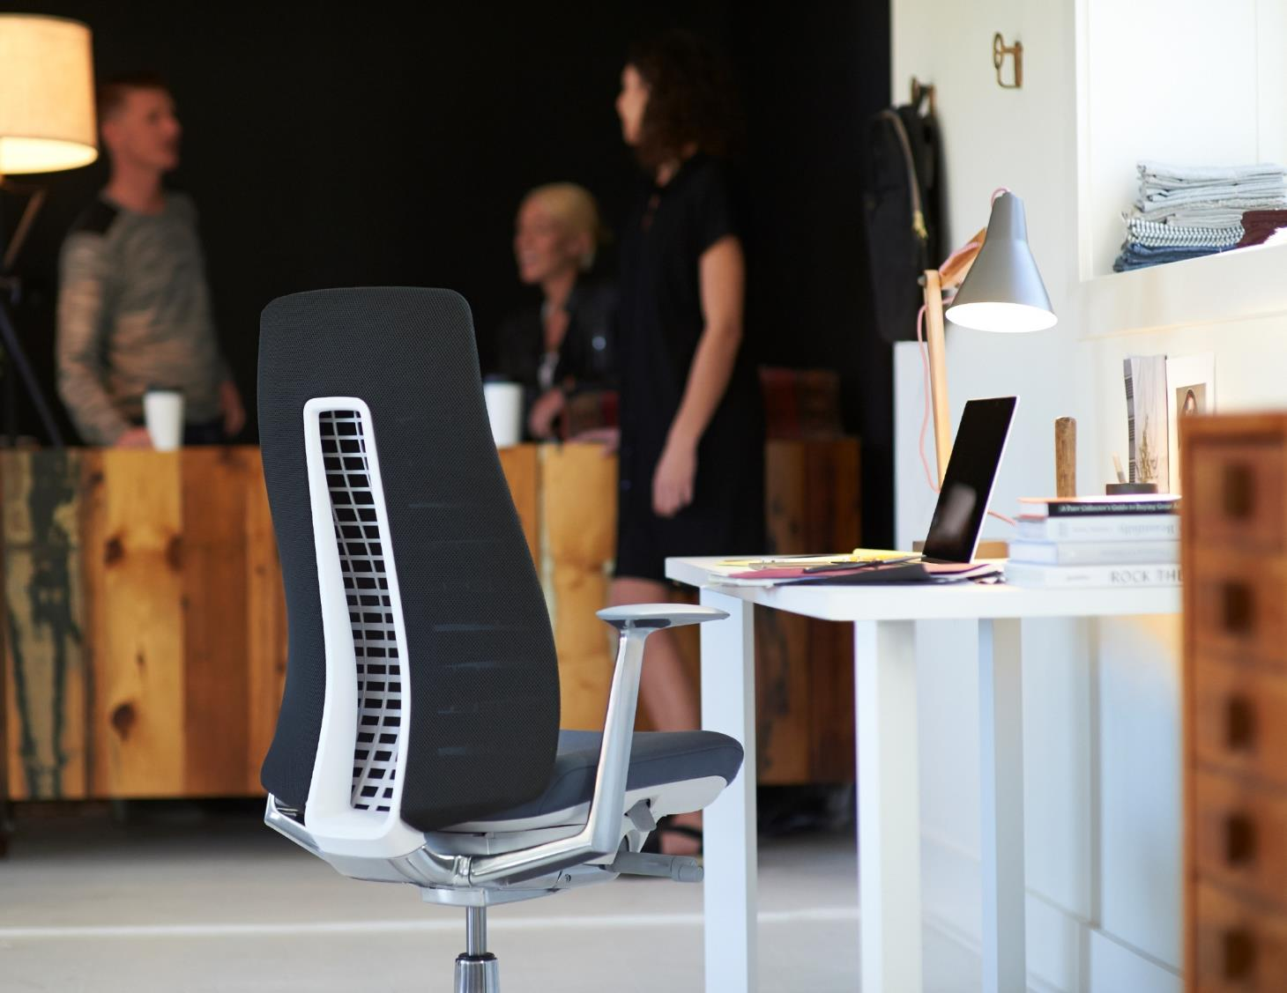
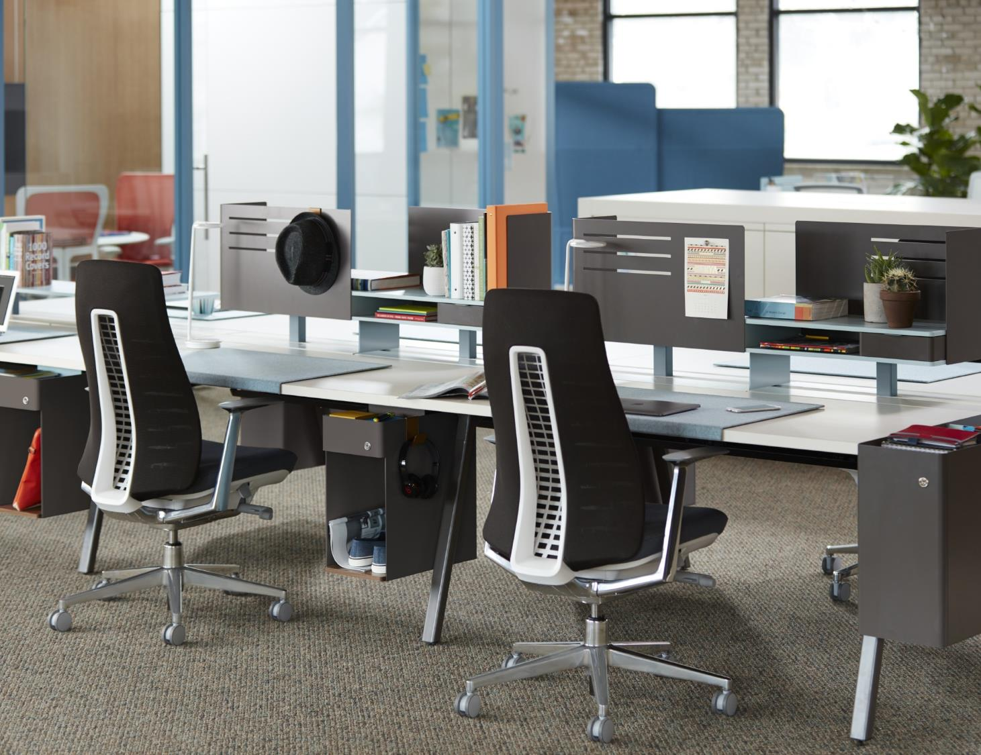
Fern
Fern provides a comfortable, engaging sitting experience that creates good feelings,
keeping you balanced and centered in your chair. Its approachable design is
less machine, more human, with mechanics discreetly integrated into the warm,
residential aesthetic.
back to overview

Slide 34
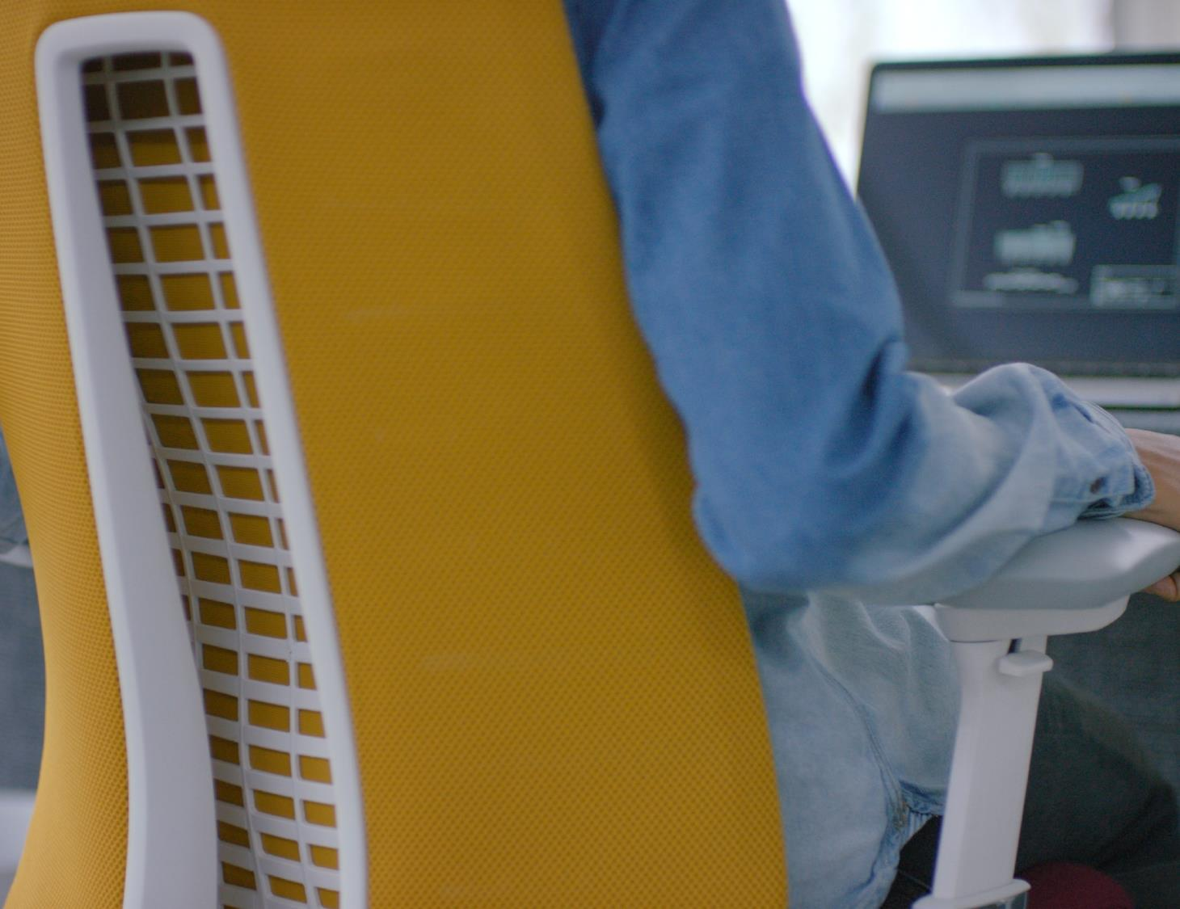
Fern
Fern provides a comfortable, engaging sitting experience that creates good feelings,
keeping you balanced and centered in your chair. Its approachable design is
less machine, more human, with mechanics discreetly integrated into the warm,
residential aesthetic.
back to overview

Slide 35
Bowi
Simple clean aesthetic to suit most
environments​
Unique pivoting mechanism, allows easy nesting​
Cost effective
all plastic design​
designed by brodbeck design and Haworth Design Studio​
back to overview
Notes:
Add Key Selling Points (from DLP Sheets) here instead of technical Details

Slide 36
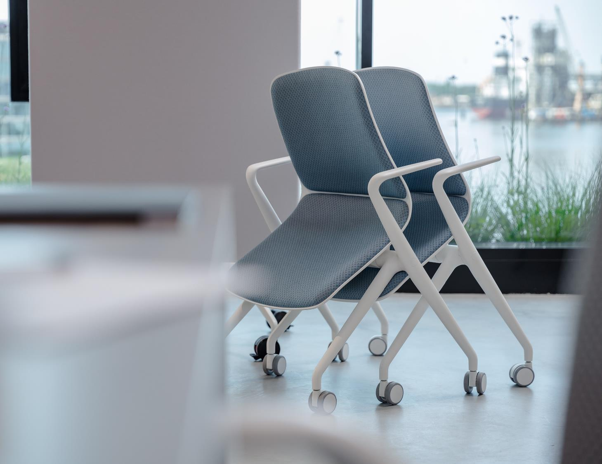
Minimalist Design
Bowi is designed in clean simple aesthetic that compliments a range of environments, such as conference, meeting and projects rooms or cafeterias.
back to overview

Slide 37
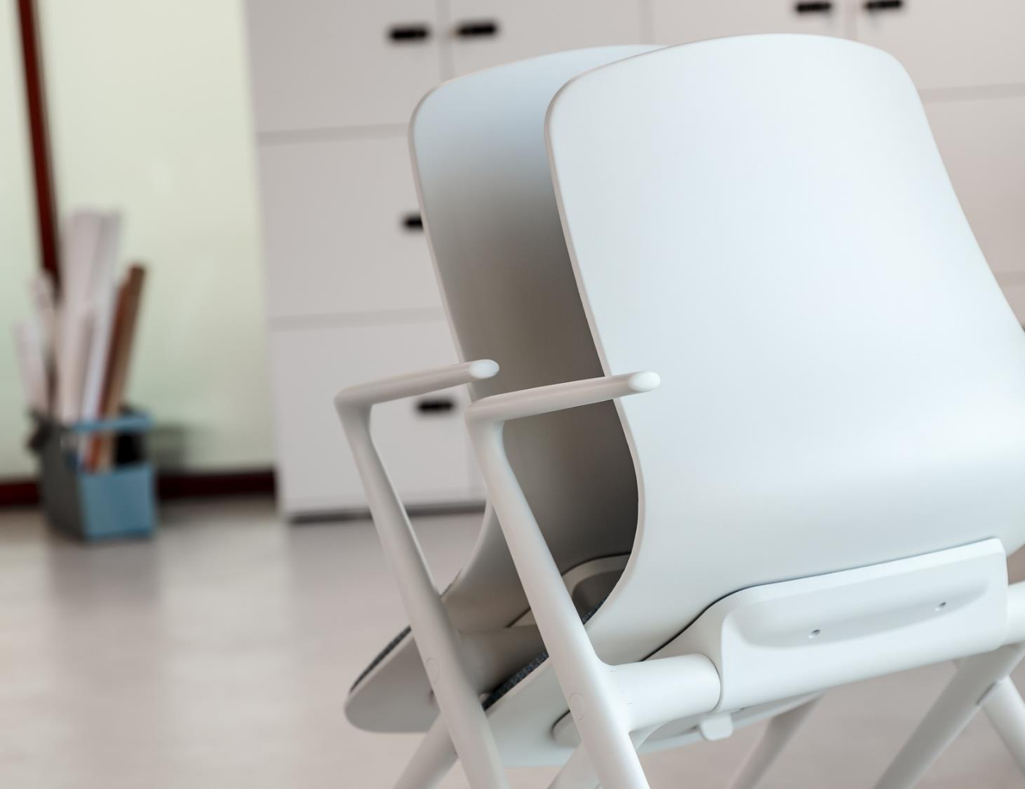
Easy Nesting
Crafty mechanism allows the chair to be easily inclined and nested using minimal space, to address to the increasing need for space and flexibility.​
​
back to overview
Notes:
Add Key Selling Points (from DLP Sheets) here instead of technical Details

Slide 38
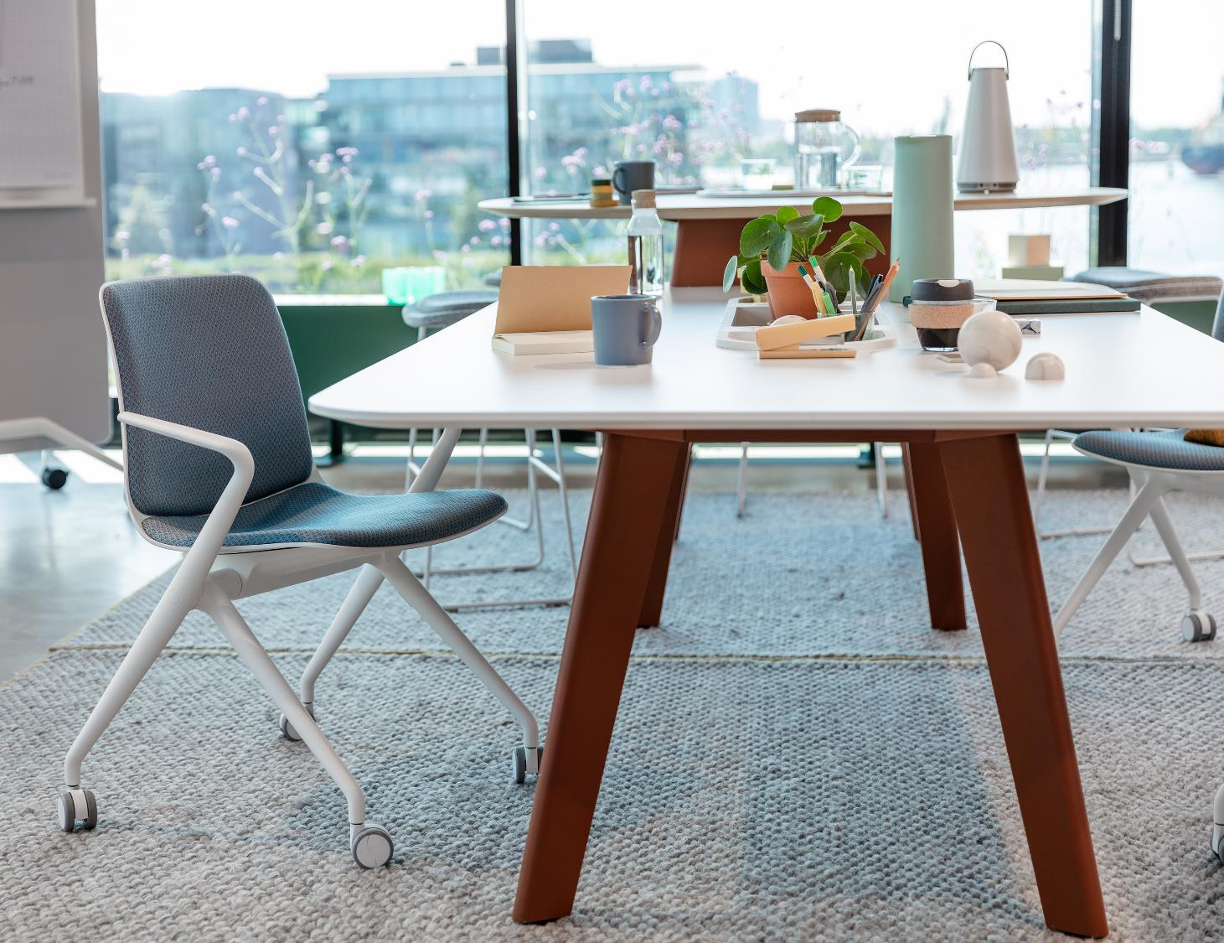
Budget-friendly
With all plastic construction, Bowi is designed to be cost-effective, providing a versatile seating solution at an affordable price. ​
back to overview
Notes:
Add Key Selling Points (from DLP Sheets) here instead of technical Details

Slide 39
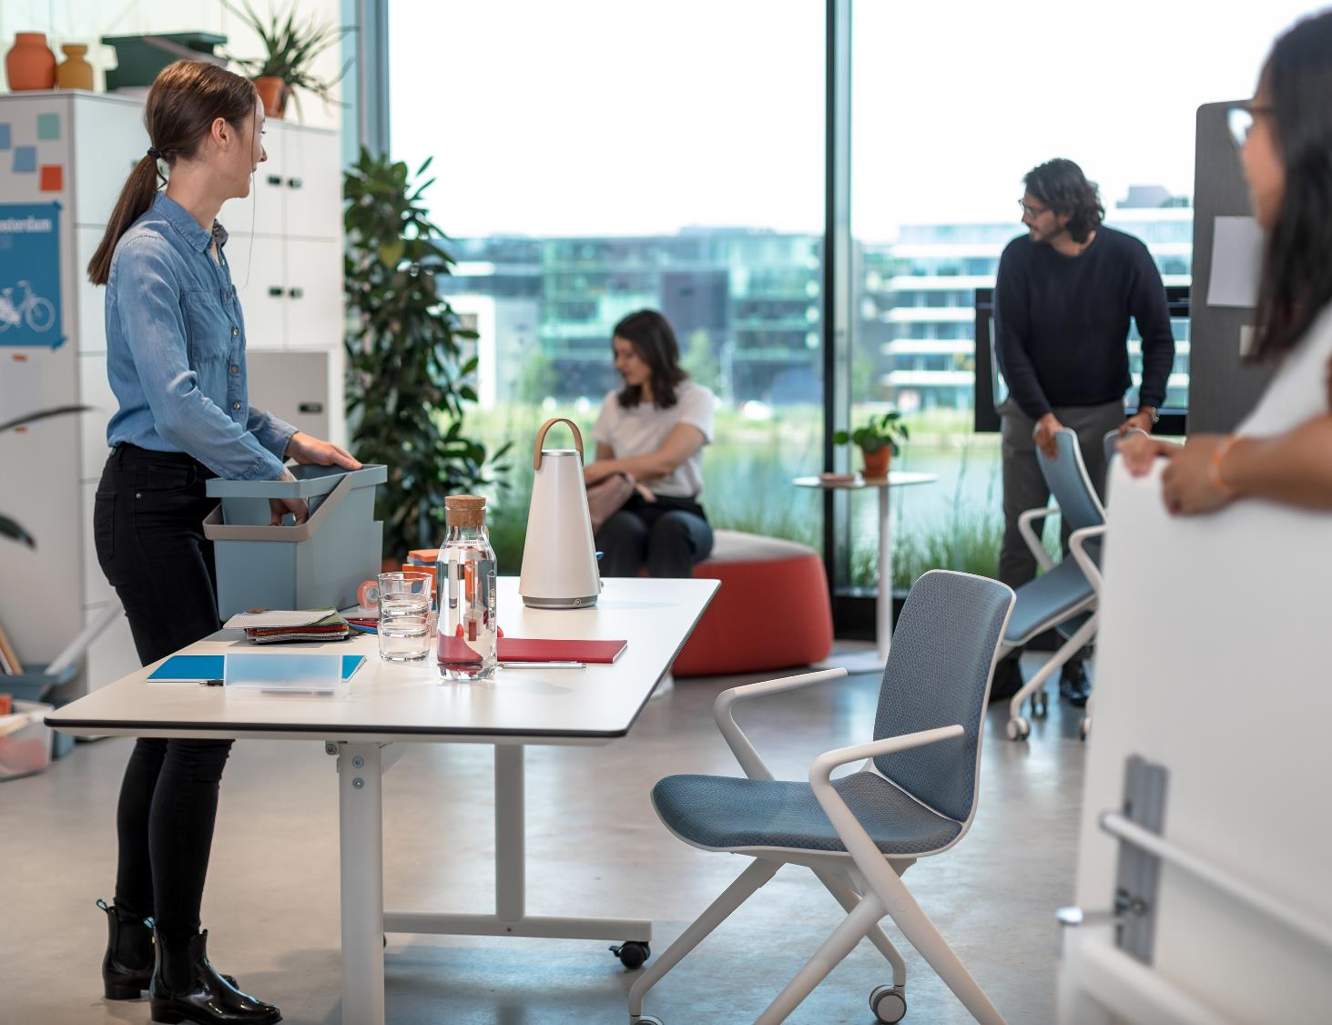
Bowi
back to overview
Notes:
Add Key Selling Points (from DLP Sheets) here instead of technical Details

Slide 40
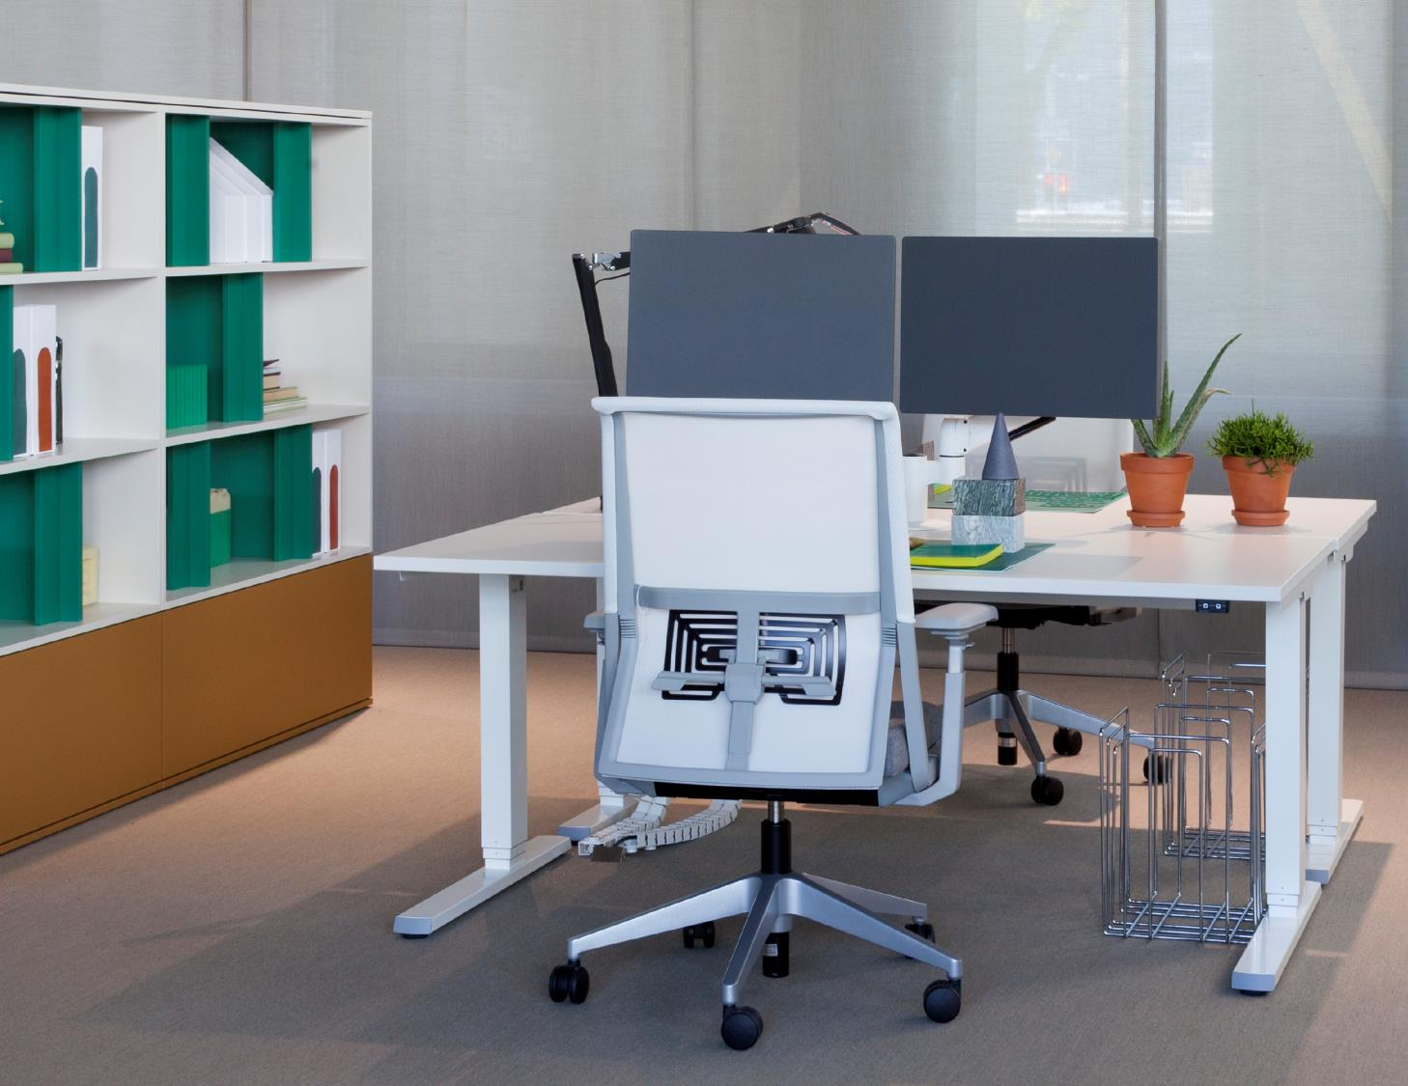
Comforto 59
designed by Simon Desanta and Haworth Design Studio
Automatic weight control mechanism: The chair automatically adjusts itself to the user’s body weight and allows the user to forget that they are sitting
Options: PAL™ asymmetric and height adjustable lumbar support, AIR-GO-PUR™ seat, 4D NPR or fixed armrests, headrest
back to overview
Notes:
Add Key Selling Points (from DLP Sheets) here instead of technical Details

Slide 41
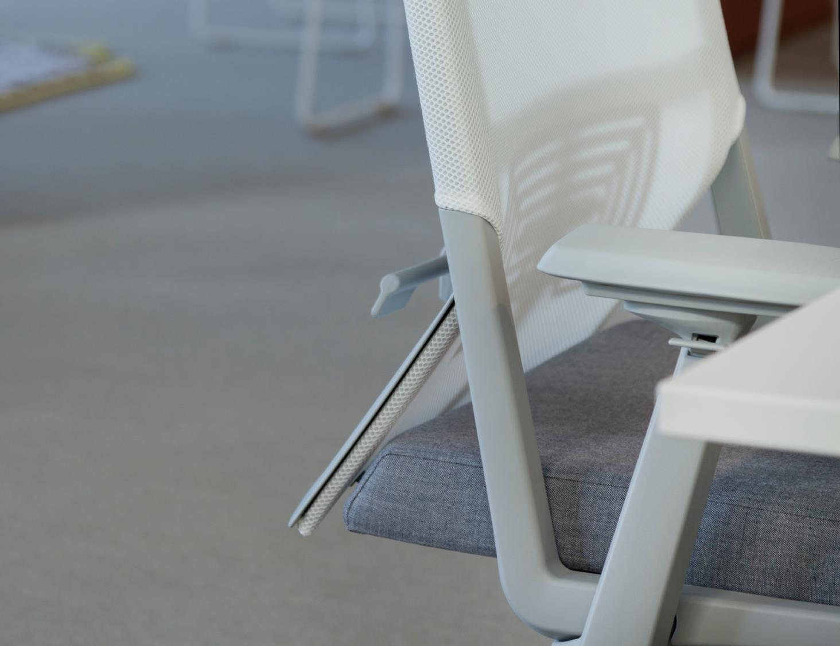
Comforto 59
Design and function: the Comforto 59 chair incorporates essential functionality into a sleek, clean design.
back to overview

Slide 42
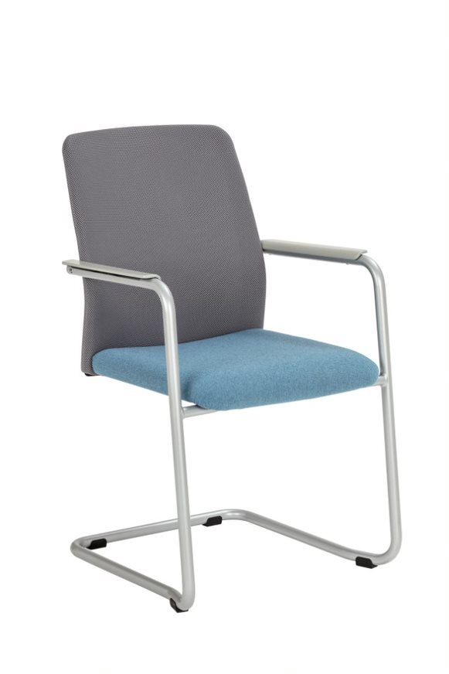
Intermezzo
A versatile visitor chair program, suited to all classical seating applications where people come together for a period of time.
back to overview
Notes:
Add Key Selling Points (from DLP Sheets) here instead of technical Details

Slide 43
Nia
Redefining work seating
Traditional task chairs contrast the increasingly residential-themed workplace aesthetic. Nia with it’s slim upholstered profile and concealed mechanisms finally create a chair that compliments this aesthetic without compromising performance
back to overview
Notes:
Add Key Selling Points (from DLP Sheets) here instead of technical Details

Slide 44
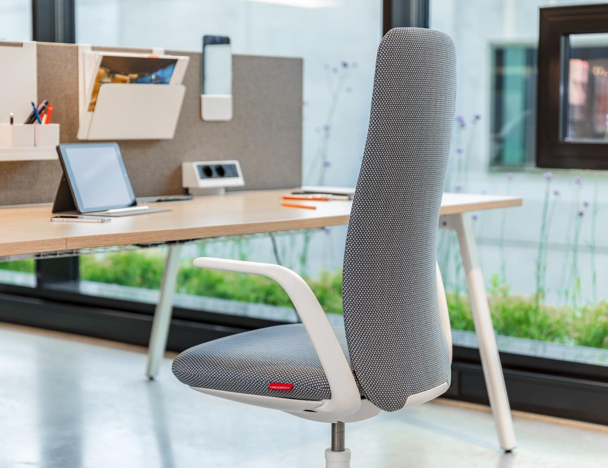
So many opportunities
Nia is designed to blend the style and comfort of lounge chair with the performance of a task chair, creating a solution for many different work settings, from meeting/conference rooms, focus work areas and collaboration zones.
back to overview
Notes:
Add Key Selling Points (from DLP Sheets) here instead of technical Details

Slide 45
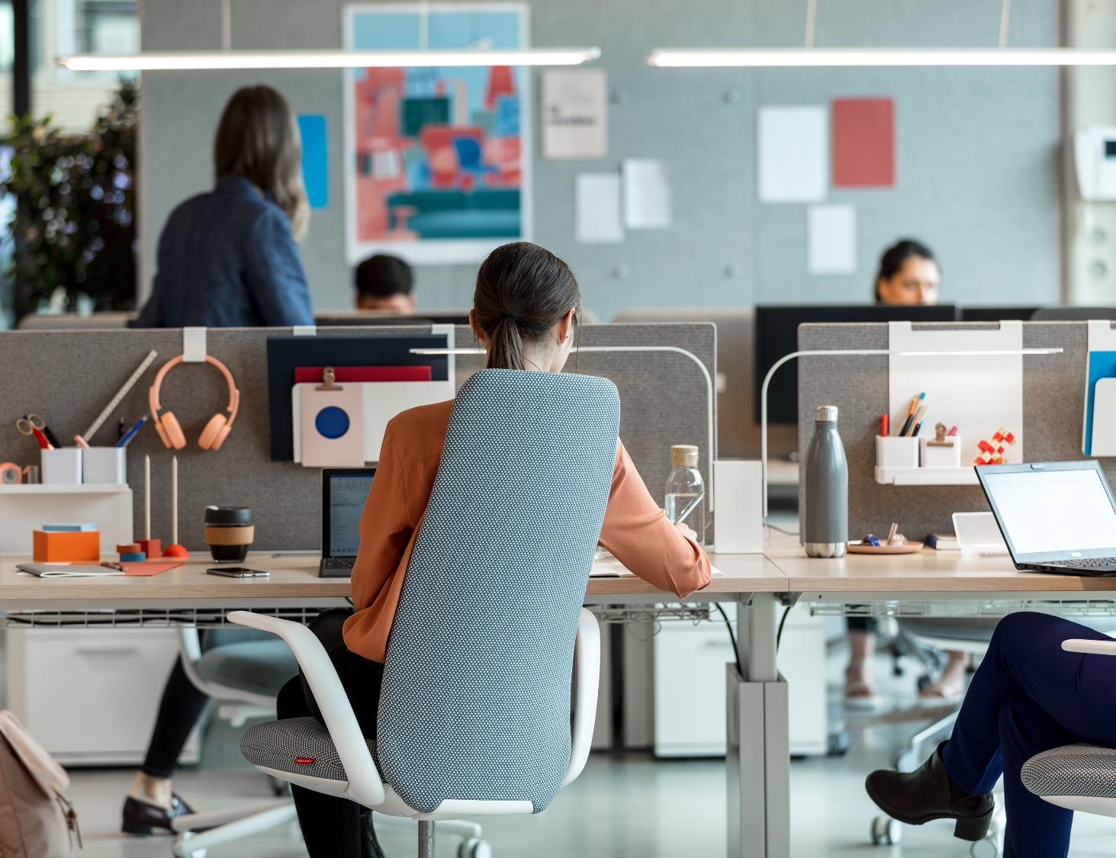
Freedom as wanted, support as needed
Nia's weight-activated mechanism and unique pivoting back accommodate and quickly adapt to users postures without complicated adjustment controls.​
back to overview

Slide 46
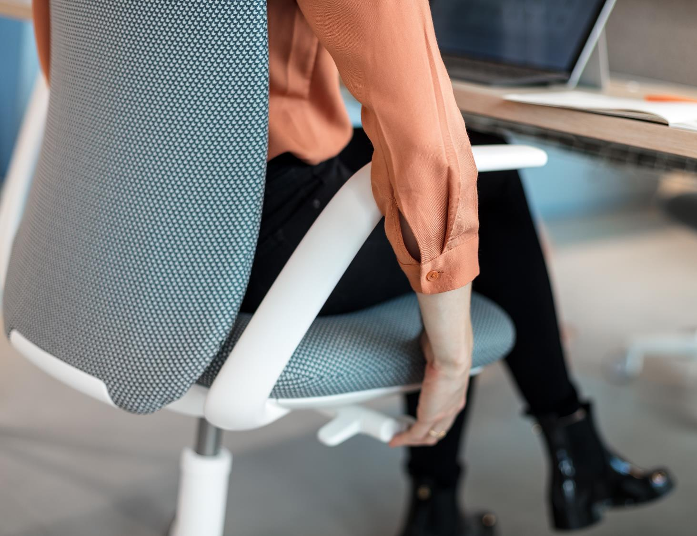
Nia
back to overview

Slide 47
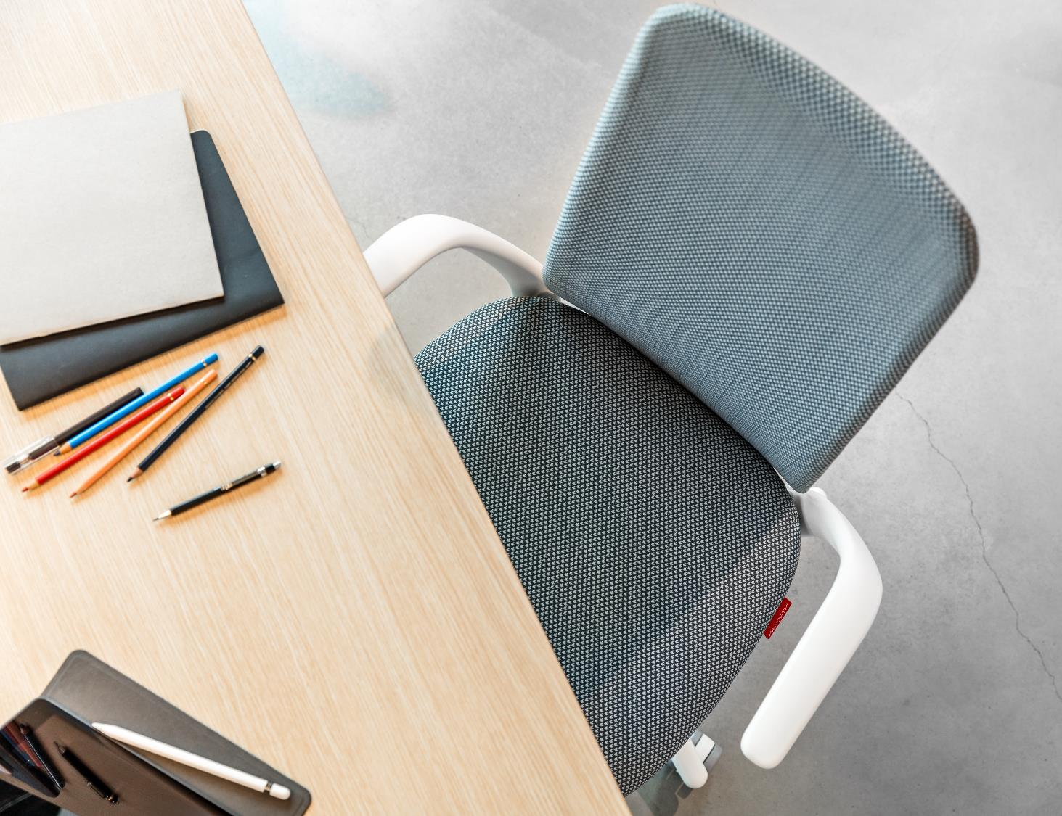
Nia
back to overview

Slide 48
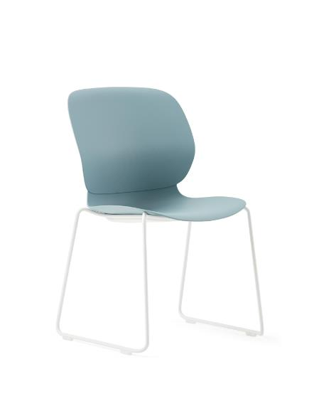
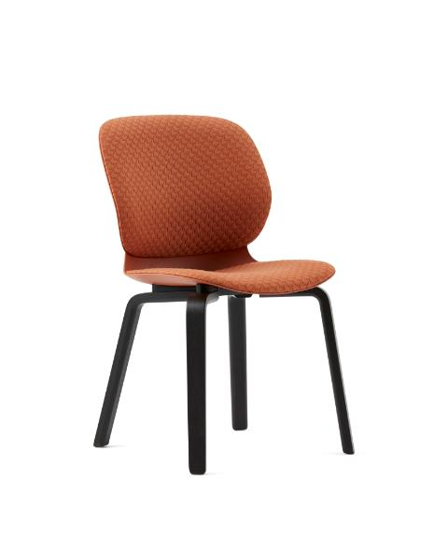
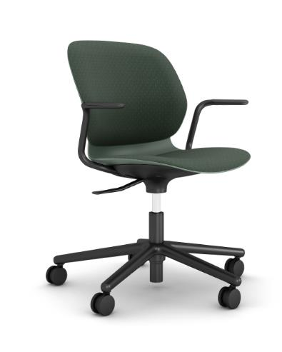
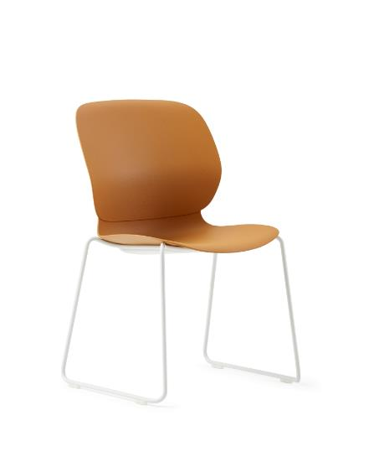
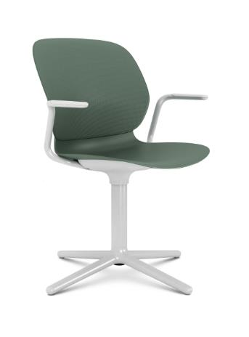
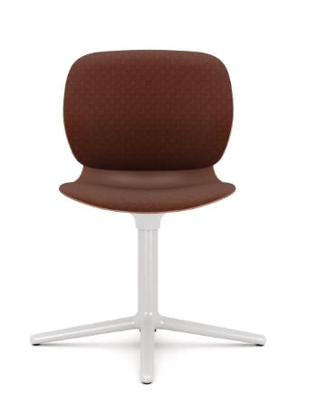
Maari
Its design was influenced by our knowledge of seat and back contours and Patricia Urquiola’s design vision.
Designed with a built-in level of support, Maari accommodates a broad range of users.
back to overview
Notes:
Add Key Selling Points (from DLP Sheets) here instead of technical Details

Slide 49
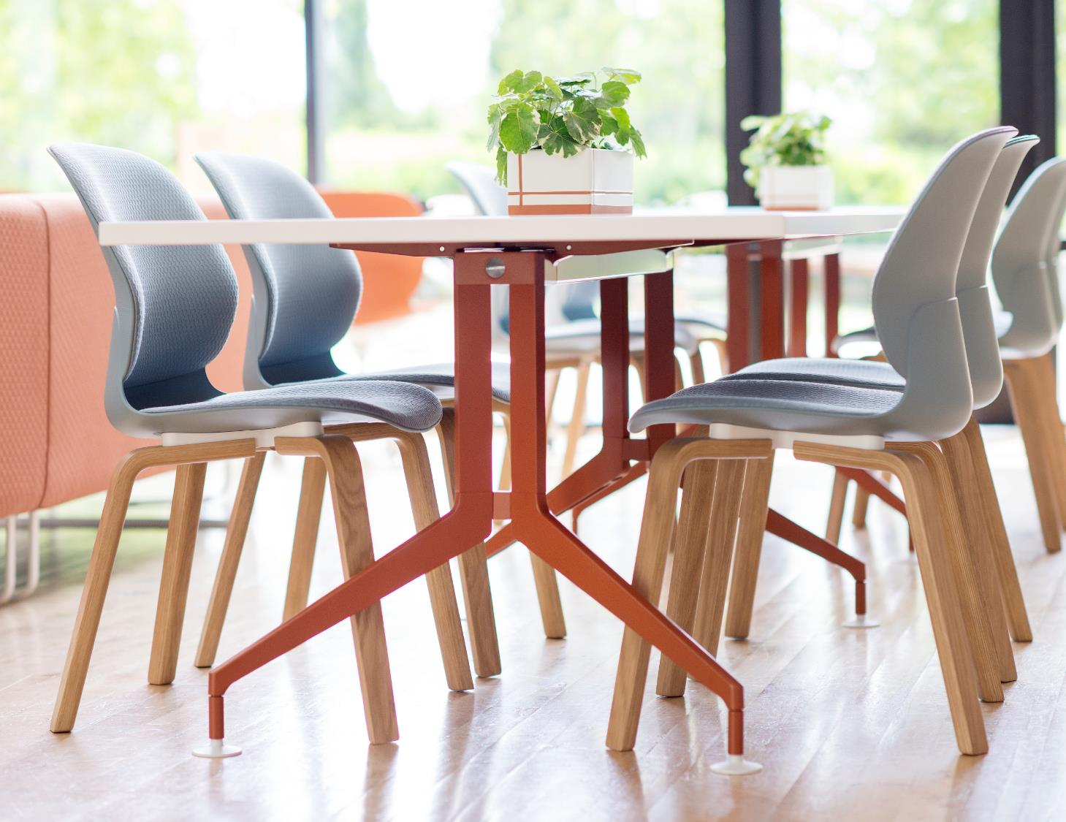
Maari
back to overview
Notes:
Add Key Selling Points (from DLP Sheets) here instead of technical Details

Slide 50
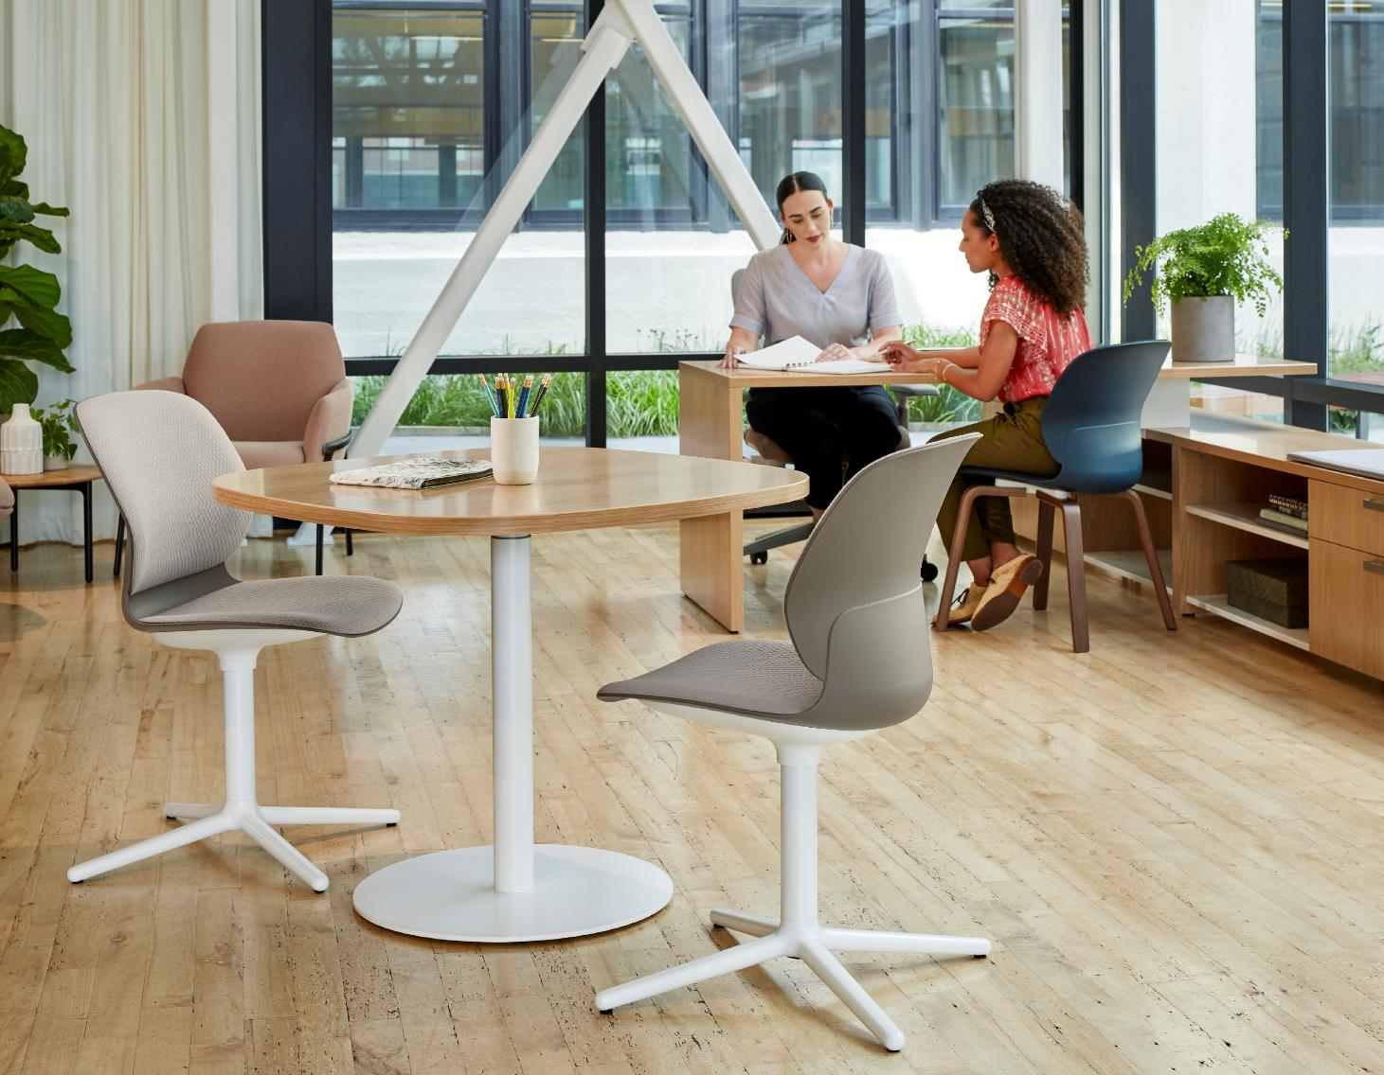
Maari
Maari lets you furnish many spaces with a family of
seating — one of the largest in the market. Designed by Patricia Urquiola, Maari is based on a one-piece, delicately textured, moulded shell that’s the same for all chairs. Choose any base with the same shell for a breadth of applications.
back to overview

Slide 51
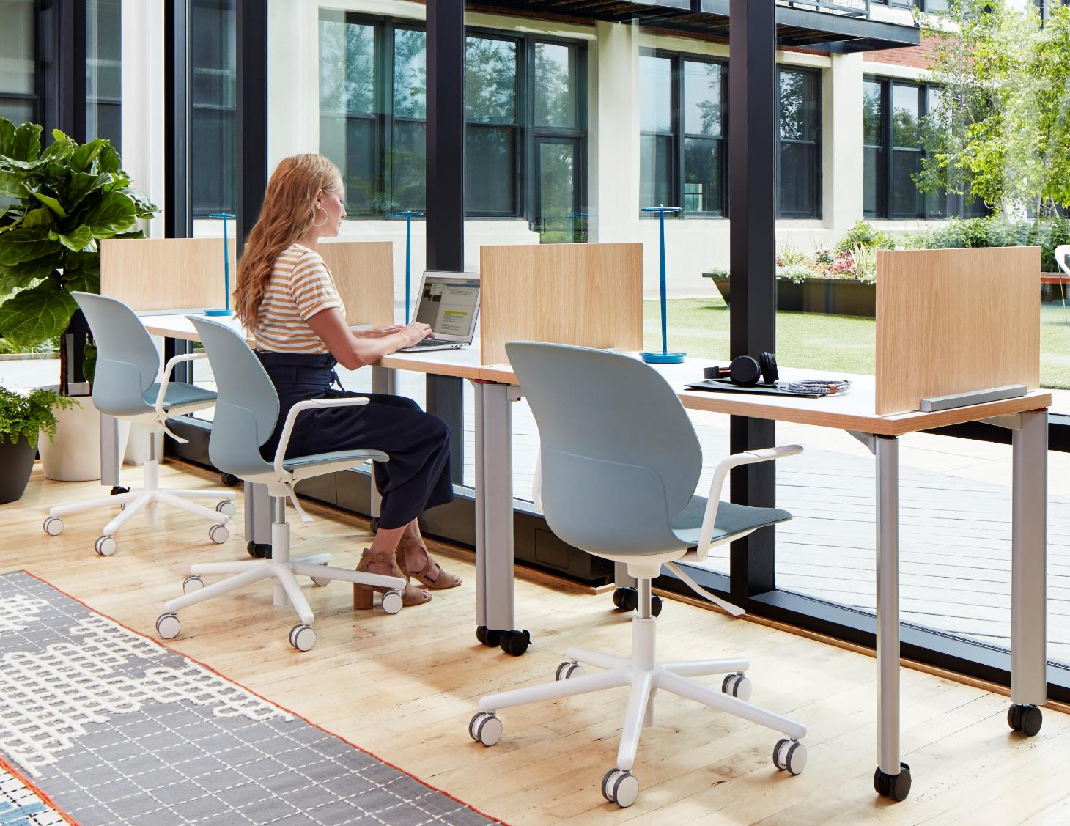
Maari
Maari lets you furnish many spaces with a family of
seating — one of the largest in the market. Designed by Patricia Urquiola, Maari is based on a one-piece, delicately textured, moulded shell that’s the same for all chairs. Choose any base with the same shell for a breadth of applications.
back to overview
Notes:
Add Key Selling Points (from DLP Sheets) here instead of technical Details

Slide 52
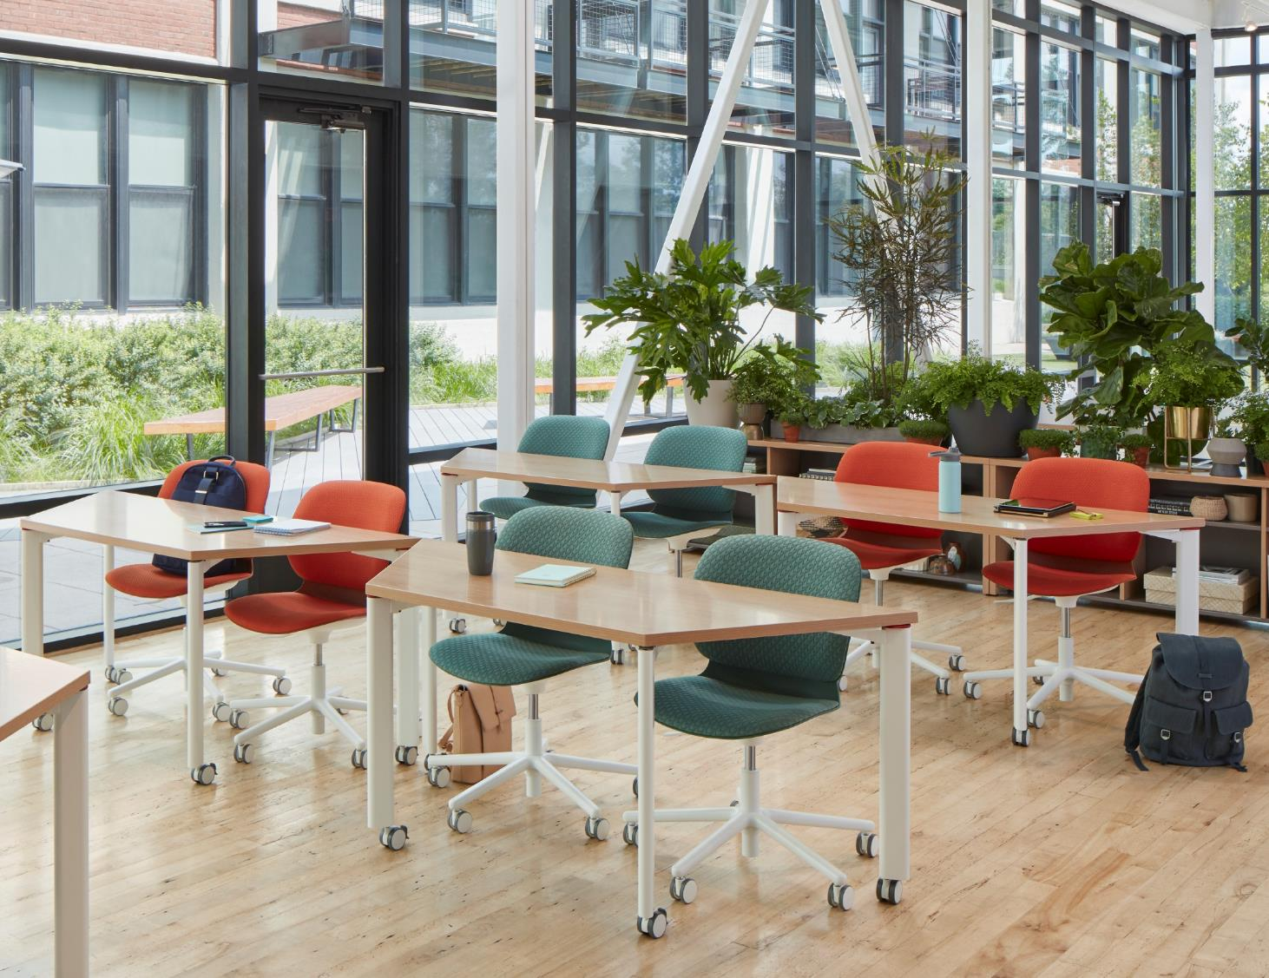
Maari
Maari lets you furnish many spaces with a family of
seating — one of the largest in the market. Designed by Patricia Urquiola, Maari is based on a one-piece, delicately textured, moulded shell that’s the same for all chairs. Choose any base with the same shell for a breadth of applications.
back to overview

Slide 53
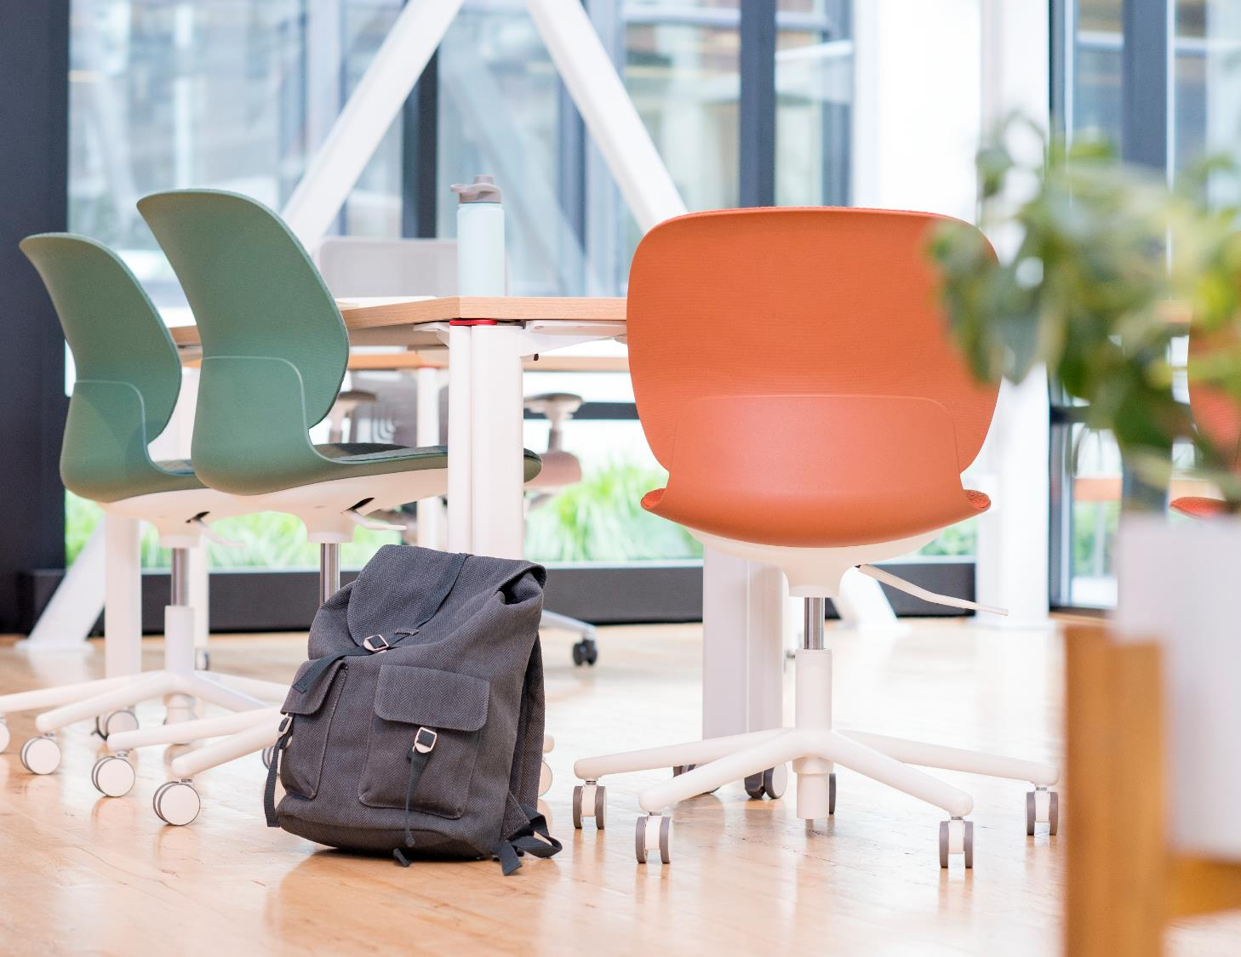
Maari
Maari lets you furnish many spaces with a family of
seating — one of the largest in the market. Designed by Patricia Urquiola, Maari is based on a one-piece, delicately textured, moulded shell that’s the same for all chairs. Choose any base with the same shell for a breadth of applications.
back to overview

Slide 54
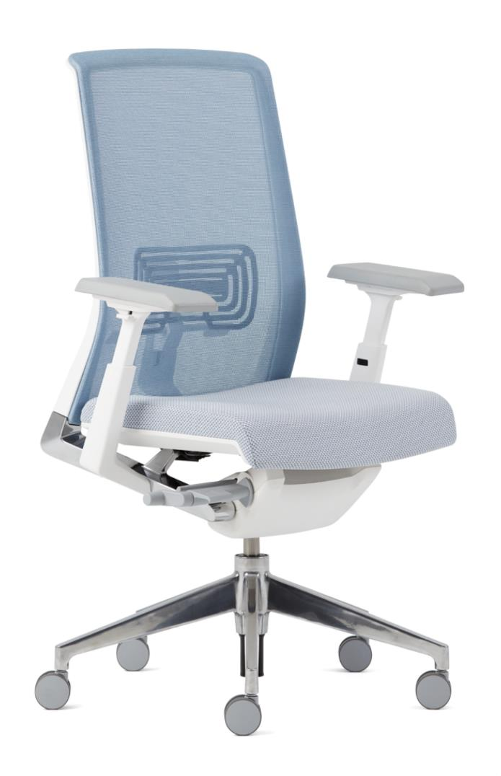
Very
The Very chair's top characteristics include its universal appeal, wide range of application, high level of recyclability & fantastic scope of colour.
back to overview

Slide 55
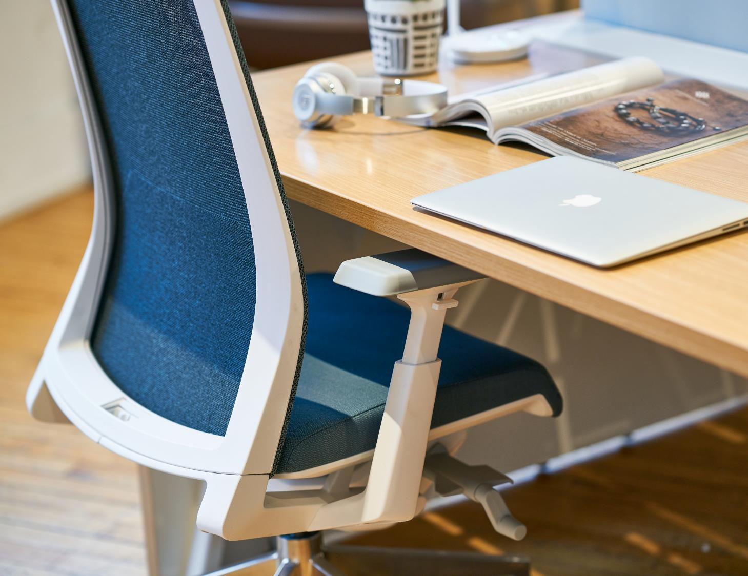
Very
The Very chair's top characteristics include its universal appeal, wide range of application, high level of recyclability & fantastic scope of colour.
back to overview

Slide 56
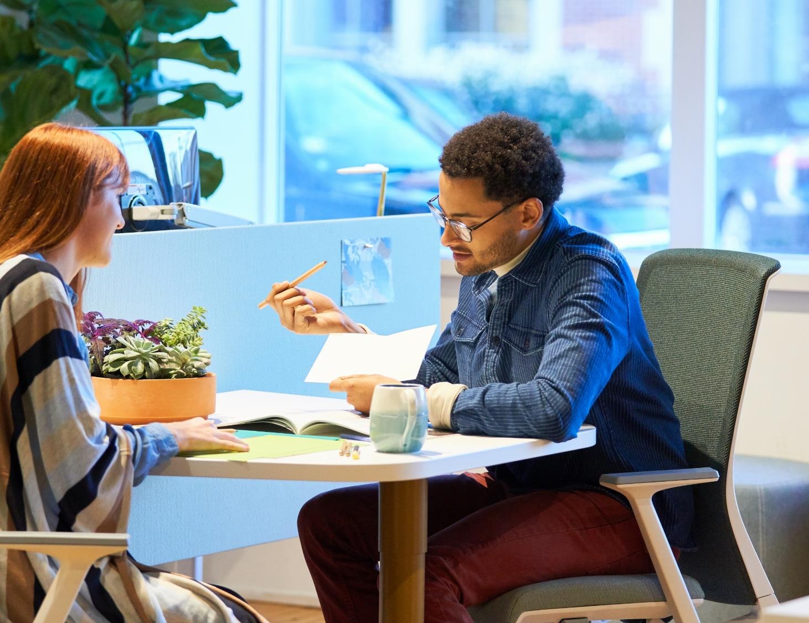
Very
The Very chair's top characteristics include its universal appeal, wide range of application, high level of recyclability & fantastic scope of colour.
back to overview
Notes:
Add Key Selling Points (from DLP Sheets) here instead of technical Details

Slide 57
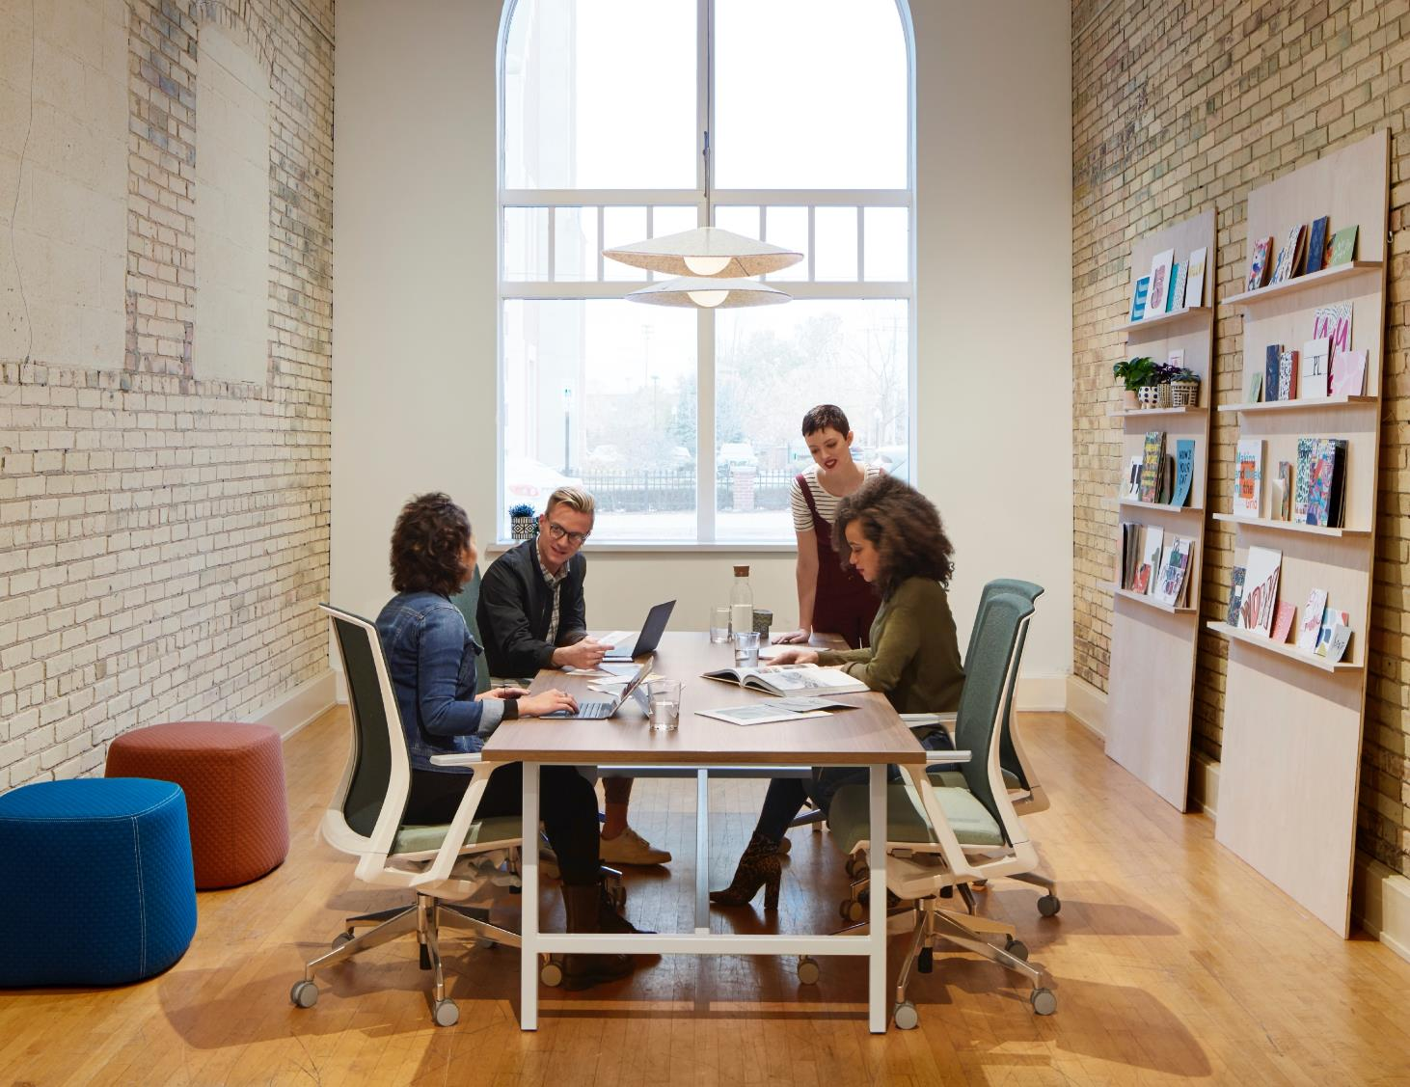
Very
DESIGNED by Michael Welsh, Nicolai Czumaj-Bront & Haworth Design Studio
Contains 39% recycled content and up to 100% recyclable materials
3-point-synchronised adjustment, with or without asymmetrical lumbar support, 4D, NPR or fixed armrest, Mesh or fully upholstered back rest
back to overview
Notes:
Add Key Selling Points (from DLP Sheets) here instead of technical Details

Slide 58
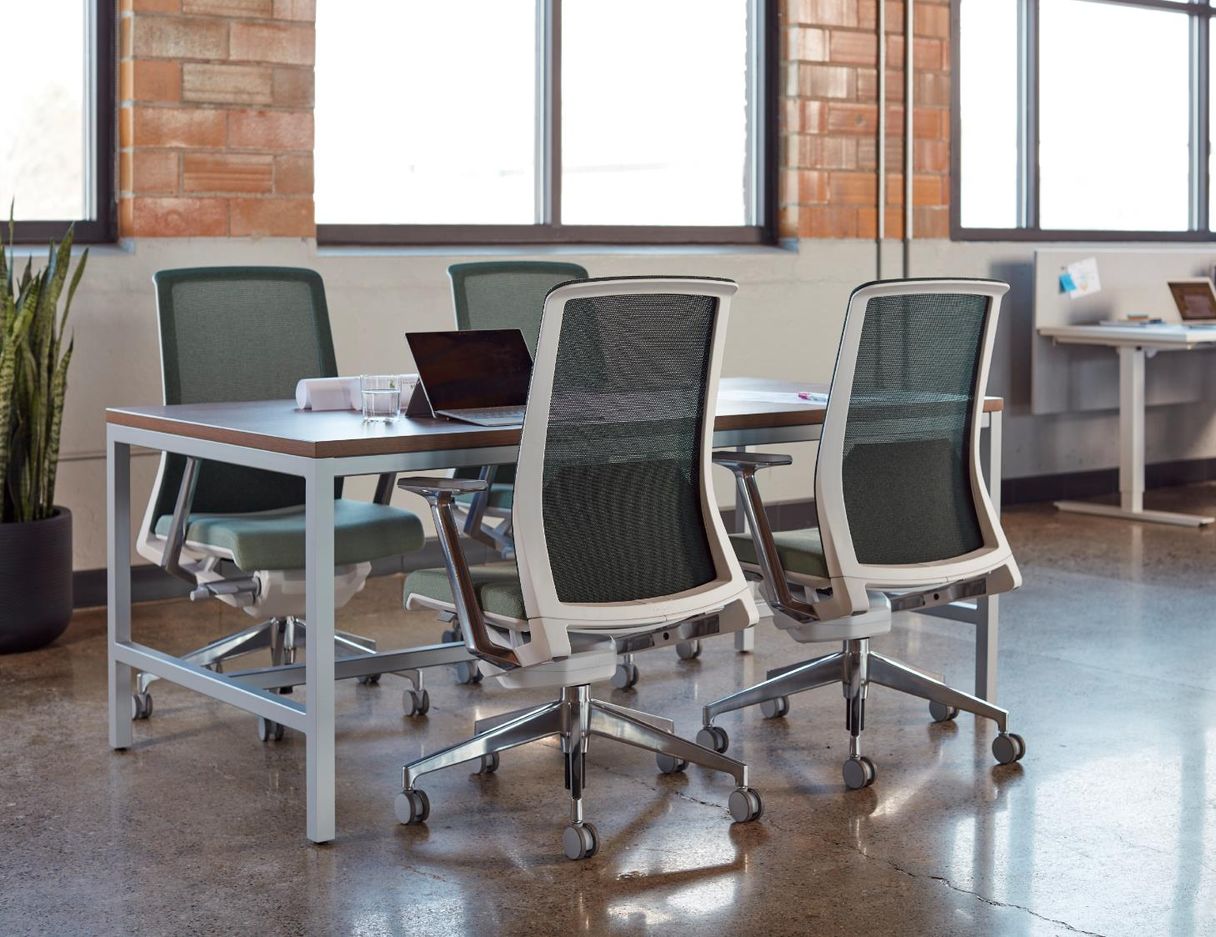
Very
DESIGNED by Michael Welsh, Nicolai Czumaj-Bront & Haworth Design Studio
Contains 39% recycled content and up to 100% recyclable materials
3-point-synchronised adjustment, with or without asymmetrical lumbar support, 4D, NPR or fixed armrest, Mesh or fully upholstered back rest
back to overview

Slide 59
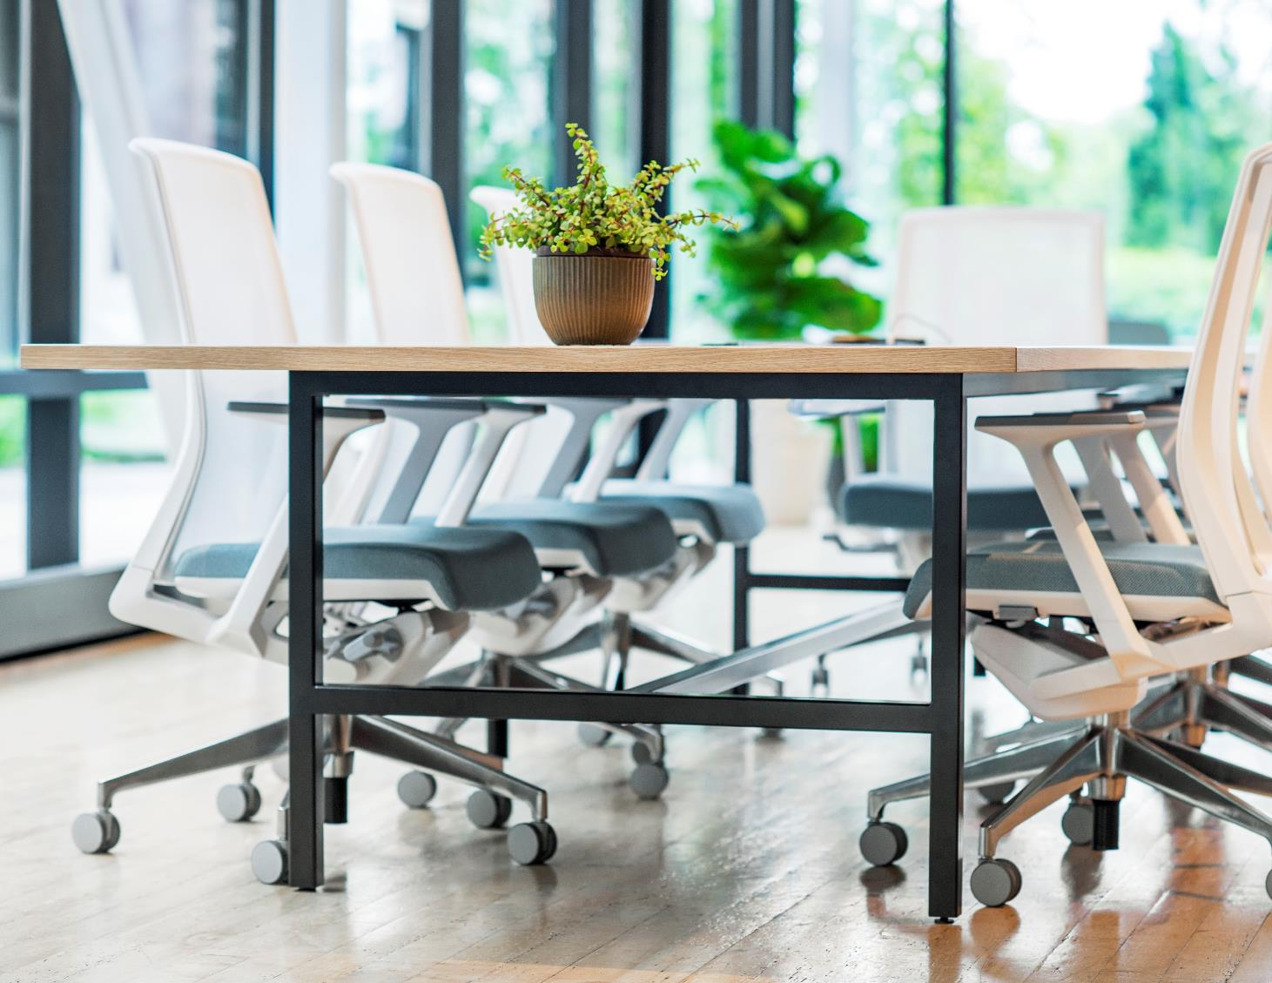
Very
DESIGNED by Michael Welsh, Nicolai Czumaj-Bront & Haworth Design Studio
Contains 39% recycled content and up to 100% recyclable materials
3-point-synchronised adjustment, with or without asymmetrical lumbar support, 4D, NPR or fixed armrest, Mesh or fully upholstered back rest
back to overview

Slide 60
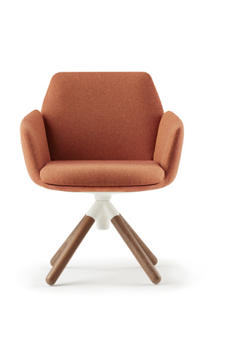
Poppy
DESIGNED by Patricia Urquiola and Haworth Design Studio
comfortable and cozy
flexible and accommodating
expressive and charming
back to overview
Notes:
Add Key Selling Points (from DLP Sheets) here instead of technical Details

Slide 61

Poppy
Haworth worked with designer Patricia Urquiola on this contemporary lounge chair. Poppy brings the warmth of home furnishings into the office space.
Poppy is a soft, cushioned lounge seat. It can be used in a conference room, a waiting area, or even as a desk chair.
back to overview

Slide 62

Poppy
Haworth worked with designer Patricia Urquiola on this contemporary lounge chair. Poppy brings the warmth of home furnishings into the office space.
Poppy is a soft, cushioned lounge seat. It can be used in a conference room, a waiting area, or even as a desk chair.
back to overview

Slide 63

Poppy
Haworth worked with designer Patricia Urquiola on this contemporary lounge chair. Poppy brings the warmth of home furnishings into the office space.
Poppy is a soft, cushioned lounge seat. It can be used in a conference room, a waiting area, or even as a desk chair.
back to overview

Slide 64

Poppy
Haworth worked with designer Patricia Urquiola on this contemporary lounge chair. Poppy brings the warmth of home furnishings into the office space.
Poppy is a soft, cushioned lounge seat. It can be used in a conference room, a waiting area, or even as a desk chair.
back to overview

Slide 65

Lively
DESIGNED by Steve Nemeth and Haworth Design Studio
CONTAINS: 25% recycled content and up to 100% recyclable; GREENGUARD GOLD, NF Environment and Quality Office certified
Height adjustable lumbar support, 3D or NPR armrests, Automatic weight synchronous mechanism, seating family and a variety of colour choices
REDDOT DESIGN AWARD winner 2013
back to overview
Notes:
Add Key Selling Points (from DLP Sheets) here instead of technical Details

Slide 66

Lively
DESIGNED by Steve Nemeth and Haworth Design Studio
CONTAINS: 25% recycled content and up to 100% recyclable; GREENGUARD GOLD, NF Environment and Quality Office certified
Height adjustable lumbar support, 3D or NPR armrests, Automatic weight synchronous mechanism, seating family and a variety of colour choices
REDDOT DESIGN AWARD winner 2013
back to overview
Notes:
Add Key Selling Points (from DLP Sheets) here instead of technical Details

Slide 67

Lively
DESIGNED by Steve Nemeth and Haworth Design Studio
CONTAINS: 25% recycled content and up to 100% recyclable; GREENGUARD GOLD, NF Environment and Quality Office certified
Height adjustable lumbar support, 3D or NPR armrests, Automatic weight synchronous mechanism, seating family and a variety of colour choices
REDDOT DESIGN AWARD winner 2013
back to overview
Notes:
Add Key Selling Points (from DLP Sheets) here instead of technical Details

Slide 68




Chick Pouf
Openest Chick poufs help leverage open space — small or large — by creating cozy, flexible areas that inspire people to do their best work. Easy to arrange and ready for anything, Chick poufs are at home in any setting — from individual focus and retreat areas, to collaborative and social gathering spots.
back to overview

Slide 69

Chick Pouf
Openest Chick poufs help leverage open space — small or large — by creating cozy, flexible areas that inspire people to do their best work. Easy to arrange and ready for anything, Chick poufs are at home in any setting — from individual focus and retreat areas, to collaborative and social gathering spots.
back to overview

Slide 70

Chick Pouf
DESIGNED by Patricia Urquiola
back to overview
Notes:
Add Key Selling Points (from DLP Sheets) here instead of technical Details

Slide 71

Chick Pouf
DESIGNED by Patricia Urquiola
back to overview
Notes:
Add Key Selling Points (from DLP Sheets) here instead of technical Details

Slide 72

Chick Pouf
DESIGNED by Patricia Urquiola
back to overview
Notes:
Add Key Selling Points (from DLP Sheets) here instead of technical Details

Slide 73

Soji
DESIGNED by Arne Dassen & Haworth Design Studio
back to overview
Notes:
Add Key Selling Points (from DLP Sheets) here instead of technical Details

Slide 74

Soji
Thoughtfully designed and informed by ergonomics, Soji is a highly-adjustable task chair that syncs your body and mind the second you sit down — for healthier levels of performance and well-being, no matter where you work.
back to overview

Slide 75

Soji
Thoughtfully designed and informed by ergonomics, Soji is a highly-adjustable task chair that syncs your body and mind the second you sit down — for healthier levels of performance and well-being, no matter where you work.
back to overview

Slide 76

Soji
Thoughtfully designed and informed by ergonomics, Soji is a highly-adjustable task chair that syncs your body and mind the second you sit down — for healthier levels of performance and well-being, no matter where you work.
back to overview

Slide 77

Soji
Thoughtfully designed and informed by ergonomics, Soji is a highly-adjustable task chair that syncs your body and mind the second you sit down — for healthier levels of performance and well-being, no matter where you work.
back to overview

Slide 78

Fabrics

Slide 79








Fabrics
Collection Small Arrow
by Haworth®
4L0CR
Crossbow
4L0TA
Target
4L0FL
Fletcher
4L0QU
Quiver
4L0ST
Shaft
4L0AR
Archer
4L0BA
Barb
4L0NK
Nock

Slide 80







Fabrics
Collection Big Arrow
by Haworth®
4D0BL
Blue
4D0CN
Cool Neutral
4D0DB
Dark Blue
4D0GD
Gold
4D0GR
Green
4D0MG
Medium Grey
4D0RE
Red

Slide 81








Fabrics
Collection Diagonale
by Haworth®
4N0BA
Bias
4N0DA
Diamond
4N0SH
Slash
4N0ST
Slant
4N0CH
Chevron
4N0FE
Featherstitch
4N0MA
Matrix
4N0HT
Half Timber

Slide 82













Fabrics
Collection Steelcut Trio
by Kvadrat®
58/0205
58/0124
58/0153
58/0533
58/0713
58/0645
New!
58/0946
New!
58/0383
New!
58/0453
New!
58/0515
New!
58/0253
New!
58/0113
New!

Slide 83










Fabrics
Collection 59
X2 BY CAMIRA®
59/0016
59/0012
59/0015
59/0005
59/0002
59/0006
59/0008
59/0020
59/0019

Slide 84



















Fabrics
Collection Atlas
by Kvadrat®
LW-A131
LW-B151
LW-D361
LW-E461
LW-T931
LW-G501
LW-H531
LW-J561
LW-K571
LW-V951
LW-F471
LW-N651
LW-L621
LW-M631
LW-C181
LW-P671
LW-Q771
LW-R861
LW-S881

Slide 85






Fabrics
Collection Soji Knit Mesh
BY CAMIRA®
XT001​
Carbon
XT002​
Cayenne
XT003​
Clay
XT004​
Juniper
XT005​
Mist
XT006​
Navy

Slide 86

Fabrics
Overview
*only legs/seat
**only shelves

Slide 87

Sustainability
Making the world better is one of Haworth’s fundamental, company-wide values. This philosophy guides our members every day as we work to strengthen the communities where we live and work. Through our research, development, and the actualisation of creative, sustainable solutions, we help protect and restore the environment, support and strengthen global communities, create economic value, and inspire well-being—now and for the future.

Slide 88
Our sustainable principles can be observed in our seating portfolio with the following examples:
Product Environmental Data Sheets (PEDS) to provide product-related sustainability information and supported by independent sustainability certification such as FEMB Level and NF Environment
Indoor air quality performance certified according to GREENGUARD ™ GOLD or Indoor Advantage™ Gold
Almost all seating fabric collections are certified either OEKO-TEX or EU Ecolabel
Most metal parts, Haworth uses powder painting, a VOC-free finishing process that creates low amounts of waste. Through a transition to water-based finishes and powder-coat paints, we’ve realized an over 90% reduction in VOC emissions from our processes since 2007
Our responsibility also extends beyond just the products we manufacture with Haworth Global awarded EcoVadis Gold for Corporate Social Responsibility Excellence, amongst the top 5% of manufacturers assessed by EcoVadis
Sustainability

Slide 89
Thank you!

