Slide 1
Intuity
Park Bench

Slide 2
Content
1 - Introduction
2 - Why Park Bench
3 - Statement of Line
4 - Idea Starters
5 - Fabrics and finishes

Slide 3
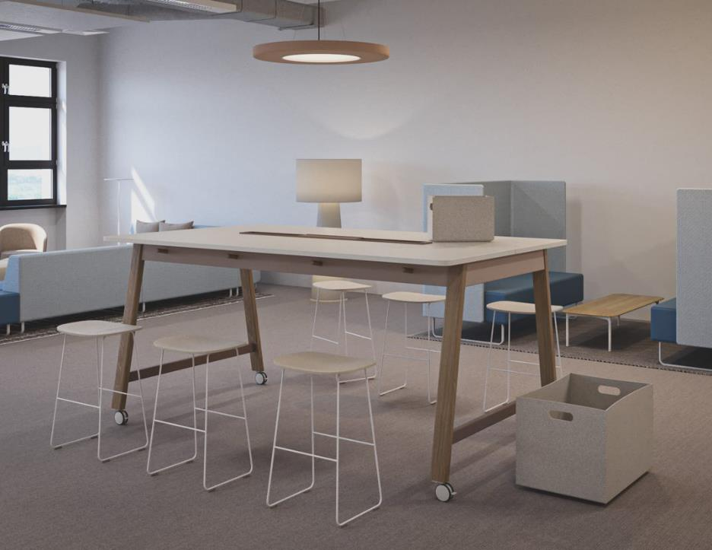
Intuity Park Bench
Park Bench is a communal table setting that provides visual cues of “informality” and “open space”. An informal aesthetic that encourages the opportunity to “stop by, sit down together, and take an
open-minded moment to reflect and share ideas / experiences”.

Slide 4
Refined details
To support spontaneous collaboration, or quick touch-downs Park Bench ensures you can always find somewhere to place your belongings. Park Bench provides special features such as hooks for your handbags where you can hang around 5kg weight. Also, foot rest with a cover can act as a platform to hold your heavy luggage.

Slide 5
Why Park Bench?
Intuity Family
As part of the Intuity family, Park Bench inherits the tradition and design of the Intuity platform. It helps establish new informal settings for individuals and teams to work effectively.
Communal Design
A communal, fresh looking setting with visual cues of informality and open space. Park Bench encourages to create a collaborative environment where individuals and teams huddle, incubate ideas, and socialise.
Multiple Flavour
Depending on the activity, Park Bench offers a playful range of work tools that suit the unique requirements of the individuals. Meanwhile, distinctive leg and table options with variety of colour options provide unique flavours.

Slide 6


Flexibility in the post-CoVid office
Due to its design, Intuity Park Bench offers a unique opportunity to meet while taking into consideration the required social distance for the post-CoVid office world through the depth of its tops.
The Park Bench standing height table on wheels can be easily moved or re-oriented to create new office configurations or support distancing requirements.
In sizes up to 240cm width and 100cm depth, Park Bench allows you to create large tables for collaborative settings where social distancing requirements can be preserved. Helping future proof workplace layouts.

Slide 7
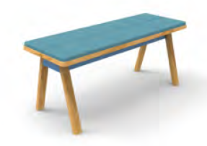
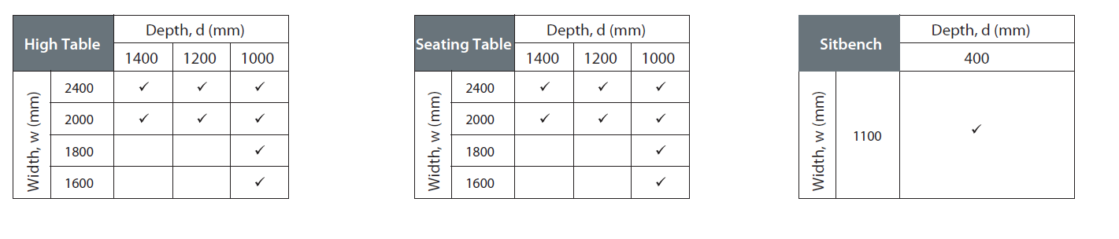
Statement of Line

Slide 8
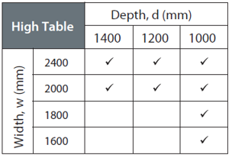
Intuity Park Bench High Table
A pleasant space for easy gathering, spontaneous meetings, and a quick touchdown. It offers features such as hooks, foot rest, wheels and power access for convenience.
Additional options include:
Central Tray
Power section
Bottom Cover
Umbilical cord
Foot rest
Foot rest cover
Wheels

Slide 9
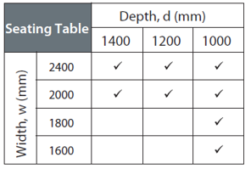
Intuity Park Bench Seating Table
An ideal table for working and idea sharing at a seated height. It is compatible with a stool, which follows the same design language, as well as other seating solutions.
Additional options include:
Central Tray
Power section
Bottom Cover
Umbilical cord

Slide 10
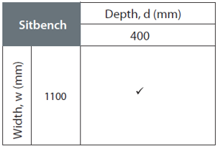
Intuity Park Bench Stool (Sitbench)
A comfortable place to sit and rest. It complements the seating height table, and provides a less formal and more collaborative seating experience in the workplace.
Additional options include:
Cushion top with 3 fabric collections
Melamine top in standard Haworth finishes

Slide 11
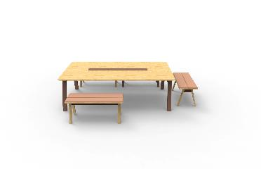
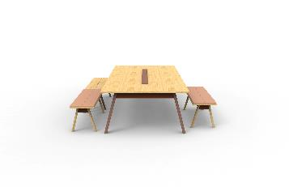
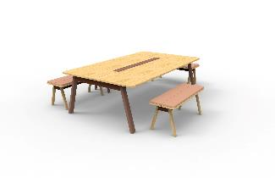
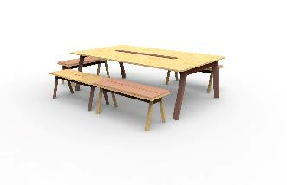
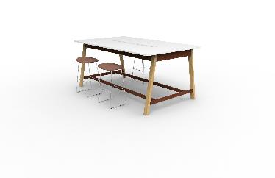
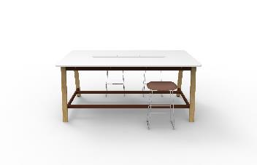
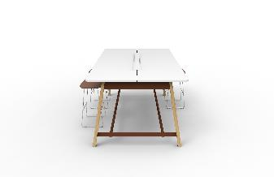
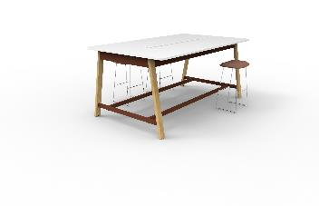
Configurations

Slide 12
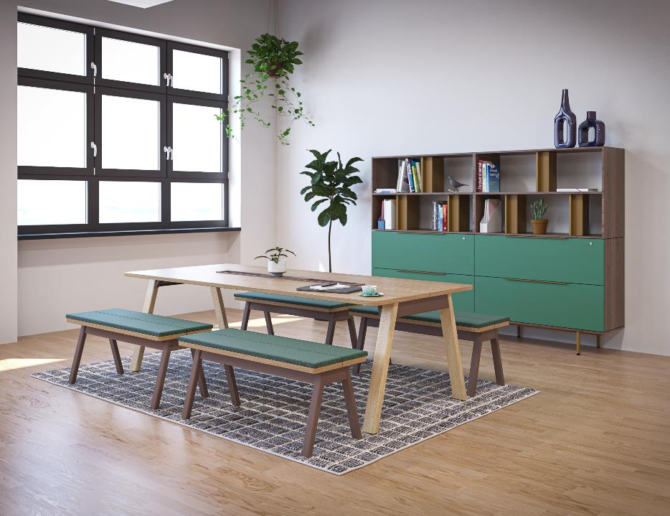
Idea Starters

Slide 13
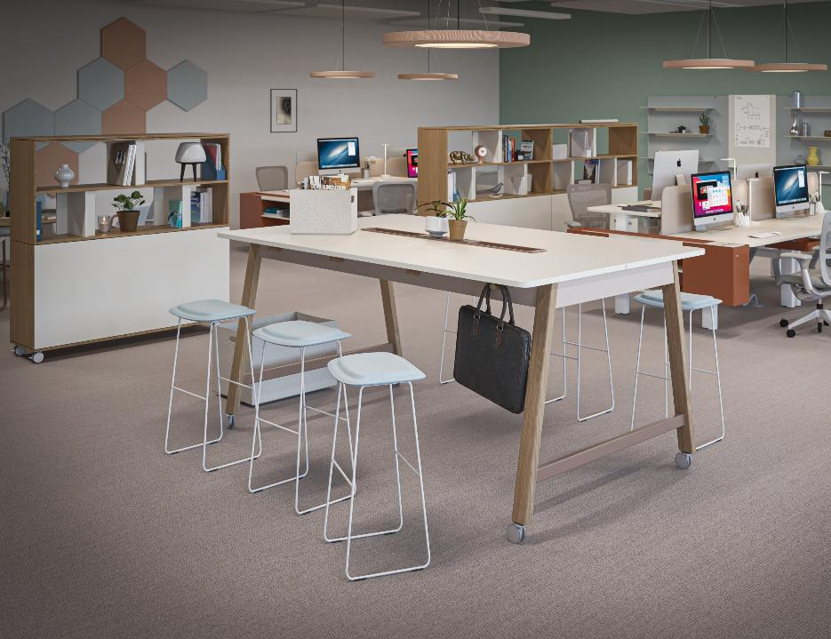
Idea Starters

Slide 14
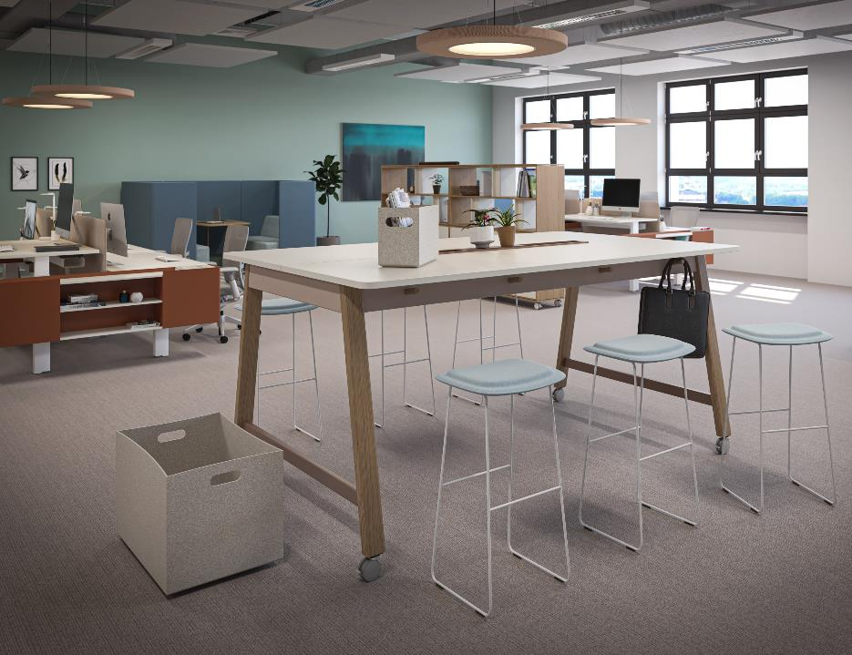
Idea Starters

Slide 15

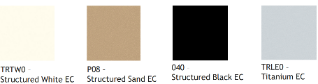
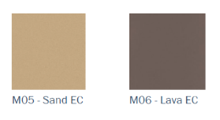

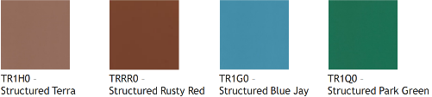
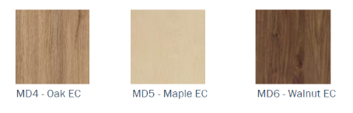

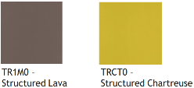
Colours & Materials- Finishes
Melamine
Metal

Slide 16
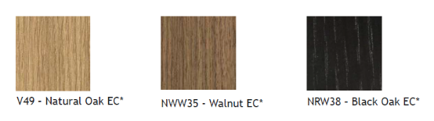
Colours & Materials - Finishes
Veneer

Slide 17
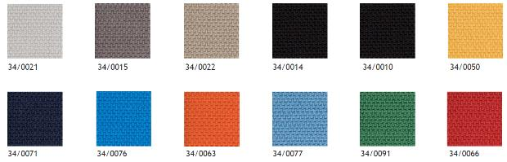


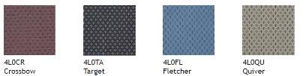

Colours & Materials - Fabrics
Collection 34
Collection C66
Collection Small Arrow

Slide 18




Additional information
Assembly time of Park Bench is on an average 1 hour with 2 installers.
Park Bench has a standard lead time, veneer tops will increase the lead time by 3 weeks
Park Bench tops always have a gap of 5 mm between them as this is part of the design.
Park Bench offers you 3 option for the electrical boxes (in the central tray)
- Electrical box – 2 x Electra + 1 x 2USB
- Electrical box – 1 x Electra + 1 x HDMI + 1 x 2USB
- Electrical box – 1 x Electra + 1 x display port + 1 USB-C

