Slide 2
Notes:
What is Immerse?
Designed in partnership with Patricia Urquiola, Immerse is a collection of tables in a variety of shapes, sizes, and levels that create visual comfort to make a space more inviting and support different activities.

Slide 4
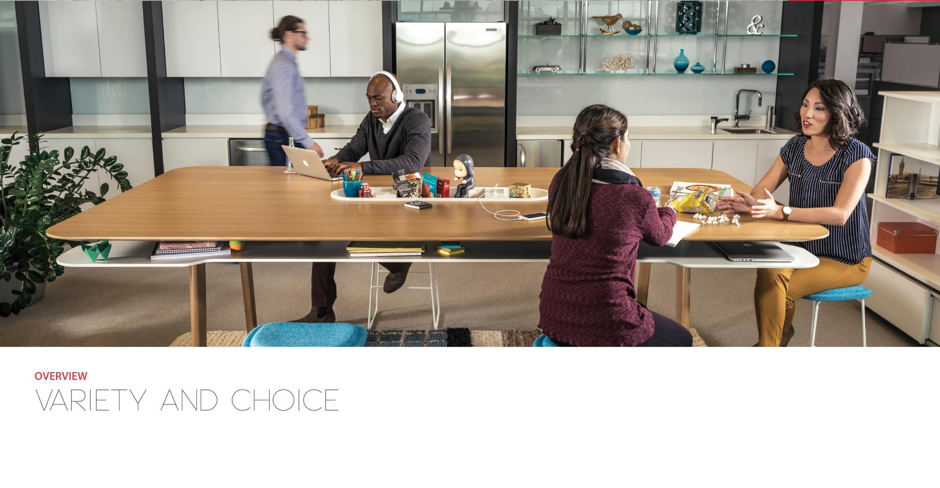
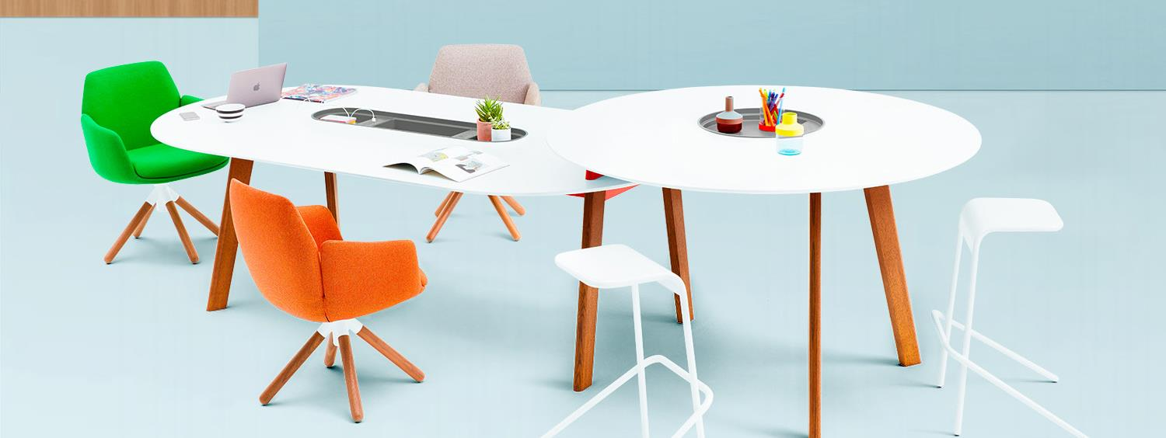
Notes:
Why Immerse?
People desire variety and choice to perform their best.
As space design requires more flexibility, organizations recognize the growing need for adaptable spaces that support the diverse and dynamic ways people work.
People seek meaningful spaces that support purposeful work.
Comfortable spaces that feel like home entice people to come into the office, keeping talented workers engaged.
Work environments that holistically affect physical, cognitive, and emotional needs foster well-being in people.
Positive emotions are consistently associated with better performance. A workplace that truly supports the well-being of its occupants must go beyond protecting physical health by providing physical, cognitive, and emotional comfort.

Slide 5
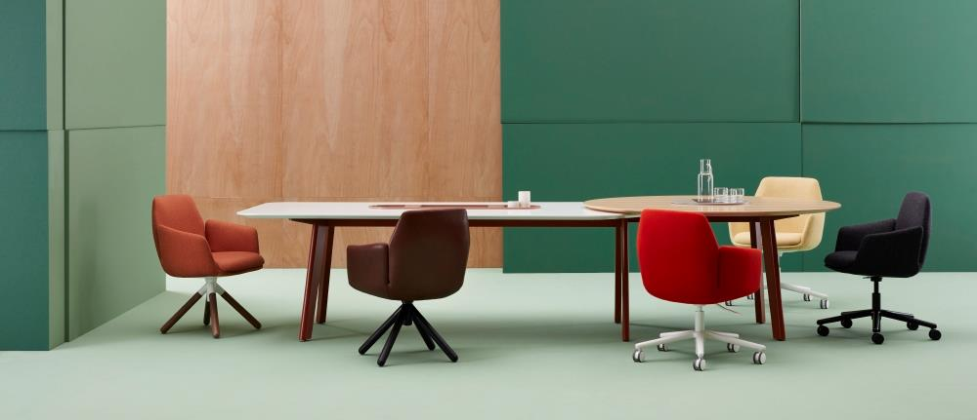
Notes:
Immerse helps you furnish a variety of environments that support people’s collaborative work processes for creative performance and innovation.
As workspaces continue to change in support of collaboration, Immerse creates an adaptable area where communal instincts can spontaneously come to life.
Each Immerse worksurface creates a social hub of positive energy that invites serendipity, variety and choice in the workplace.

Slide 6
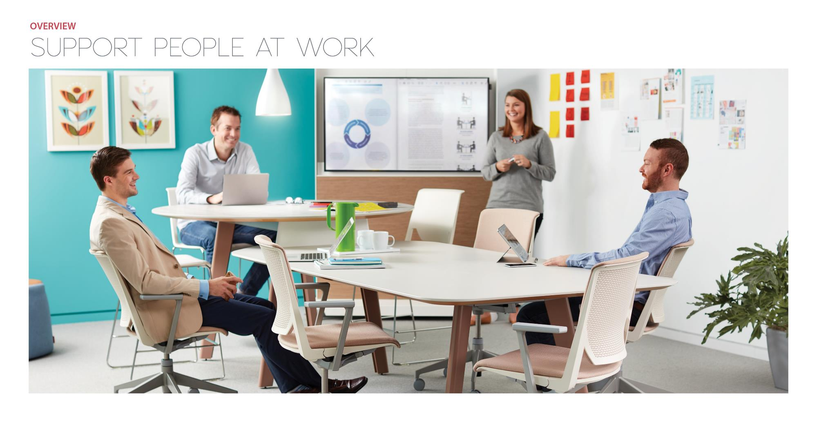
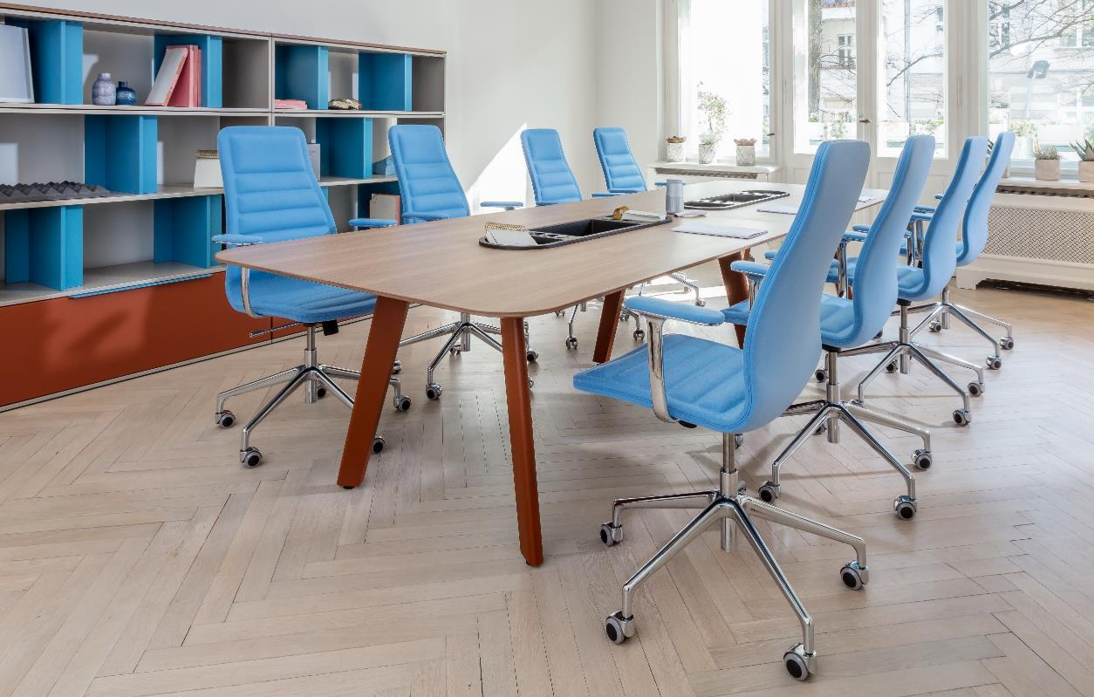
Notes:
Immerse creates meaningful, purposeful spaces that help people feel comfortable at work.
Immerse helps create a balance between functional and sensory spaces that offer a welcome sense of warmth and comfort in the workplace.
With Immerse, teams can come together, connect, and collectively engage in an intimate workplace setting.
Immerse allows interpersonal interactions to organically change by the moment, adding a unique personality to conference rooms, project spaces, studios, and dining areas.

Slide 7
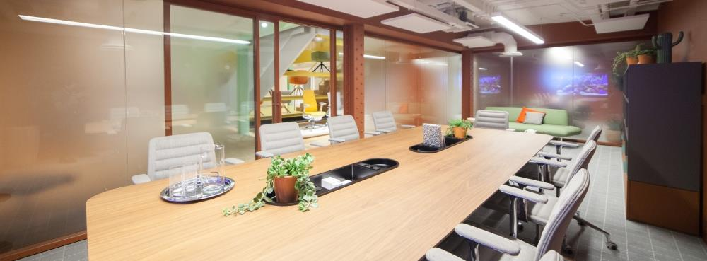
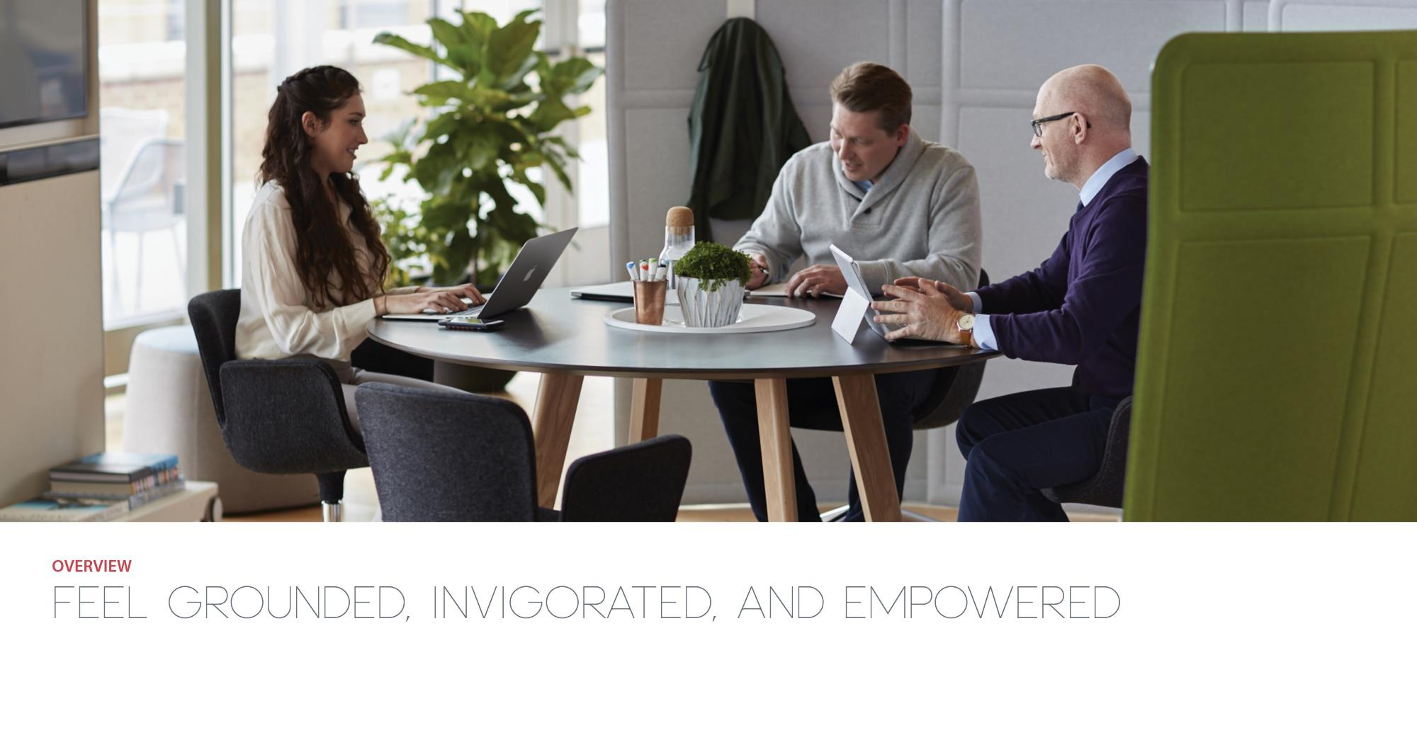
Notes:
Immerse creates meaningful, purposeful spaces that help people feel comfortable at work.
Immerse helps create a balance between functional and sensory spaces that offer a welcome sense of warmth and comfort in the workplace.
With Immerse, teams can come together, connect, and collectively engage in an intimate workplace setting.
Immerse allows interpersonal interactions to organically change by the moment, adding a unique personality to conference rooms, project spaces, studios, and dining areas.

Slide 8
Notes:
Statement of Line
Immerse conference table worksurfaces are available in a variety of standard finish options, including veneer.
Leg base options include powder-coated steel, as well as select wood finishes.

Slide 9
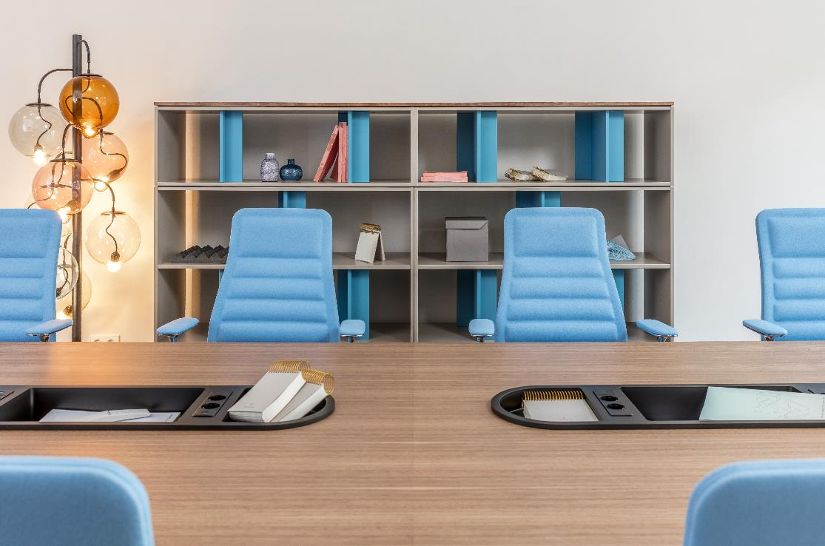
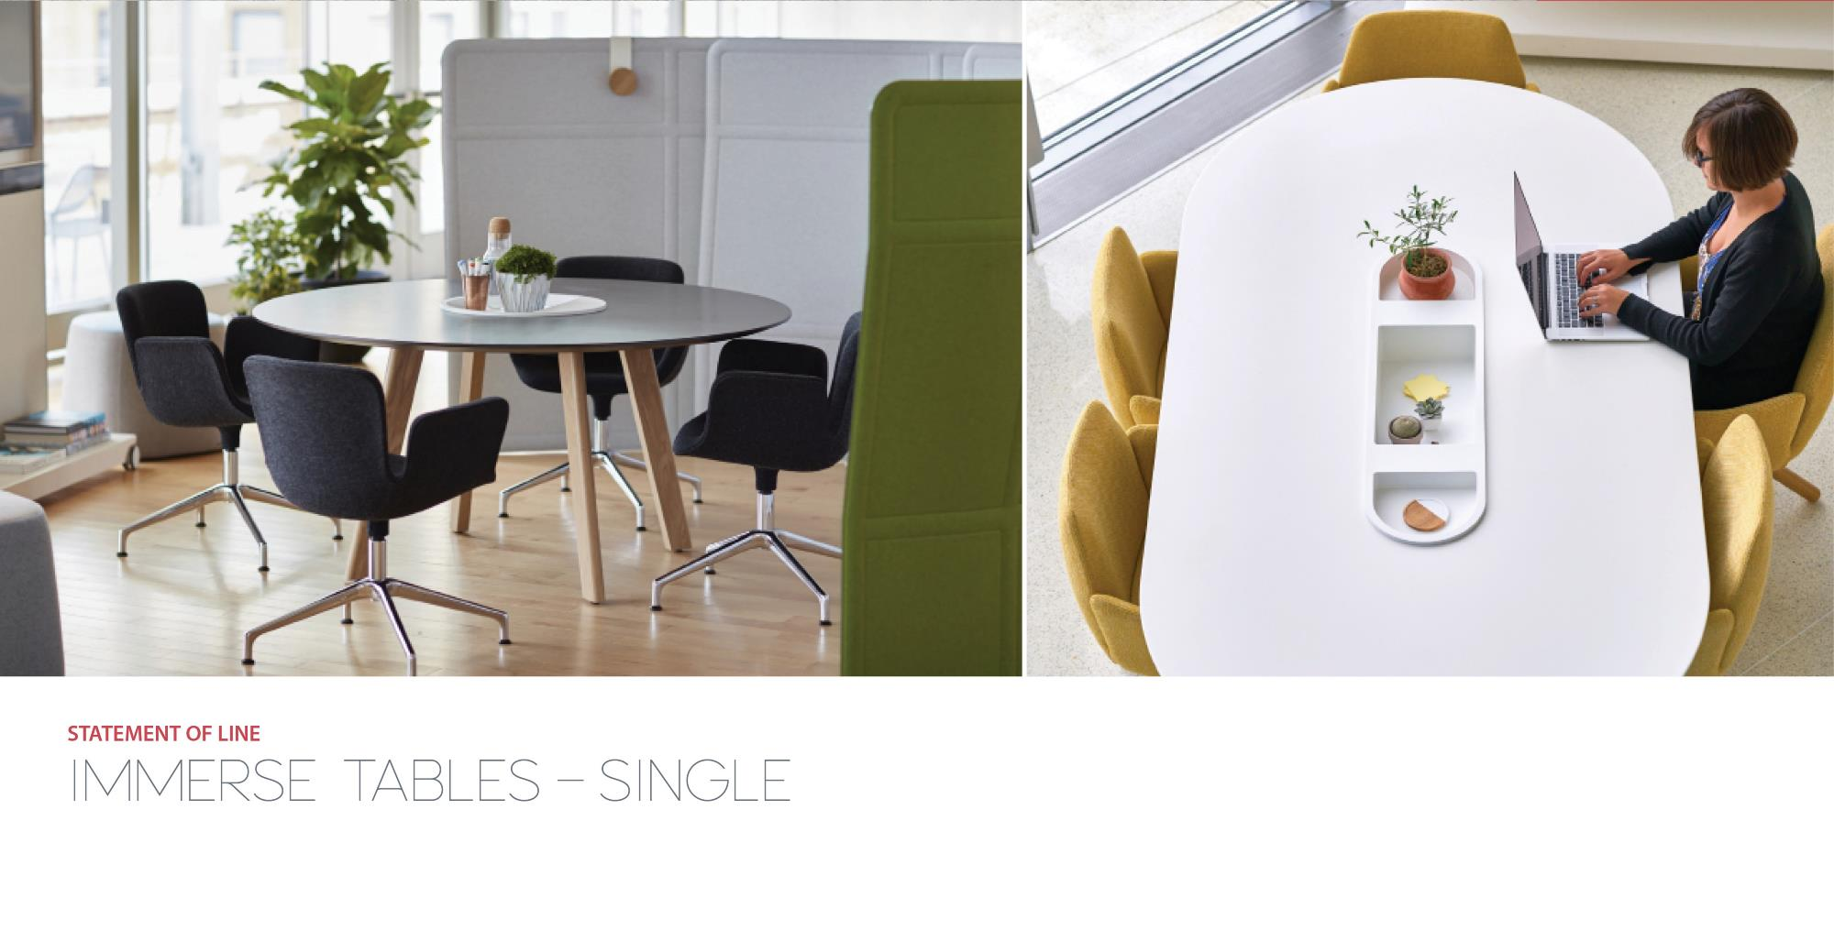
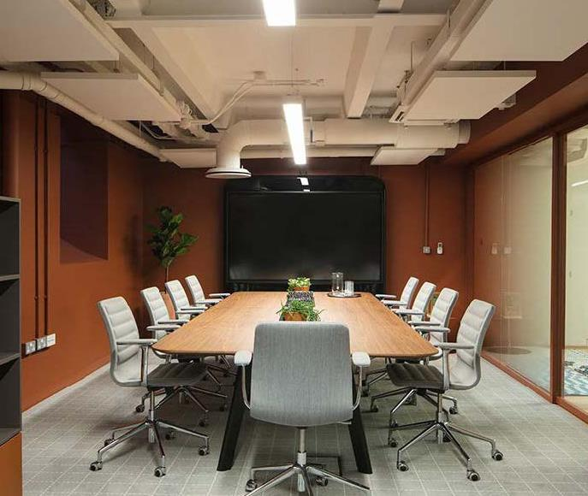
Notes:
Single
Single table in round, square, rectangular and racetrack shape.

Slide 10
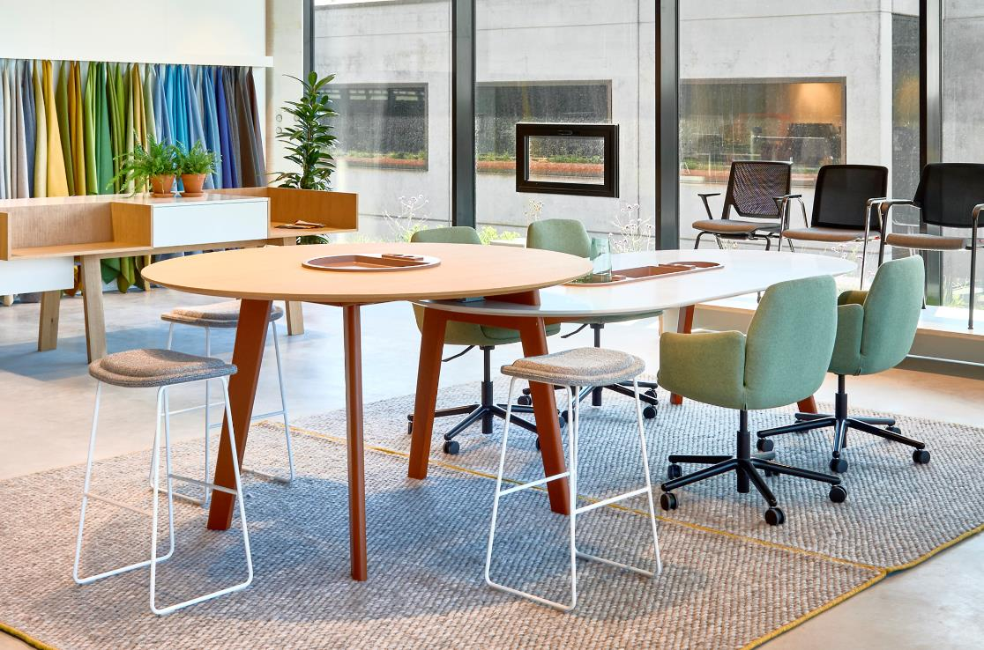
Notes:
Shift
Creates two adjacent sitting and standing worksurfaces, each at varied heights, to support choice and a natural inclination to work together.

Slide 11
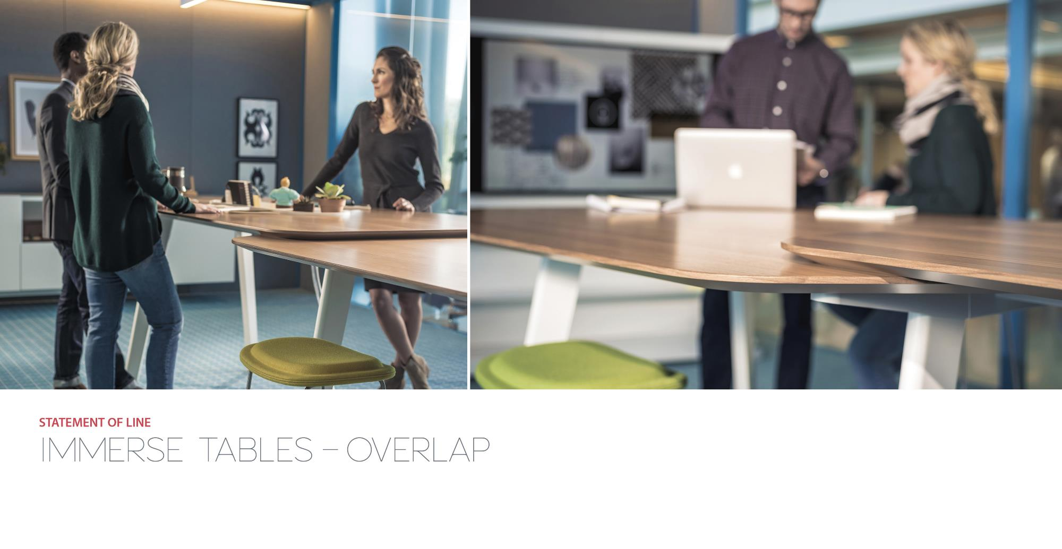
Notes:
Overlap
Made for movement, sitting, or standing, with a unique dual level worksurface that supports well-being and your choice to sit, stand, and work actively.

Slide 12
Notes:
Planter
Provides central open storage and power outlets, letting teams share, store and power up for thoughtful engagement.

Slide 13
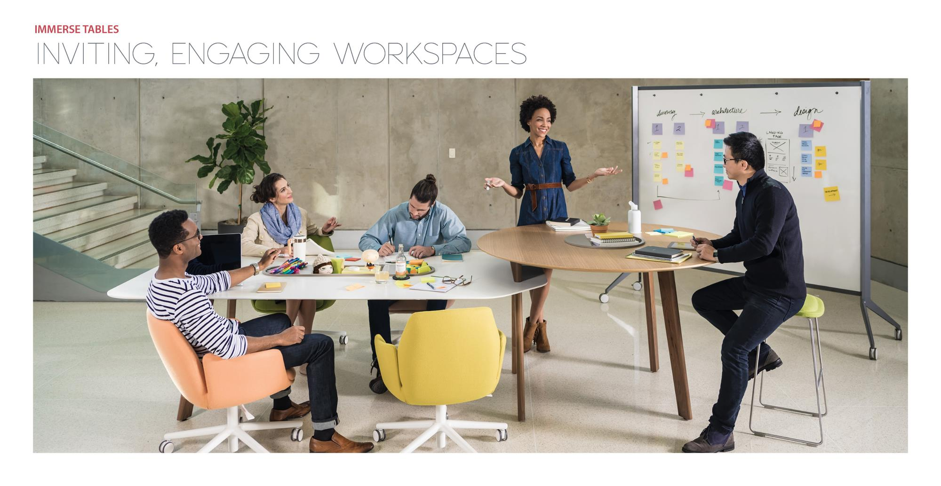
Notes:
Why Immerse?
Immerse tables create a landscape of varied surfaces, providing a hub of spaces that support collaboration and diverse workstyles.
The welcoming feel of Immerse draws people in for the spontaneous interaction, collaboration, and communication experiences they crave at work.
Immerse warms up the work environment, inspiring the engagement and creativity that leads to innovation.

Slide 14
Notes:
Why Immerse?
Immerse tables create a landscape of varied surfaces, providing a hub of spaces that support collaboration and diverse workstyles.
The welcoming feel of Immerse draws people in for the spontaneous interaction, collaboration, and communication experiences they crave at work.
Immerse warms up the work environment, inspiring the engagement and creativity that leads to innovation.

Slide 15
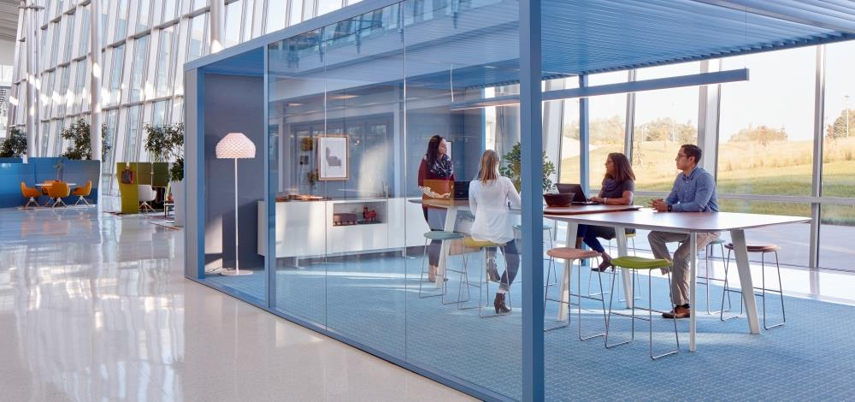
THANK YOU

