Slide 1
A_Wood
Overview
Sales Presentation
March 2020

Slide 2
Content
Value proposition
Statement of line
Key features
Colors and materials

Slide 3
Value Proposition
Why A_Wood?
The working environment is changing, and the furniture must now compose an agile, friendly and comfortable landscape.
Warm and natural
A_Wood is part of the trend and transforms workspaces into an inspiring living space.

Slide 4
Statement of Line
Rectangular & squared single desks
Benches
Meeting

Slide 5
Technical Details tops
High density chipboard: 700kg/m3
Its rigidity allows to not use a structure.
Collaborative work – desk and benches
Laminated: thickness 36 mm
Melamine : thickness 35 mm
Meeting – meeting rooms Melamine : thickness 25 mm

Slide 6
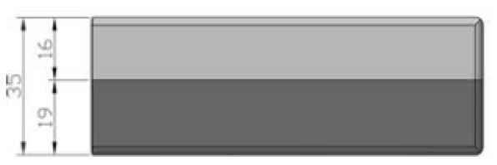
Technical Details tops
Twin-edge
Slims the edge of the top and radically changes the line of the desk.
Patented process
The lower edge is harmonized with the leg finish.
The upper edge is the same finish as the top.

Slide 7
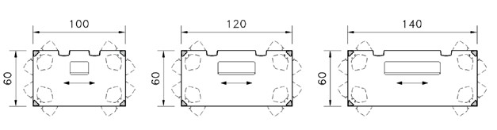
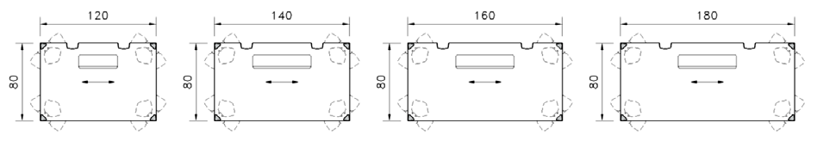
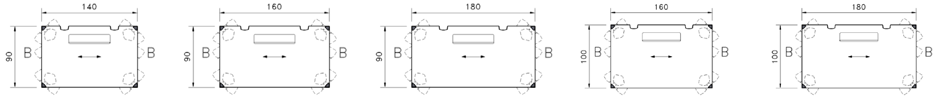
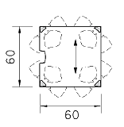
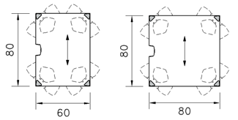
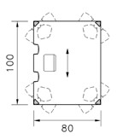
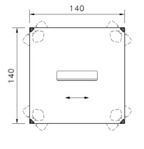
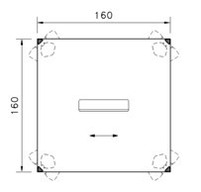
Top Shapes
Rectangular and squared tops

Slide 8
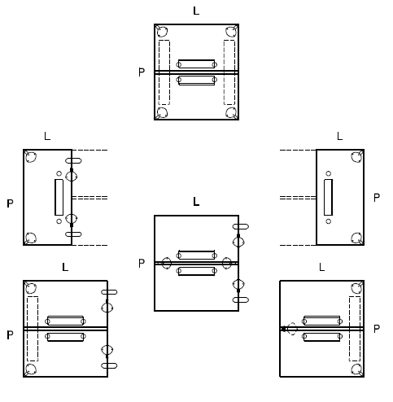
Top Shapes
Benches

Slide 9
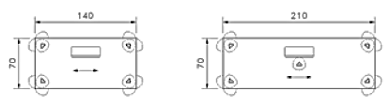
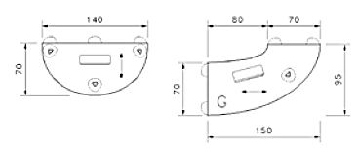
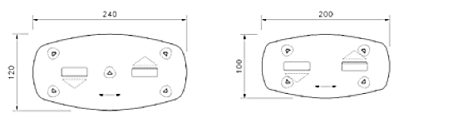
Top Shapes
Meeting

Slide 10
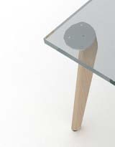
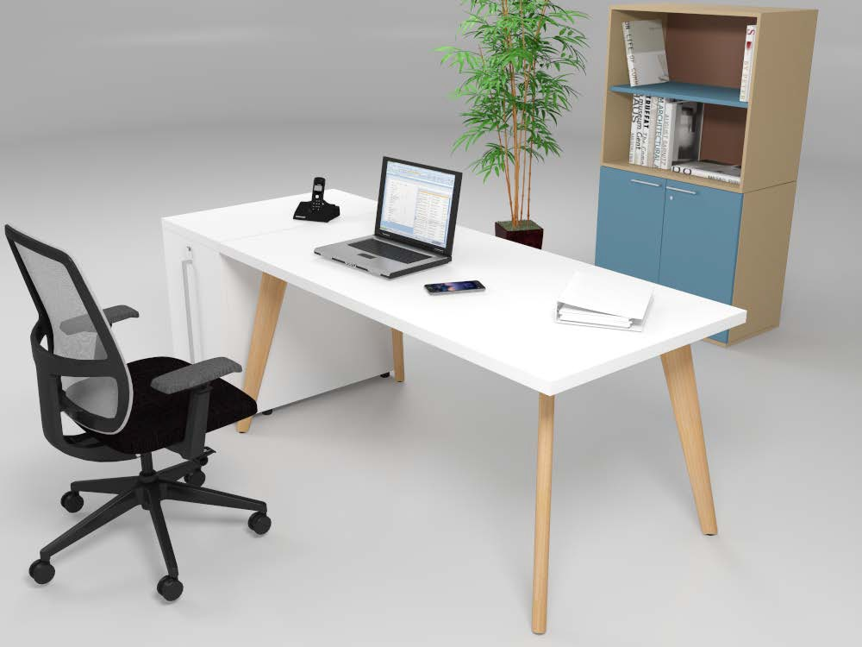
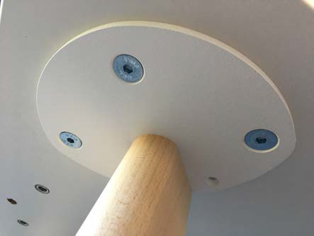
Technical Details legs
Natural Massive Beech
Fixed Leg
73 cm
Fixing with M10 countersunk screws, Assembly with tool.

Slide 11
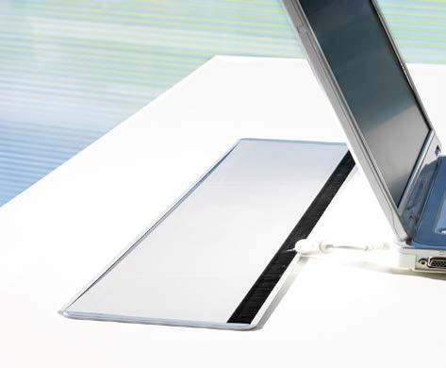
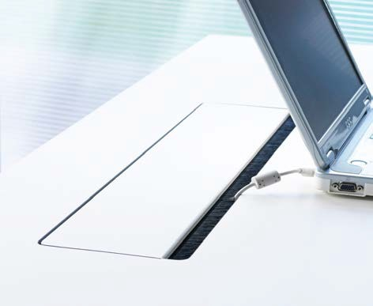
Cable Management
Aluminium cable outlet
equipped with brushes
shock absorber
Thickness 2 mm
W. 24 x D. 12 for tops until L. 100 cm
W. 36 x D. 12 for tops from L. 100 cm
Cable outlet to match melamine finish of top
equipped with brushes
shock absorber
Thickness 19 mm
W. 60 x D. 14 cm for tops L. 140 to 200 cm
W. 40 x D. 14 cm for tops L. 120 cm
W. 20 x D. 14 cm for tops L. 100 cm

Slide 12
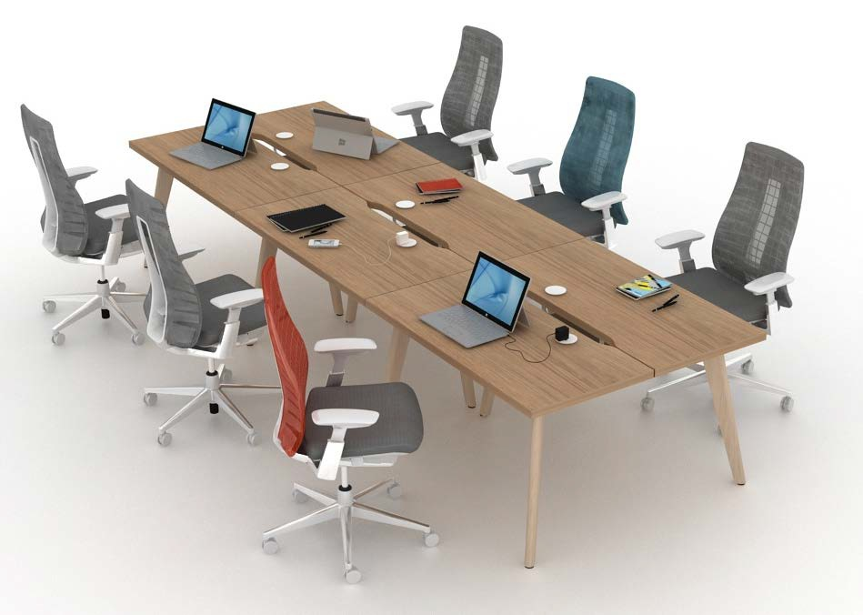
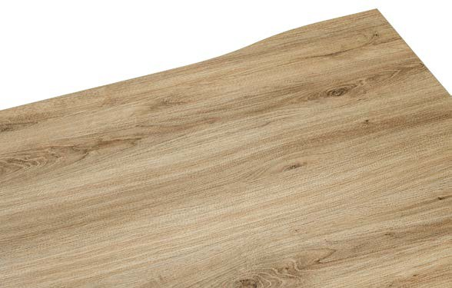
Cable Management
Scallop - Cut out of 35mm deep on the top

Slide 13
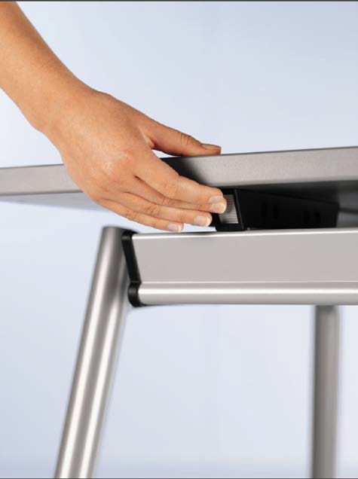
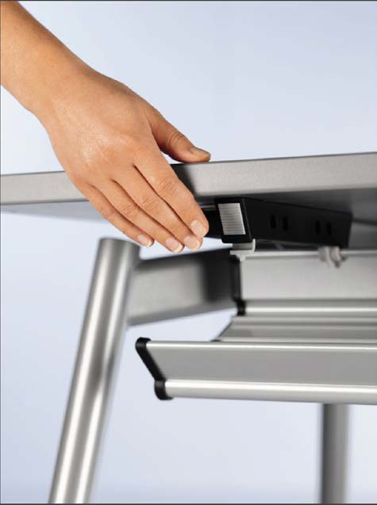
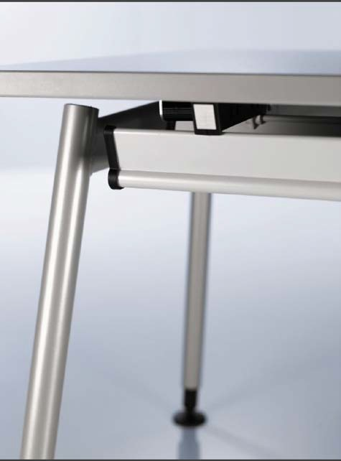
Cable Management
Hexagon – Cable Tray

Slide 14
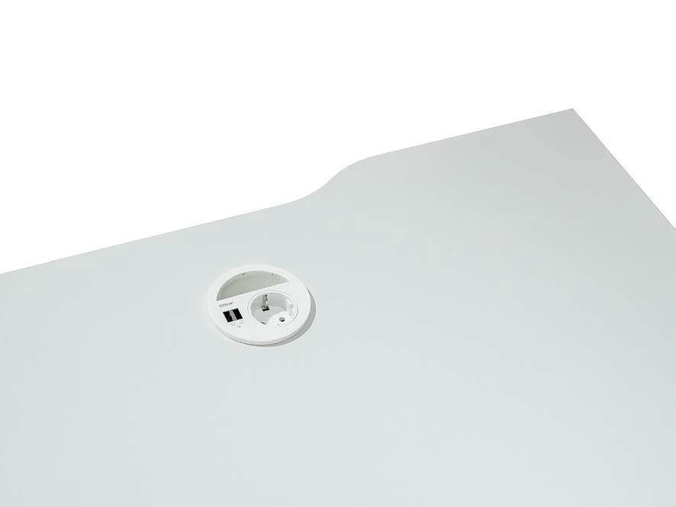
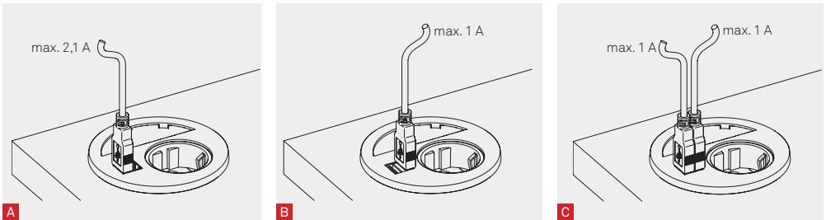
Electrification
Circle 80
Available on the left or on the right or on both sides
Composition : 1 plug
2 USB chargers 2,1A max (1A max on each USB, if both are used on the same time)
1 hole power cable 1,5m

Slide 15
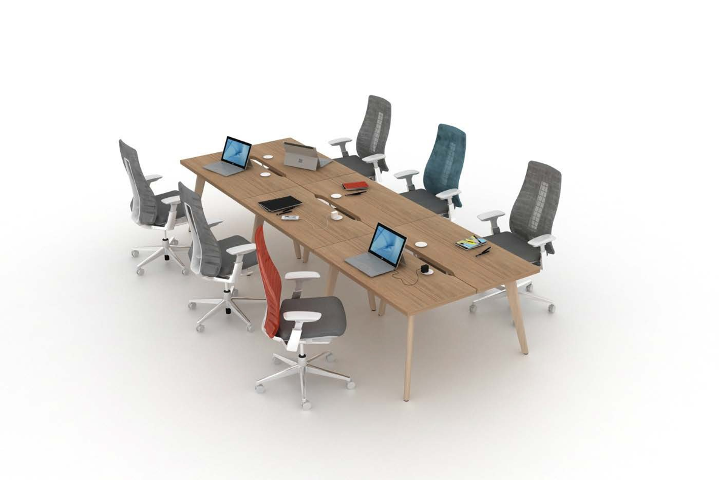
Bench configuration
Start element
End element
Middle element
Start extension or start module
+
+
End extension or end module

Slide 16
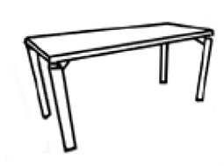
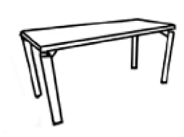
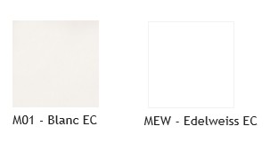
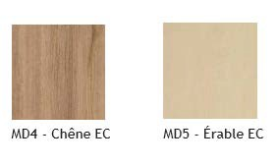
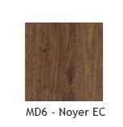

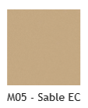
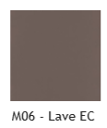
Material & Finishes
Melamine tops 35mm
Laminate tops 36mm
M01 – White EC
L01 – White EC
LEW – Edelweiss EC (1)
LD4 – Oak EC
LD5 - Maple EC
MEW – Edelweiss EC (1)
MD4 – Oak EC
MD6 – Walnut EC (1) (2)
L06 – Lava EC
L02 – Light grey EC
L05 – Sand EC
LD6 – Walnut EC* (1)
The MEW and MD6 finishes do not comply with the technical luminance requirements of the NF OEC standard applicable to the desks tops (15 ≤ Y ≤ 75)
Finish without overlay, doesn't comply to NF OEC and NF Environment
* LD6 : restricted SOL. Worktops with a depth bigger than 130cm are not available in LD6.
(1) The LEW and LD6 finishes do not comply with the technical luminance requirements of the NF OEC standard applicable to the desks tops (15 ≤ Y ≤ 75)

Slide 17
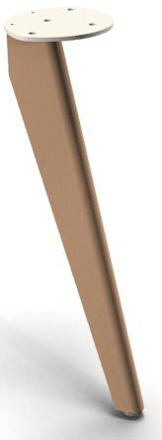
Material & Finishes
Leg - Natural massive beech

Slide 18
Thank You
March 2020

